Slide 1
Countdown to Christmas!
A selection of festive language-based activities

Slide 2


Countdown to the festive break
With the countdown to the Christmas break almost upon us, we’ve created a festive pack of activities for you and your students to enjoy between now and the New Year.
Whether completed in class or as part of homework, the following pages include a range of resources and ideas that you can adapt as you wish.
Have a lovely last few weeks of term.

Slide 3
Celebrations around the world
While December may mean the arrival of Christmas for many, it also includes other major cultural and religious holidays around the world too.
Task your students to look at one, or a selection of these celebrations, exploring their meaning, cultural significance, how the day/period of time is celebrated and the languages involved too!
December celebrations
1. Christmas
2. St. Nicholas Day
3. Bodhi Day / Rohatsu
4. Feast Day of Our Lady Guadalupe
5. Hanukkah
6. Yule
7. Boxing Day
8. Kwanzaa

Slide 4
Festive cards
It’s time for charades!
Bring some art to your language classroom and ask your students to design a card for a celebration of their choice.
Together with creating some fantastic designs, encourage your students to write a message in their chosen language. To extend the task, why note create a festive poem or song to perform to the class?
Want to bring some festive cheer to your classroom? In your chosen language, encourage your students to play charades. To help get you going, we’ve created a table of festive words, items, movies and songs for you to use. Download now

Slide 5
Festive word search
U | E | L | F | E | S | É | P | F | M | S | P | A
C | J | O | U | B | D | X | U | A | E | D | A | C
L | K | L | A | G | L | Y | G | S | X | P | A | I
O | B | U | D | Q | E | B | C | I | É | M | L | F
C | Y | M | N | N | O | G | M | D | T | Q | I | C
H | L | I | S | E | W | B | I | N | O | U | P | E
E | K | É | Y | I | F | U | B | S | I | M | É | D
É | C | R | L | G | Y | N | O | H | L | I | Z | J
X | H | E | R | E | R | B | U | I | E | D | Y | V
U | S | S | T | J | V | É | G | A | O | H | T | A
K | P | A | N | T | O | M | I | M | E | S | M | N
E | N | N | E | R | L | B | E | K | Y | B | W | É
Can you find 10 French words for:
Candle
Snow
Gifts
Bell
Pantomime
Elf
Reindeer
Lights
Star
Sledging

Slide 6
Festive word search
U | E | L | F | E | S | É | P | F | M | S | P | A
C | J | O | U | B | D | X | U | A | E | D | A | C
L | K | L | A | G | L | Y | G | S | X | P | A | I
O | B | U | D | Q | E | B | C | I | É | M | L | F
C | Y | M | N | N | O | G | M | D | T | Q | I | C
H | L | I | S | E | W | B | I | N | O | U | P | E
E | K | É | Y | I | F | U | B | S | I | M | É | D
É | C | R | L | G | Y | N | O | H | L | I | Z | J
X | H | E | R | E | R | B | U | I | E | D | Y | V
U | S | S | T | J | V | É | G | A | O | H | T | A
K | P | A | N | T | O | M | I | M | E | S | M | N
E | N | N | E | R | L | B | E | K | Y | B | W | É
French:
Candle (Bougie)
Snow (Neige)
Gifts (Cadeaux)
Bell (Cloche)
Pantomime (Pantomime)
Elf (Elfe)
Reindeer (Renne)
Lights (Lumières)
Star (Étoile)
Sledging (Luge)

Slide 7
Festive word search
L | E | B | K | U | C | H | E | N | C | P | Z
H | A | R | K | S | M | E | P | K | E | A | N
Z | I | G | L | G | R | O | D | E | L | N | J
H | E | D | L | U | X | K | E | R | R | T | B
P | I | F | E | O | M | V | J | Z | A | O | U
K | S | C | L | S | C | M | W | E | B | M | E
S | L | J | F | D | E | K | S | Q | M | I | X
Z | A | H | U | N | W | Y | E | P | T | M | O
E | U | H | E | E | N | H | C | S | V | E | T
H | F | L | B | D | I | S | V | H | P | L | S
B | E | L | E | U | C | H | T | U | N | G | J
K | N | F | M | D | Q | U | R | E | N | B | L
Can you find 10 German words for:
Candle
Snow
Gingerbread
Bell
Pantomime
Reindeer
Lights
Ice skating
Sledging
Elf

Slide 8
Festive word search
L | E | B | K | U | C | H | E | N | C | P | Z
H | A | R | K | S | M | E | P | K | E | A | N
Z | I | G | L | G | R | O | D | E | L | N | J
H | E | D | L | U | X | K | E | R | R | T | B
P | I | F | E | O | M | V | J | Z | A | O | U
K | S | C | L | S | C | M | W | E | B | M | E
S | L | J | F | D | E | K | S | Q | M | I | X
Z | A | H | U | N | W | Y | E | P | T | M | O
E | U | H | E | E | N | H | C | S | V | E | T
H | F | L | B | D | I | S | V | H | P | L | S
B | E | L | E | U | C | H | T | U | N | G | J
K | N | F | M | D | Q | U | R | E | N | B | L
German
Candle (Kerze)
Snow (Schnee)
Gingerbread (Lebkuchen)
Bell (Glocke)
Pantomime (Pantomime)
Reindeer (Ren)
Lights (Beleuchtung)
Ice skating (Eislaufen)
Sledging (Rodeln)
Elf (Elf)

Slide 9
Festive word search
T | K | D | W | S | E | V | E | I | N | L | G
A | C | O | V | N | P | R | D | J | L | E | E
M | A | E | K | E | I | F | E | T | X | N | S
J | M | U | F | J | L | P | D | R | I | A | T
G | P | F | L | O | S | A | V | I | O | Y | R
K | A | U | U | H | R | M | C | N | T | D | E
L | N | E | C | X | E | F | S | R | V | T | L
P | A | S | E | A | G | I | T | O | D | U | L
P | N | E | S | M | A | J | V | E | S | T | A
N | T | F | P | A | L | X | P | N | T | W | Z
V | P | A | N | T | O | M | I | M | A | G | T
R | K | B | E | I | S | D | U | E | N | D | E
Can you find 10 Spanish words for:
Candle
Snow
Gingerbread
Bell
Pantomime
Reindeer
Lights
Ice skating
Sledging
Elf

Slide 10
Festive word search
T | K | D | W | S | E | V | E | I | N | L | G
A | C | O | V | N | P | R | D | J | L | E | E
M | A | E | K | E | I | F | E | T | X | N | S
J | M | U | F | J | L | P | D | R | I | A | T
G | P | F | L | O | S | A | V | I | O | Y | R
K | A | U | U | H | R | M | C | N | T | D | E
L | N | E | C | X | E | F | S | E | V | T | L
P | A | S | E | A | G | I | T | O | D | U | L
P | N | E | S | M | A | J | V | E | S | T | A
N | T | F | P | A | L | X | P | N | T | W | Z
V | P | A | N | T | O | M | I | M | A | G | T
R | K | B | E | I | S | D | U | E | N | D | E
Spanish
Candle (Vela)
Snow (Nieve)
Gifts (Regalos)
Bell (Campana)
Pantomime (Pantomima)
Reindeer (Reno)
Lights (Luces)
Star (Estrella)
Sledging (Trineo)
Elf (Duende)

Slide 11
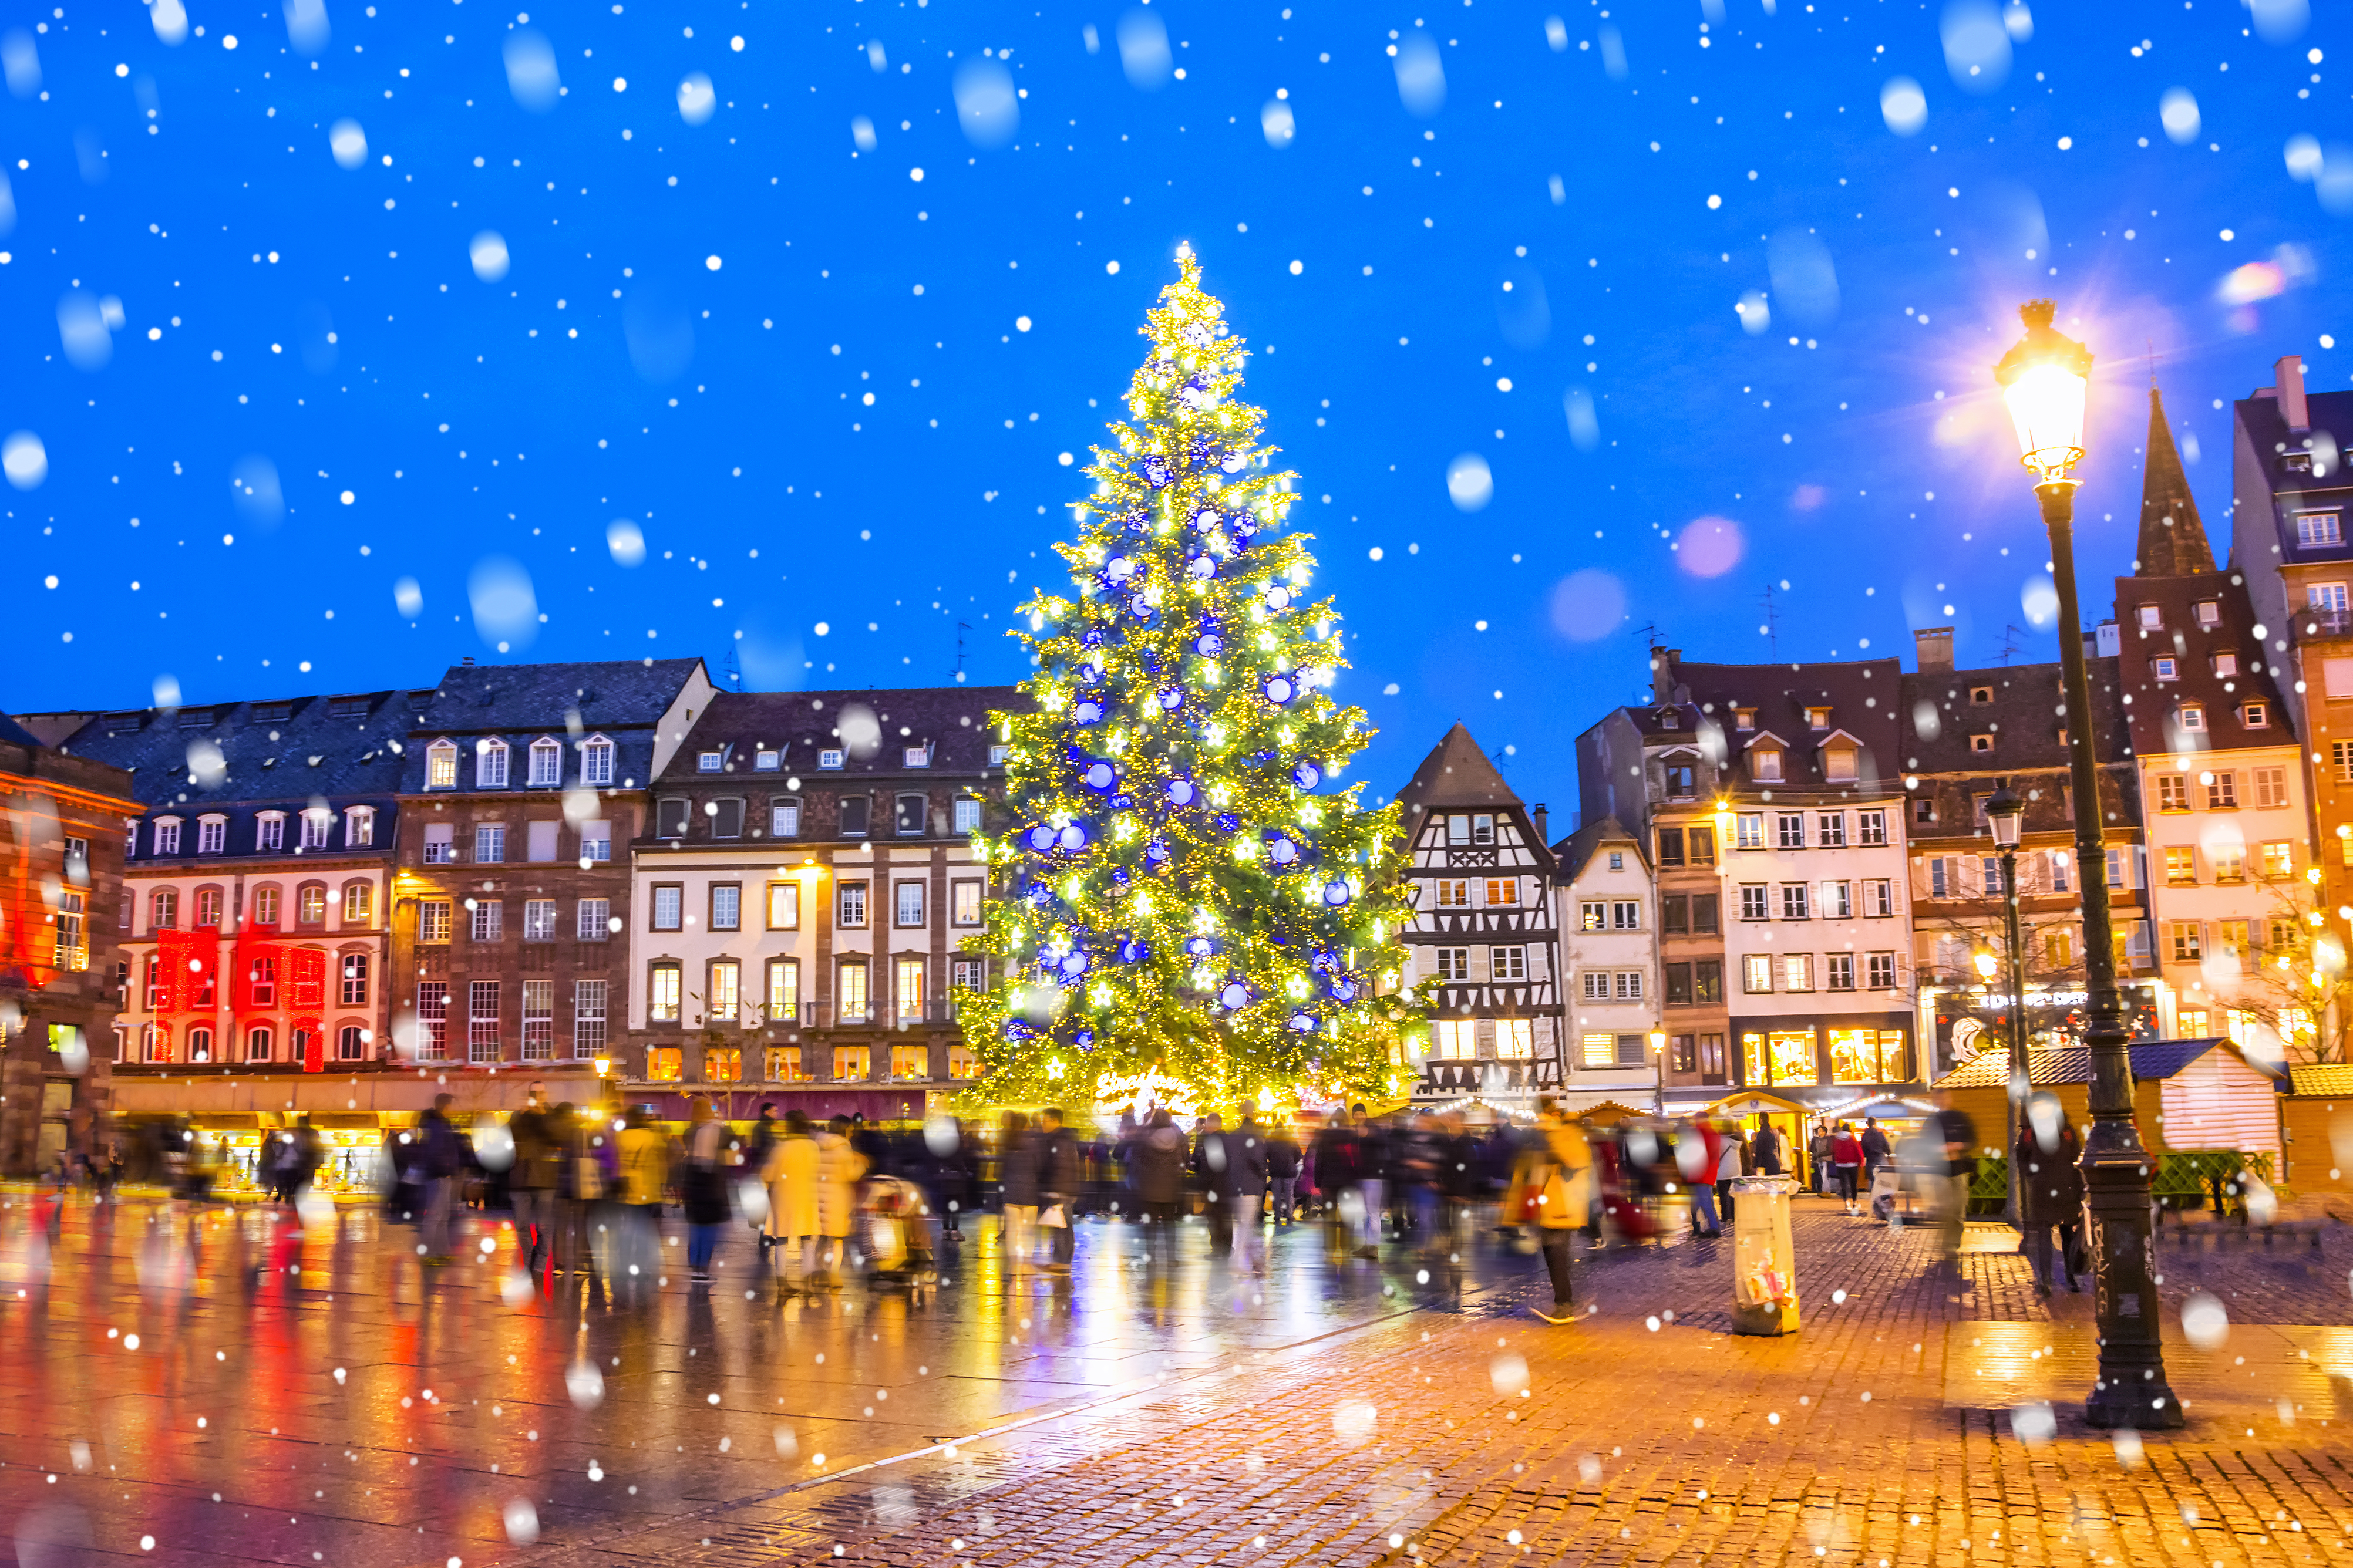
Eye spy
Using the following pictures or some of your own, ask children to identify five-seven elements in their chosen language. To extend this work, students can write a descriptive paragraph in their chosen language about the scene.

Slide 12
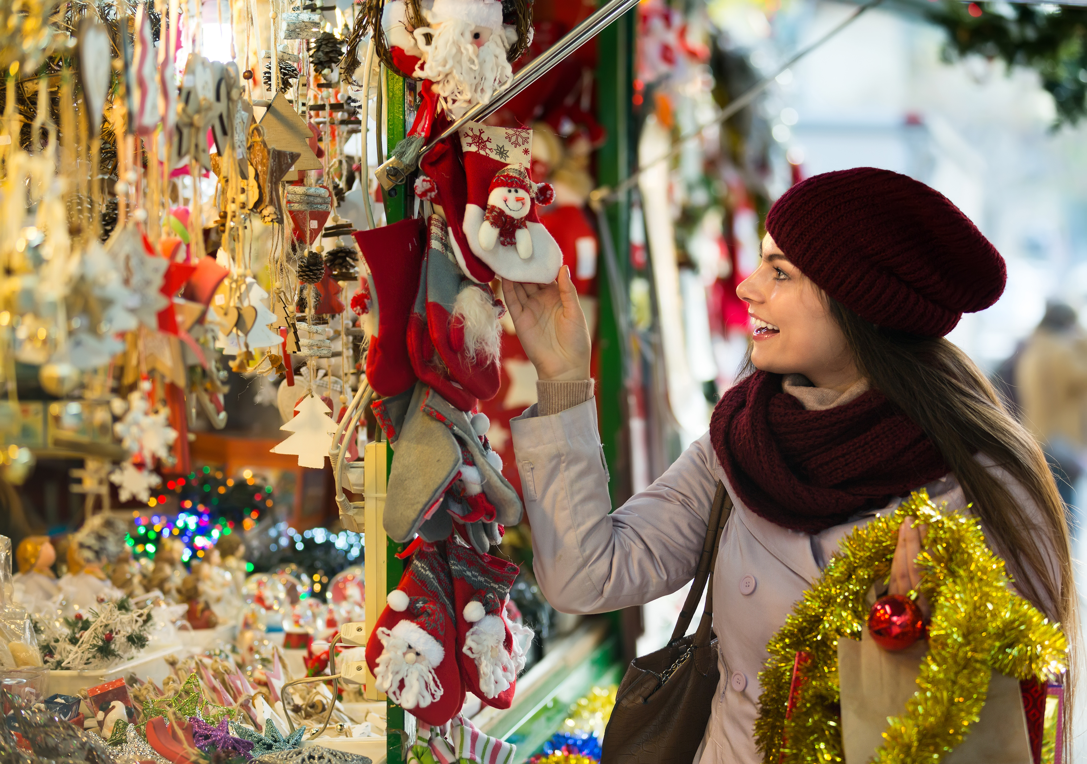
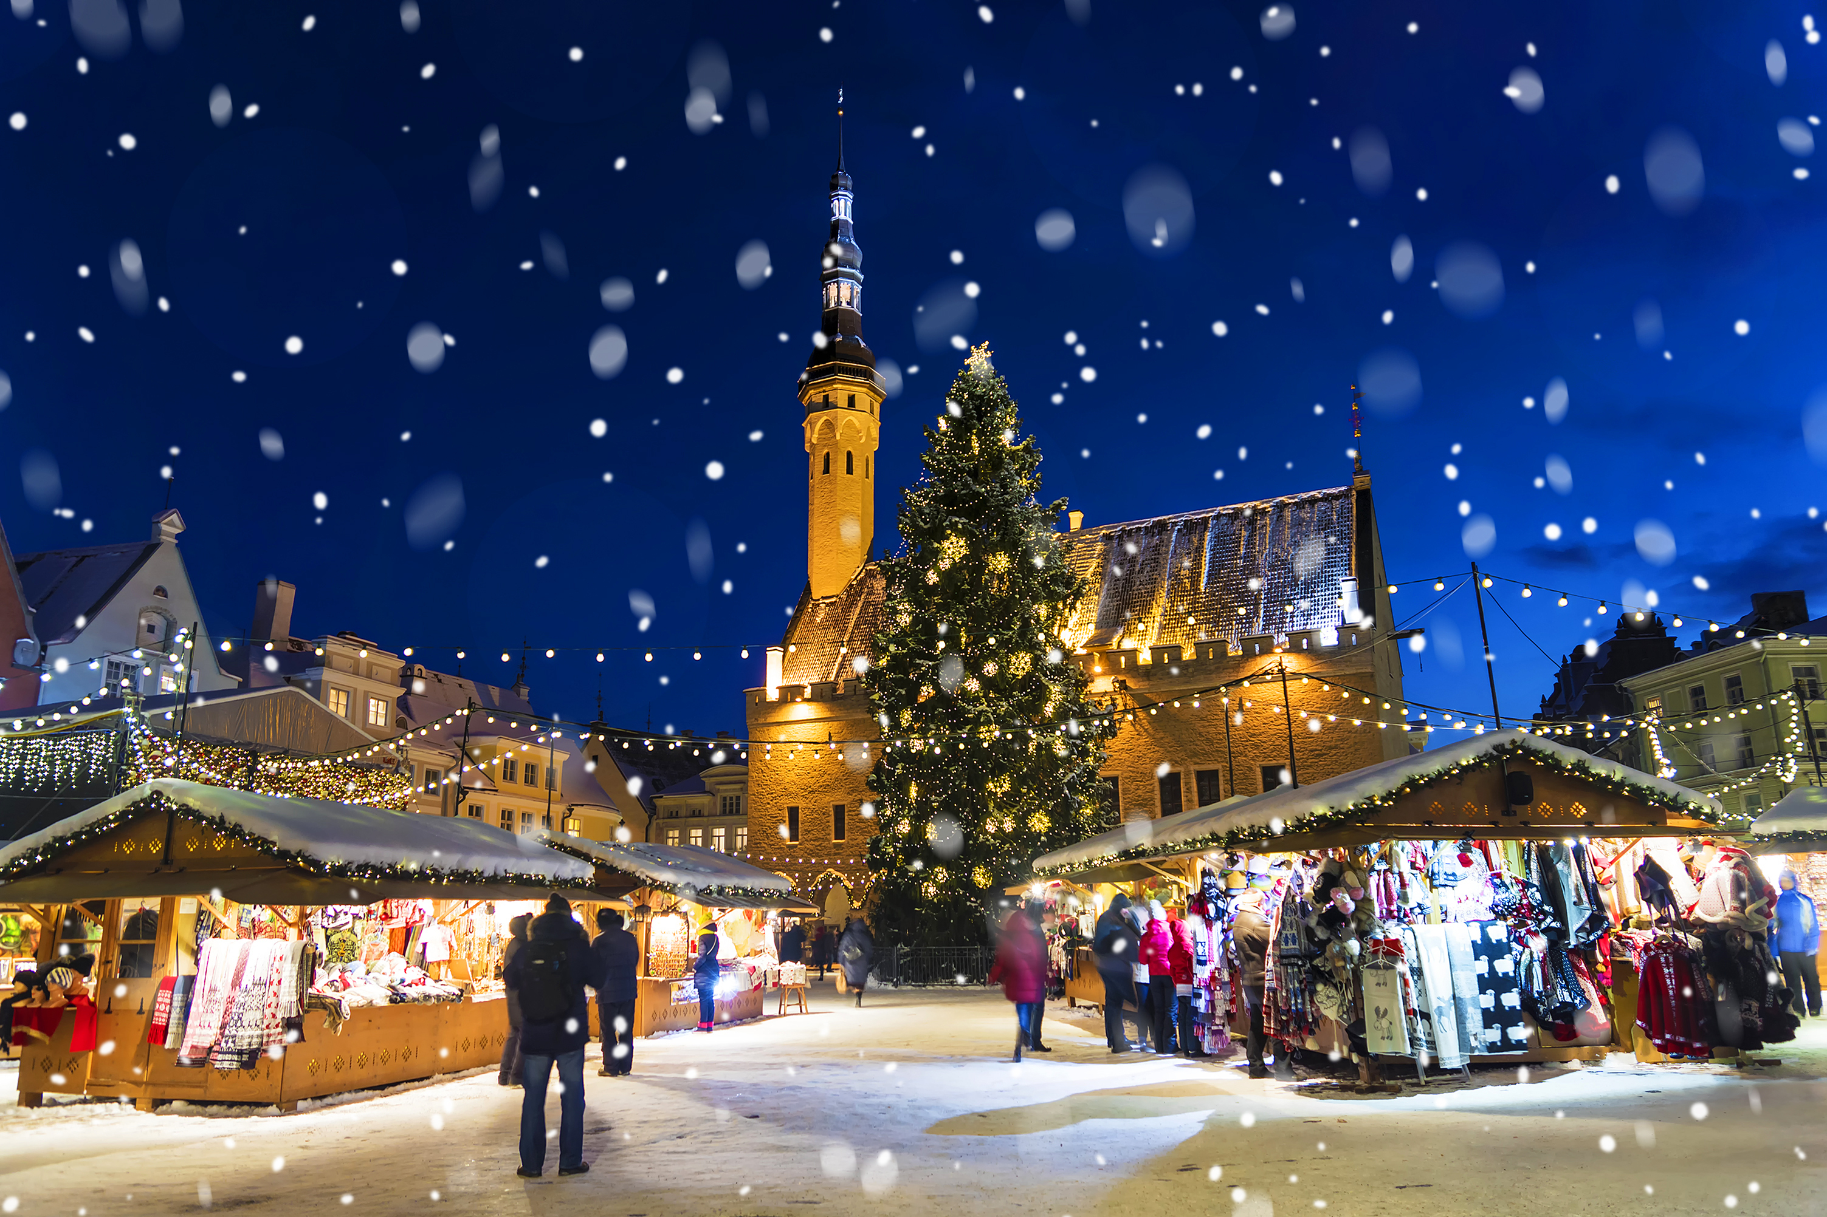
Eye spy
What can you see in these pictures?

Slide 13
English, French, Czech… which is it?
Match the word ‘celebrate’ to the correct translation
Czeck
Urdu
Festive translations | Language
1. Feiern
2. Celebrar
3. Célébrer
4. Celebrare
5. Kutlamak
6. Celebrar
7. Slavit
8. جشن منانا
9. 祝う
10. Vieren
Turkish
Portuguese
French
Italian
Spanish
German
Japanese
Dutch

Slide 14
Quiz time!
Who doesn’t love a quiz at this time of year?
Set as an in-class activity or homework, challenge your students to complete this quiz.
For each language, we’ve created two versions for you, one with the questions in English for your students to reply in your chosen language and another to challenge your older students where the questions are also asked in your chosen language.
French quiz (Version without answers)
German quiz (Version without answers)
Spanish quiz (Version without answers)

