Slide 1





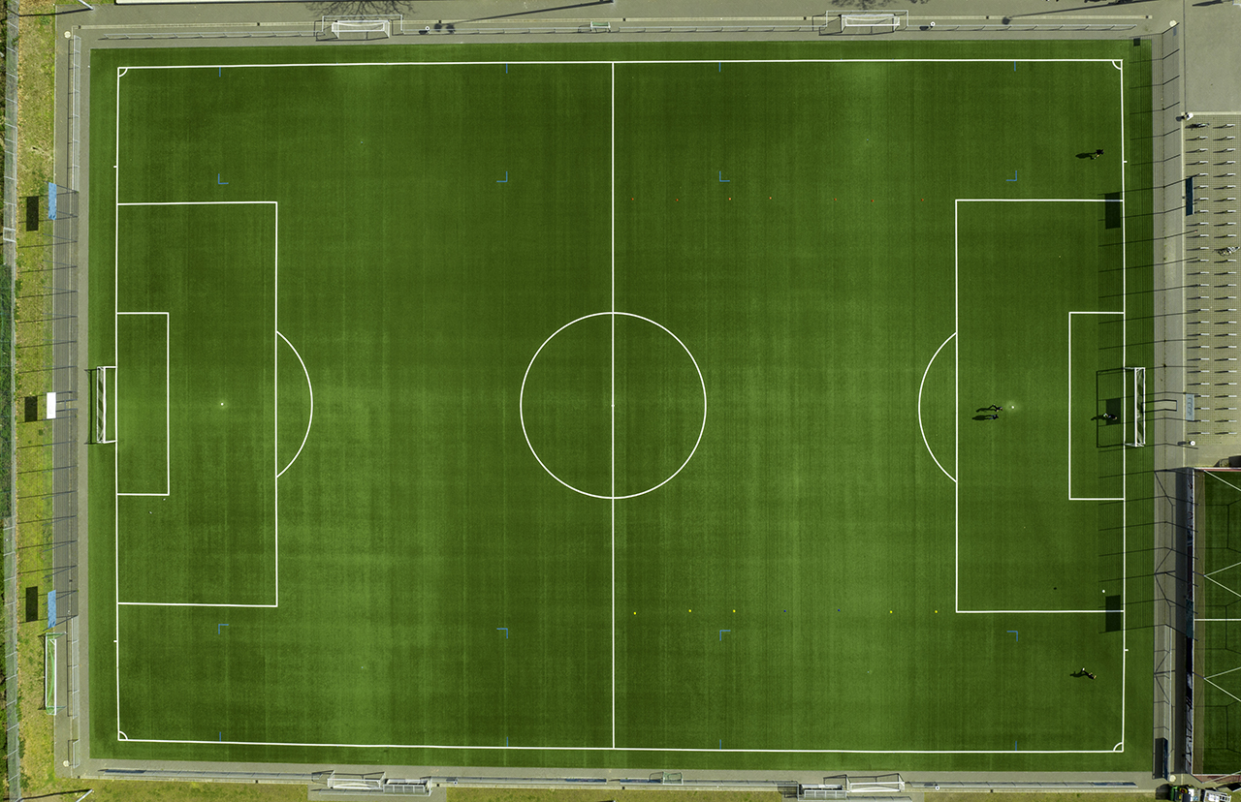
Where can maths take you?
Notes:
Good morning! Today’s assembly is all about this big question, “where can maths take you?”
It’s about showing you that maths turns up in more places than people expect.
It can help you design buildings, film wildlife, predict the weather, run a business, protect people, create theatre sets, work in sport, or make decisions about health and food.
By the end of this assembly, I want you to have at least one new answer to this question: where could maths take me?”

Slide 2
Quick Vote
Football
Filming animals
Firefighting
Designing theatre sets
Weather forecasts
Running a pub or café
All of the above
Raise a hand if you think maths is used in…
Notes:
Let’s start with a quick vote. You can raise your hand, stand up, point, or just think your answer in your head.
Where do you think maths is used? Football? Filming animals? Firefighting? Theatre set design? Weather forecasting? Running a pub or café?
The answer is all of them. That’s the point of today, helping us to see that maths is a key part of making real-life decisions critical to lots of different jobs.

Slide 3
Maths is Everywhere!
Maths helps people….
make decisions
spot patterns
understand risk
estimate and plan
use data
design and create
solve problems under pressure
Notes:
When people say, ‘When will I ever use this?’, they often imagine maths as a worksheet. But in real life, maths is often about thinking.
It is noticing patterns. Estimating what is reasonable. Making a plan. Checking if something is safe. Using data to decide what to do next.
You do not always see the maths from the outside, but it is often there underneath.

Slide 4
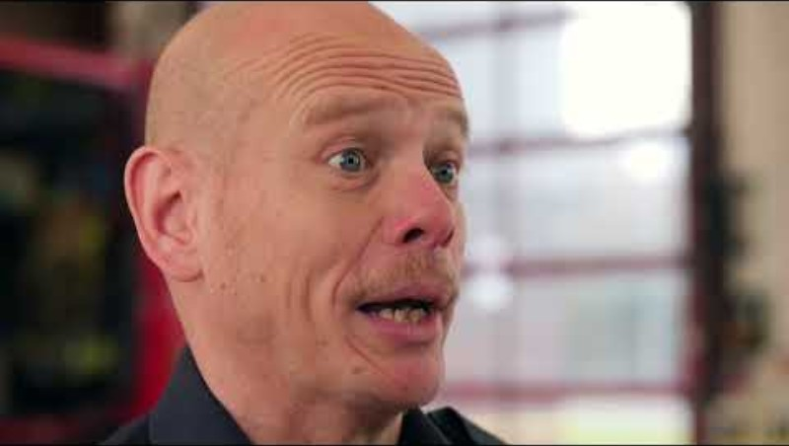
Darren
Firefighter
Darren Barrett is a firefighter with nearly 26 years’ experience. In his role, maths plays a crucial part in keeping both firefighters and the public safe.
Notes:
Here is one example that is about speed, safety and judgement.
In firefighting, maths is not about sitting quietly with a calculator. It can be about making quick decisions when people’s safety depends on it. Firefighters use maths to think about things like air pressure, time, and water.
As you watch, think about this: what kind of maths skills might matter here? Estimating? Time? Pressure? Capacity? Mental calculation?”
Student interaction after video:
“Turn to the person next to you and finish this sentence:
‘A firefighter might need maths when…’”

Slide 5
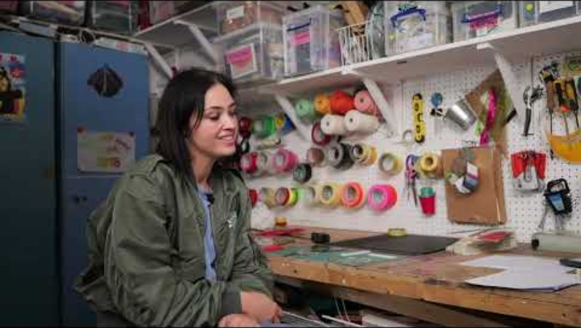
Sophie, Hela and Bridget
Set Designers
Sophie Jacobs, Hela Dondertman and Bridget Merton are the creators of their own set design business: Set appeal.
From looking at space, angle of visibility and moving sets from one location to another, maths is an important aspect of their day-to-day work.
Notes:
Set designers create the worlds we see on stage, on screen or in performance spaces. But those worlds have to fit. They have to be seen from the audience. They may need to move. They have to be built safely.
That means thinking about space, angles, scale and measurement. Maths helps creative ideas become real.”
Student interaction:
“Look at the room we are in now. What would a set designer need to think about if this space had to become a theatre set?
Think about: Where would people stand? What could the audience see? How big could objects be? How would things move?”

Slide 6
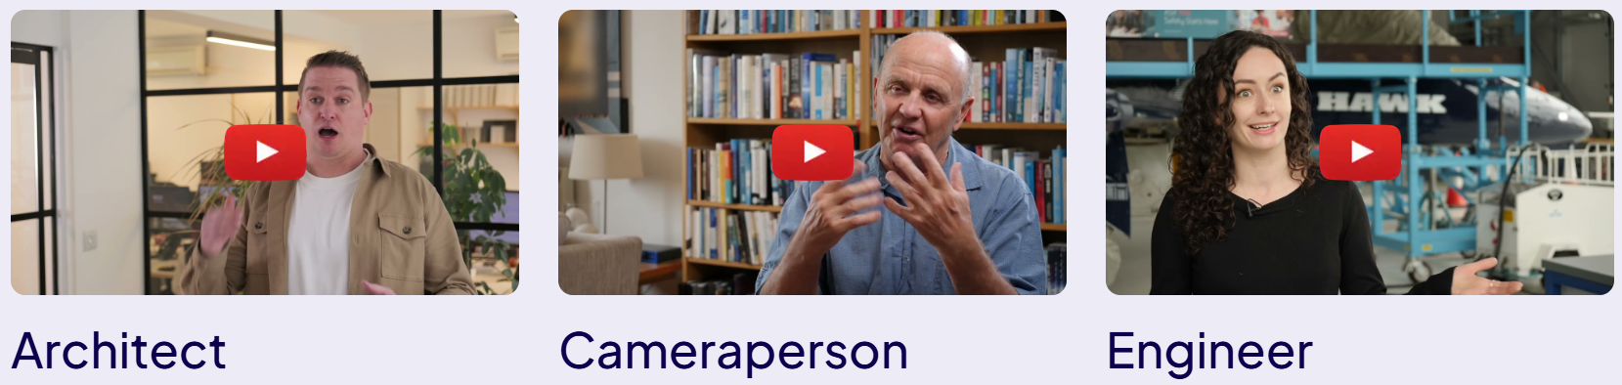
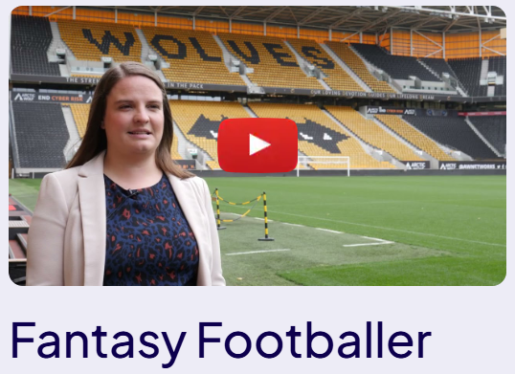
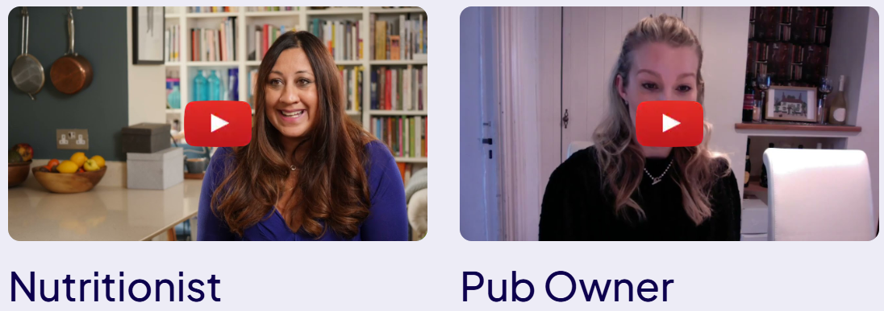
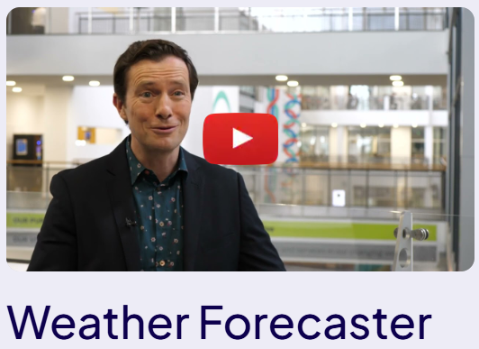
Your future in maths: A-Z | Pearson UK
Notes:
“Now it’s your turn to choose.
Look at the careers on the screen. Which one would you most like to hear more about? You do not have to choose the one you think is the most mathematical. Choose the one that interests you most.”
Interactivity options:
Students vote by raising hands
Click the link to go to the main page and select the video you want.
Teacher follow-up:
“What we notice straight away is that maths connects to lots of different interests. Sport. Animals. Weather. Food. Travel. Design. Business. Technology. Engineering. That means maths can support different kinds of futures.”

Slide 7

Maths skills, not just maths topics
You may already be building these skills:
Estimating
Checking if an answer makes sense
Reading graphs
Using percentages
Measuring
Spotting patterns
Explaining your thinking
Solving problems step by step
Notes:
It is easy to think maths is only about getting the final answer right. But the skills you build in maths are much wider.
When you estimate, you learn to make sensible decisions. When you read a graph, you learn to understand information quickly. When you explain your thinking, you learn to communicate clearly.
These skills matter in lots of jobs, but they also matter in everyday life.”
Inclusive message:
“You do not have to be the fastest person in the room to be good at mathematical thinking. Careful, creative, visual, practical and logical thinkers all use maths.”

Slide 8
Mini Challenge match the maths to the career
Career |  | Maths skill
Firefighter |  | Data, points, probability
Set designer |  | Money, pricing, stock
Fantasy football creator |  | Ratios, quantities, health data
Weather forecaster |  | Space, scale, angles
Pub owner |  | Time, pressure, capacity
Nutritionist |  | Graphs, models, statistics
Notes:
Teacher speaker notes:
“Let’s have a quick match-up. You can discuss with the person next to you, or just think it through.
Which maths skill links to which career? Some are obvious. Some might surprise you.”

Slide 9
Mini Challenge answers
Career |  | Maths skill
Firefighter |  | Time, pressure, capacity
Set designer |  | Space, scale, angles
Fantasy football creator |  | Data, points, probability
Weather forecaster |  | Graphs, models, statistics
Pub owner |  | Money, pricing, stock
Nutritionist |  | Ratios, quantities, health data
Notes:
eacher reveal:
“Lots of these careers use more than one type of maths. A pub owner might use money, stock, percentages and forecasting. A weather forecaster might use data, graphs, models and probability. A fantasy football creator might use points, trends, fixtures and player data.”

Slide 10

What if maths feels difficult?
Maths can still be part of your future if…
You find it hard sometimes
You need more time
You prefer practical examples
You are stronger with visual thinking
You do not see yourself as “a maths person” yet
Notes:
“This message is really important.
You do not need to find every part of maths easy for maths to help you. Lots of people use maths in practical, visual and creative ways. Lots of people build confidence over time.
Maths is not about being perfect. It is about building tools you can use. Every new skill gives you more choice.”

Slide 11

Complete one sentence:
Maths could help me with…
I was surprised that maths is used in…
One career I want to know more about is…
One maths skill I already use is…
Notes:
Teacher speaker notes:
“To finish, choose one sentence starter. You can say it to the person next to you, or just think it through for yourself.
Maths does not decide your future for you. But it can give you more options. It can help you understand the world, solve problems, make decisions and do things that matter to you.”
Closing line:
“So, where can maths take you? Maybe somewhere you already expect. Maybe somewhere you have never imagined yet.”

Slide 12

Your Future in Maths
Your future in maths: A-Z | Pearson UK

