Slide 1
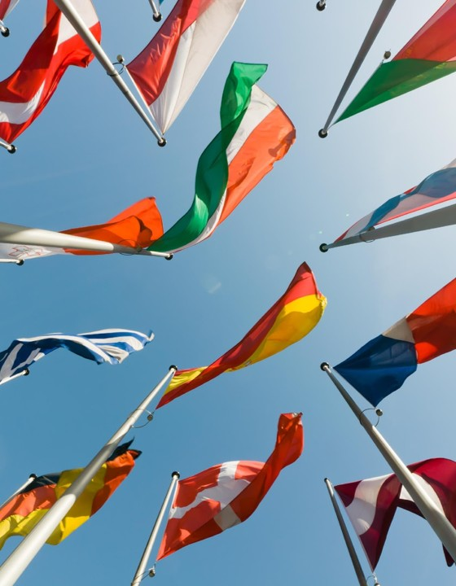
European Day of Languages Celebration
Pick and mix activities to celebrate language diversity

Slide 2

How to play: instructions for teachers
How to play
Dip into these pick and mix language activities as starters, stand-alone activities or for a whole lesson. Some activities may also be suitable for flipped learning or homework.
Answers are provided after each activity.
Keep track of student scores if you wish to find and reward an overall class winner.
Let’s get started!

Slide 3
Pick and Mix Menu
Choose your activity
1. A-Z of languages
5. Say hello!
2a. Top 10: European round
6. Fun facts: true or false
2b. Top 10: Global round
7. Words travel
3. Quick quiz
8. Language discovery
4. Social languages
9. Favourite words

Slide 4
1. A-Z of languages
Activity 1
Team round
A.
B.
C.
D.
E. Engligh
F.
G.
H.
I.
J.
K.
L.
M.
N.
O.
P.
Q.
R.
S.
T.
U.
V.
W.
X.
Y.
Z.
Write the alphabet, A-Z, in the margin of your book.
Work in teams to write down the names of as many different languages as you can think of for each letter in English.
Option: do this activity in another language that you speak or that you are learning – or in a mix of languages!
See answers!
Copyright 2026 Pearson. All rights reserved.
4

Slide 5
1. A-Z of languages Answers
Activity 1
Team round
A. Arabic, Afrikaans
B. Bulgarian
C. Cantonese, Czech, Croatian
D. Danish, Dutch
E. Engligh
F. French, Finnish
G. Greek, German, Gujarati
H. Hebrew, Hungarian, Hindi
I. Indonesian, Italian
J. Japanese
K. Korean
L. Latvian, Lithuanian
M. Mandarin
N. Norwegian
O. Occitan
P. Portuguese, Persian, Polish
Q. Québécois French
R. Russian, Romanian
S. Spanish, Swedish
T. Turkish
U. Urdu, Ukrainian
V. Vietnamese
W. Welsh
X. Xhosa
Y. Yoruba, Yiddish
Z. Zulu
Score 10 points per language.
50 bonus points for completing at least 20 letters.
100 bonus points for a language for all 26 letters.
Back to menu
Copyright 2026 Pearson. All rights reserved.
5

Slide 6
2a. Top 10: European round
Activity 2a
Approximate number of native speakers | Language
1. 160 million
2. 97 million
3. 72 million
4. 65 million
5. 63 million
6. 47 million
7. 39 million
8. 33 million
9. 24 million
10. 22 million
Put the most spoken languages in Europe in order.
Polish
Italian
English
Ukrainian
French
Romanian
Spanish
German
Russian
Dutch
See answers!
Copyright 2026 Pearson. All rights reserved.
6

Slide 7
2a. Top 10: European round Answers
Activity 2a
Approximate number of native speakers | Language
1. 160 million | Russian
2. 97 million | German
3. 72 million | French
4. 65 million | Italian
5. 63 million | English
6. 47 million | Spanish
7. 39 million | Polish
8. 33 million | Ukrainian
9. 24 million | Romanian
10. 22 million | Dutch
Put the most spoken languages in Europe in order.
10 points for each correct match.
Play Global Round
Copyright 2026 Pearson. All rights reserved.
7

Slide 8
2b. Top 10: Global round
Activity 2B
Approximate number of speakers | Language
1. 1.5 billion
2. 1.2 billion
3. 611 million
4. 561 million
5. 335 million
6. 334 million
7. 274 million
8. 269 million
9. 255 million
10. 246 million
Put the most spoken languages in the world in order.
Urdu
Arabic
English
Portuguese
French
Hindi
Spanish
Bengali
Indonesian
Mandarin Chinese
See answers!
Copyright 2026 Pearson. All rights reserved.
8

Slide 9
2b. Top 10: Global round
Answers
Activity 2B
Approximate number of speakers | Language
1. 1.5 billion | English
2. 1.2 billion | Mandarin Chinese
3. 611 million | Hindi
4. 561 million | Spanish
5. 335 million | Arabic
6. 334 million | French
7. 274 million | Bengali
8. 269 million | Portuguese
9. 255 million | Indonesian
10. 246 million | Urdu
Put the most spoken languages in the world in order.
10 points for each correct match.
Back to menu
Copyright 2026 Pearson. All rights reserved.
9

Slide 10
3. Quick Quiz
Activity 3
Team round
What are the three 'working languages' of the EU Commission (used in meetings, official documents etc.)?
How many official EU languages are there?
  12
  18
  24
Approximately how many regional/minority languages are used in Europe?
  65
  85
  105
In Spain, there is a language called Silbo gomero made up only of:
  Yodelling
  Whistling
  Clicking
What is the name of the artificial language devised in 1887 as an international means of communication?
  Esperanto
  Spanglish
  Anpean
See answers!

Slide 11
3. Quick Quiz Answers
Activity 3
Team round
What are the three 'working languages' of the EU Commission (used in meetings, official documents etc.)?
  English, French and German
How many official EU languages are there?
  C. 24
Approximately how many regional/minority languages are used in Europe?
  A. 65
In Spain, there is a language called Silbo gomero made up only of:
  B. Whistling
What is the name of the artificial language devised in 1887 as an international means of communication?
  A. Esperanto
10 points per correct answer for each student on the team.
Back to menu

Slide 12
4. Social languages
Activity 4
100 points for a post or video.
Option 1
Option 2
Write a social media post in a language that's not English to share a positive message about languages and language-learning.
For example:
  Explain why knowing other languages is important.
  Encourage people to start learning a new language.
Create a video to talk about one or all of these topics in a foreign language:
Which languages you speak, understand or are learning.
Which languages you would like to learn and why.
Your best language-learning experience – in or out of school.
Your top tips to get better at languages.
Back to menu

Slide 13
5. Say hello!
Activity 5
Hello translations | Language
1. Bonjour
2. أهلا
3. Ciao
4. 안녕하세요
5. Hola
6. こんにちは
7. Hallo
8. Χαίρετε
9. Olá
10. Habari
Match the greetings to the language.
Japanese
Arabic
Greek
Portuguese
French
Italian
Spanish
German
Swahili
Korean
See answers!
Copyright 2026 Pearson. All rights reserved.
13

Slide 14
5. Say hello! Answers
Activity 5
Hello translations | Language
1. Bonjour | French
2. أهلا | Arabic
3. Ciao | Italian
4. 안녕하세요 | Korean
5. Hola | Spanish
6. こんにちは | Japanese
7. Hallo | German
8. Χαίρετε | Greek
9. Olá | Portuguese
10. Habari | Swahili
Match the greetings to the language.
100 bonus points if you learn to say all 10 correctly.
10 points for each correct match.
Back to menu
Copyright 2026 Pearson. All rights reserved.
14

Slide 15
6. Fun facts: true or false?
Activity 6
Team round
Papua New Guinea has the most languages in use.
There is only one sign language used worldwide.
The world's longest alphabet has 74 letters.
E is the most common letter in English.
German is the fastest language in the world (syllables spoken per second).
The most languages spoken by one person is 59.
English has more words in the dictionary than any other language.
There are about 7,000 languages spoken globally.
See answers!

Slide 16
6. Fun facts: true or false? Answers
Activity 6
Team round
True: Papua New Guinea has 840 languages in use.
False: There are about 300 sign languages in use.
True: Khmer (Cambodia's language) has 74 letters.
True: E is the most common letter in English.
False: Japanese is the fastest language in the world (7.84 syllables spoken per second).
True: Ziad Youssef Fazah can communicate in 59 languages.
False: Korean has the most words in a dictionary (1.1 million).
True: About 7,000 languages are spoken globally.
10 points per correct answer for each student on the team.
Back to menu

Slide 17
7. Words travel
Activity 7
English word | Language of origin
1. Anonymous
2. Cigar
3. Cartoon
4. Entrepreneur
5. Penguin
6. Loot
7. Avatar
8. Lemon
9. Ketchup
10. Karaoke
Which language do these words come from?
Sanskrit
Italian
Arabic
Japanese
French
Welsh
Spanish
Chinese
Greek
Hindi
See answers!
Copyright 2026 Pearson. All rights reserved.
17

Slide 18
7. Words travel Answers
Activity 7
English word | Language of origin
1. Anonymous | Greek
2. Cigar | Spanish
3. Cartoon | Italian
4. Entrepreneur | French
5. Penguin | Welsh
6. Loot | Hindi
7. Avatar | Sanskrit
8. Lemon | Arabic
9. Ketchup | Chinese
10. Karaoke | Japanese
Which language do these words come from?
10 points for each correct match.
Back to menu
Copyright 2026 Pearson. All rights reserved.
18

Slide 19
8. Language discovery
Activity 8
Is this an official language for a particular country or countries?
Where else is this language spoken?
Create a poster, factsheet, video or presentation.
100 points per project.
How many people speak this language?
Find out some fun facts about your chosen language.
Choose 5-10 words or short phrases you’d like to learn in this language and find out how to write them and say them.
Create a slogan and logo to promote your chosen language.
Back to menu
Copyright 2026 Pearson. All rights reserved.
19

Slide 20
9. Favourite words
Activity 9
10 points per word
Make a list of your favourite words in a language of your choice. Here are some of our favourites:
French examples
German examples
Spanish examples
vachement
= slang for ‘really'
la chauve-souris
= bat (literally, 'bald-mouse')
Kuddelmuddel
= jumble/mess
Luftschloss
= an unrealistic dream (literally, 'air castle')
tiquismiquis
= picky/fussy
madrugar
= to get up early
Back to menu

Slide 21
Thank you for taking part!
Keep celebrating language diversity.

