Slide 1

International Primary and International Lower Secondary Professional Development Guide

Slide 2
iPrimary and iLowerSecondary: Why?
iPLS Professional Development Guide
Research identified that international schools needed:
An international curriculum, based on British best practice​
EAL Support​
Robust, trusted assessment
Professional development
The English National Curriculum was updated in 2014 so international curricula also need to be revised to support progression to International GCSE and beyond
The majority of learners - and a large number of teachers – in international schools are non-native speakers of English. How can they be supported?
External, globally benchmarked and recognised examinations at the end of key stages as well as ongoing summative assessment
Teachers need to be supported in learning and using teaching strategies to help their students achieve better outcomes.
iPrimary – learn more
iLowerSecondary – learn more
Notes:
In developing the new international primary and lower secondary programmes, we conducted research with teachers all over the world – both those taking Pearson Edexcel qualifications and using our resources, and those that aren’t.
We identified four key themes, as outlined on this slide.
1)The need for a curriculum to be in line with the updated English National Curriculum (2014), to better prepare students for the redeveloped International GCSEs – but also to have an international flavour that is not have too much of a ‘British’ context.
●
2)The need for support for teachers and learners who are not native speakers of English. A native speaker curriculum (like the English National Curriculum) is hard for non-native speakers to access, particularly at the younger ages, but schools teaching the majority of subjects in English still want a literacy based curriculum, rather than a full, ELT-style English curriculum.
●
3)We found that assessment is important for teachers – not only the externally administered ‘checkpoint’ style tests at the end of each key stage, but also the ongoing progress tests that provide more formative assessment as students move through the curriculum
●
4)Every teacher would like more training support! Professional Development that is relevant to the teacher was the number one request, while acknowledging that it can be difficult or expensive to access

Slide 3
iPrimary and iLowerSecondary: What?
iPLS Professional Development Guide
Not just a curriculum but a complete toolkit for schools, comprising of:
  Learning objectives for Reception and Nursery (K and pre-K, ages 3-5) in English, Maths and The World Around Us
  Learning objectives for Years 1-9 (age 5-14) in English, Maths, Science, Computing and (from 2021) Global Citizenship
  Complete Schemes of Work and Lesson planning for all subjects, for all eleven years, based on internationally renowned Pearson resources
  Face-to-face Professional Development plus ongoing CPD in webinar format
  Ongoing internal assessment (progress tests), updated annually
  External examinations delivered by Pearson Edexcel (Year 6 and Year 9) – first assessment in June 2019.
iPrimary – learn more
iLowerSecondary – learn more
Copyright 2025 Pearson. All rights reserved.
3
Notes:
So we created iPrimary and iLowerSecondary from Pearson Edexcel with these teacher needs in mind.
It isn’t just a curriculum, but a full teaching toolkit, consisting of:
-Full curriculum documents with learning objectives from Years 1-9 (ages 5-14) in English, Maths and Science, with Computing following later
-
-Complete programme support for teachers in the form of example Schemes of Work and Units of Work – for every subject, for every grade
-
-Three day’s Professional Development per year included as part of the programme
-
-Ongoing internal assessment, updated annually, for all subjects, for all years – combined with the end of Year 6 and Year 9 Achievement tests which are externally marked by Pearson Edexcel

Slide 4
iPrimary and iLowerSecondary: Professional Development
iPLS Professional Development Guide
Training Programme
Ongoing Support
iPLS Master Teacher and iPLS Coordinator Opportunity
3 days online / 2 days Face-to-Face / Self-Study*
A mix of implementation, pedagogy, classroom techniques and some subject specific information
Closely tied to the Teacher’s Guides that are provided as part of the programme
Webinars
Additional online training
Opportunity to showcase evidence of iPLS strategy implementation into classroom teaching resulting in certification and digital badging.
Opportunity to showcase evidence of supporting iPLS Implementation within your school, resulting in certification and digital badging.
Notes:
An iPrimary or iLowerSecondary school is entitled to either online or F2F professional development as part of the programme (dependant on price)
Professional Development is split in to three main areas –
1.Implementation (how to begin administering the programme)
2.Pedagogy and classroom techniques
3.Subject specific techniques and delivery
In the first instance, there is a core programme for schools to follow, but in subsequent years additional modules can be added in and replaced to ensure that the teachers attending training continue to grow.
The face-to-face PD is supplemented by ongoing webinars throughout the year on specific topics.

Slide 5
iPrimary and iLowerSecondary Implementation Training

Slide 6

iPrimary and iLowerSecondary Implementation Training
iPLS Professional Development Guide
QUALIFICATION AND SUBJECTS
Covers all iPrimary and/ or iLowerSecondary for the three key subjects (English, Maths and Science)
FORMAT AND DURATION
Face-to-Face – 11 hours over 2 days
Online – 3hour sessions over 3 days – 9 hours
Self – Study – 18 hours+
Our iPLS Implementation Professional Development programme has been designed to fully equip teachers with an understanding of the components of iPrimary and iLowerSecondary, as well as key teaching and learning strategies to help them implement the curriculum effectively and confidently in their classrooms.
Our professional development programme is divided into sessions that provide different areas of support:
iPrimary and iLowerSecondary Orientation
Teaching and Learning Strategies
Lesson Planning Workshop
Assessment Strategies
DELEGATE PROFILE
Teachers and year/ department leaders who are new to teaching iPrimary and/ or iLowerSecondary
NUMBER OF SPACES
8-35
CERTIFICATION
Teachers who attend at least 85% of all sessions get a certificate of attendance. Senior members of staff can also join our iPLS coordinator programme and do the optional extension task to gain an iPLS digital badge and certificate.
COST
FREE to all new iPrimary and/or iLowerSecondary customers.
Repeat sessions may be chargeable.
Additional Modules are chargeable.
F2F reserved for full subscription paying customers only.

Slide 7
Typical Agenda
iPLS Professional Development Guide
Face to Face
Online
Day 1
Session 1. 1.5hrs: Introduction to iPLS
Session 2. 1.5hrs: Active Learning
Session 3. 1.5hrs: Critical Thinking
Session 4. 1hrs: Modelled lesson: choice of English or Maths, iP or iLS or both
Day 2
Session 1. 1.5hrs: Summative Assessment
Session 2. 1.5hrs: Formative Assessment
Session 3. 1.5hrs: A detailed look at planning documents
Session 4. 1hrs: Wrap up
Day 1
Session 1. 1.5hrs: Introduction to iPLS
Session 2. 1.5hrs: Active Learning
Day 2
Session 3. 1.5hrs: Critical Thinking
Session 4. 1.5hrs: Formative Assessment
Day 3
Session 5 1hr: Summative Assessment
Session 6 1hr: A detailed look at planning Documents
Session 7 1hr: Wrap up
Copyright 2025 Pearson. All rights reserved.
7

Slide 8
Who is entitled to the full iPLS Professional Development Package
iPLS Professional Development Guide
For those schools who have taken a standalone subject
Schools who have subscribed to the full iPLS Curriculum will be able to take advantage of the iPLS Professional Development programme.
Schools who have subscribed to the full Curriculum are entitled to the following,
These subjects are, Global Citizenship, Computing or Early Years.
Depending on the subject taken, the school are entitled to the online 3-hour corresponding PD module.
In subsequent years, schools can choose one online module from the CPD offering.
Year 1
Year 2+
Full Implementation Training
Choice of up to 4 modules per year of subscription
Schools can choose to retake the Implementation training or any module that has been previously taken. This will count towards the school's entitlement for that year.

Slide 9
iPLS Continuous Professional Development Modules

Slide 10
New Courses for 2026
iPLS Professional Development Guide
Available from March 2026
Transitioning from iLS to International GCSE
Utilising AI In iPrimary
Utilising AI In iLowerSecondary
Transitioning from iP to iLS
Supporting teachers to utilize AI effectively within iPrimary teaching.
Supporting teachers to support students to utilize AI effectively within iLowerSecondary Learning.
Enabling teachers to support students in the transition from iP to iLS seamlessly.
Enabling teachers to support students in the transition from iLS to International GCSE seamlessly.
Available from September 2026
Subject Lead Leadership
Supportive Leadership
Behaviour Management
SEN Teaching Strategies
EAL Teaching Strategies
Supporting teachers to enhance their leadership practices as HOD/Subject lead. Follow on from iPLS Implementation Leadership Module.
Supporting HOD/school leaders to enhance their leadership practices to support their teaching staff. Follow on from iPLS Implementation Leadership Module.
Supporting teachers to manage behaviour in classrooms to create effective learning environments for all students. Follow on from Classroom Management module.
Providing teachers with adaptive learning strategies to support teaching students with various learning styles.
Follow on from Intro to SEN module.
Providing teachers with teaching & learning strategies to support teaching EAL students.
Follow on from Intro to EAL module.
Copyright 2025 Pearson. All rights reserved.
10

Slide 11
iPrimary and iLowerSecondary: Professional Development Thematic Packages
iPLS Professional Development Guide
English
Maths
Science
English Reading Comprehension
Raising Attainment in Writing
Bug Club
iPrimary Anthologies
Inspire English
Building Blocks
Introduction to Maths Mastery
Problem Solving in Mathematics
Bar Modelling in Mathematics
Power Maths
Abacus
Maths Progress International
Enquiry Based-Science
Pearson International Primary Science (PIPS)
Exploring Science International
Notes:
New for 2026
As we are now adding more and more courses to the offering, we are now able to offer thematic options for schools to chose from.
These are as follows.

Slide 12
iPrimary and iLowerSecondary: Professional Development Thematic Packages
iPLS Professional Development Guide
Early Years
Other Subjects
Teaching with Technology
Introduction to Early Years
Effective Learning in the Early Years Classroom
Behaviour Management in the Early Years Classroom
Systematic Synthetic Phonics
Bug Club Phonics
Computing
Inspire Computing
Global Citizenship
Sustainability
Skills Ladders
  Implementation
  D&T
  Art
  Music
  PE
  Geography
  History
Enhancing Teaching with Technology
Teaching Online Effectively
How to Teach SEN students online
Utilising AI In iPrimary
Utilising AI In iLowerSecondary
Notes:
New for 2026
As we are now adding more and more courses to the offering, we are now able to offer thematic options for schools to chose from.
These are as follows.

Slide 13
iPrimary and iLowerSecondary: Professional Development Thematic Packages
iPLS Professional Development Guide
Classroom Management
SEN Teaching
Leadership
Classroom Management
Behaviour Management (New – Sept 26)
Collaborative Learning
Introduction to SEN
SEN Teaching Strategies (New – Sept 26)
Introduction to SEN
SEN Teaching Strategies (New – Sept 26)
Coaching
Effective Communication
Effective Feedback
iPLS Implementation Leadership
Subject Implementation Leadership (New – Sept 26)
Supportive Leadership (New – Sept 26)
Presentation Skills
EAL Teaching
Introduction to teaching EAL students
EAL Teaching Strategies (New – Sept 26)
Notes:
New for 2026
As we are now adding more and more courses to the offering, we are now able to offer thematic options for schools to chose from.
These are as follows.

Slide 14
iPrimary and iLowerSecondary: Professional Development Thematic Packages
iPLS Professional Development Guide
Pedagogy
Introduction to teaching EAL Students
EAL Teaching Strategies (New – Sept 26)
Collaborative Learning
Differentiated Learning
Effective Communication
Effective Feedback
Enhancing Teaching with Technology
Coaching
Introduction to SEN
SEN Teaching Strategies (New – Sept 26)
Presentation Skills
Utilising AI in iPrimary (New – March 26)
Utilising AI in iLowerSecondary (New – March 26)
Transitioning from iPrimary to iLowerSecondary (New – March 26)
Transitioning from iLowerSecondary to International GCSE (New – March 26)
Notes:
New for 2026
As we are now adding more and more courses to the offering, we are now able to offer thematic options for schools to chose from.
These are as follows.

Slide 15
iPLS CPD Modules
Module Descriptions

Slide 16
iPLS Professional Development Guide - english
English

Slide 17

iPLS Professional Development Guide - english
iPLS English Reading Comprehension
iPLS Raising Attainment in Writing
Bug Club
This module looks at a range of strategies and explores ways of developing the classroom skills students need to be able to comprehend what they read.
By the end of the session participants will;
Investigate the problems students have with reading comprehension,
Understand the value of reading for pleasure,
Be able to apply active learning strategies in developing reading comprehension.
This module looks at the skills students need to achieve the best grade possible in the Year 6 and Year 9 externally marked Achievement tests.
By the end of the session participants will;
Understand the expectations for writing in the Year 7 and Year 9 Achievement Tests,
Understand how writing is marked externally and model and discuss strategies to support writing skills.
For schools who have purchased Bug Club resources to support their teaching of iPrimary English, can chose from the following courses,
Bug Club Core PD
Bug Club Refresher PD
Bug Club, Leadership and Planning
Bug Club, Developing Early Reading
Bug Club and SEND
3 hours Live Module
3 hours Live Module
To be confirmed upon agenda of training.

Slide 18
iPLS Professional Development Guide - english
Inspire English
Building Blocks
iPrimary Anthologies
Designed to support teachers who are using the Inspire English courseware in their classrooms, split into two live facilitated online sessions, session one will focus on facilitation with the course, its functionality and strategies to use it to teach the subject in question in the classroom.
A task is then set between session one and session two where teachers are given the opportunity to use the resource in the classroom and make notes and return to session two reflect on their experience, how successfully they have used it and how they can build on that each time they teach.
For schools who have purchased Building Blocks resources to support their teaching of iPrimary English,.
By the end of the training, participants will,
Understand how to use Building Blocks effectively,
Consider effective strategies to teaching grammar and punctuation,
Gain confidence in using the resources in an interactive and engaging way with the year groups they teach.
This module focuses on how to use the iPrimary Anthology resources effectively in teaching alongside the iPLS Curriculum.
By the end of the session, participants will,
Understand how the anthologies and activity books support iPrimary English planning​
Consider effective strategies to ensure active learning and critical thinking​
Gain confidence in using the resources in an interactive and engaging way with the year groups they teach
3.5 hours Live Module, split across 2 sessions
3 hours Live Module
3 hours Live Module

Slide 19
iPLS Professional Development Guide - Maths
Maths

Slide 20
iPLS Professional Development Guide - Maths
iPLS Introduction to Maths Mastery
iPLS Problem Solving in Mathematics
iPLS Bar Modelling
This module focuses on why teaching for mastery is so much more than students focusing on getting the right answer.
In developing successful mathematicians there needs to be a development of a growth mindset, conceptual understanding and the development of Maths Talk in teaching and learning.
By the end of the session participants will;
Understand the key concepts of teaching for mastery, growth mindset, conceptual understanding,
and be able to strengthen their students learning in Maths.
This module focuses on providing guidance to teachers to ensure they have the skills to develop their students problem-solving skills.
To develop successful mathematicians’ teachers will need to develop their student’s ability to reason mathematically by understanding the importance of developing reasoning in all maths and how problem-solving can be developed by teaching strategies.
Please note this module is available once teachers have undertaken the iPLS Introduction to Maths Mastery module.
This module aims to equip participants with the necessary skills to teach bar modelling effectively.
By the end of the session participants will;
Be able to understand what bar modelling is,
Experience different types of bar modelling and be able to use these in class to solve problems.
Please note this module is available once teachers have undertaken the iPLS Introduction to Maths Mastery module.
3 hours Live Module
3 hours Live Module
3 hours Live Module

Slide 21
iPLS Professional Development Guide - Maths
Power Maths
Abacus
Maths Progress International
For schools who have purchased Power Maths resources to support their teaching of iPrimary Maths, can chose from the following courses,
Core
Refresher
Using Power Maths in Reception
Teaching Mixed Age Groups
Strengthening Understanding and Intervention
Deepening Understanding
Deep Dive Lesson Planning
This course is for those who already have a subscription to Abacus.
Learn how to make the most of your Abacus online subscription and printed resources and ensure consistency of use throughout your school.
The course is practical, hands-on and covers:
Mastery: how Abacus fits with a mastery approach
Planning: how to use the planning, what the different optional resources are and when to use them
Methods and strategies: the Abacus approach to calculation
How to: set up groups, allocate resources, use the markbook, use Pupil World
Assessment: the different types of assessment within Abacus.
Designed to support teachers who are using the Maths Progress International courseware in their classrooms, split into two live facilitated online sessions, session one will focus on facilitation with the course, its functionality and strategies to use it to teach the subject in question in the classroom.
A task is then set between session one and session two where teachers are given the opportunity to use the resource in the classroom and make notes and return to session two reflect on their experience, how successfully they have used it and how they can build on that each time they teach.
To be confirmed upon agenda of training.
2 x 3 hours Live Module
3.5 hours Live Module, split across 2 sessions

Slide 22
iPLS Professional Development Guide - science
Science

Slide 23
iPLS Professional Development Guide - science
Enquiry Based Science
Pearson International Primary Science (PIPS)
Exploring Science International
This module provides guidance on how to deliver scientific enquiry effectively in an iPLS classroom.
By the end of the session participants will;
Be able to define and describe scientific enquiry,
Consider and understand examples of scientific enquiry,
Compare and contrast enquiry with passive learning and construct methods of incorporating the acquisition of subject knowledge into enquiry-based learning.
This module focuses on how to use the iPrimary Anthology resources effectively in teaching alongside the iPLS Curriculum.
By the end of the session, participants will,
Understand the structure and resources available in PIPS.​
Explore its main features and how to use the resource to enhance teaching and learning.​
Engage and participate in a number of learning activities to enhance lesson delivery.​
Understand how to assess your children’s understanding
Designed to support teachers who are using the Exploring Science courseware in their classrooms, split into two live facilitated online sessions, session one will focus on facilitation with the course, its functionality and strategies to use it to teach the subject in question in the classroom.
A task is then set between session one and session two where teachers are given the opportunity to use the resource in the classroom and make notes and return to session two reflect on their experience, how successfully they have used it and how they can build on that each time they teach.
3 hours Live Module
3 hours Live Module
3.5 hours Live Module, split across 2 sessions

Slide 24
iPLS Professional Development Guide – Early Years
Early Years

Slide 25
iPLS Professional Development Guide – early years
Introduction to Early Years
Effective Learning in the Early Years Classroom
Behaviour Management in the Early Years Classroom
This module is structured around the iPrimary Early Years Curriculum and will develop teachers understanding of the broader pedagogy and ethos behind the iPrimary curricula.
By the end of the session, participants will;
Understand the key pedagogies and ethos which support iPrimary early years,
Investigate lesson content and discuss classroom organisation and best practice in the early years environment.
This module looks at how to create an effective learning environment in Early Years.
By the end of the session participants will;
Consider what effective learning looks like in the Early Years​
Understand the importance of Maslow Hierarchy of Needs in the Early Years classroom​
Understand how the classroom environment can impact learning and behaviour​
Explore how to create an enabling environment within your classroom​
Consider how your role develops positive communication strategies
This module focuses on providing guidance to teachers to support them in managing behaviour in their early years classrooms.
By the end of the session participants will;
Understand what types of behaviour to look out for,
Have explored strategies for managing behaviour,
How shaping your classroom can influence learner behaviour
3 hours Live Module | 3-6 hours Self-Study Module
Available as a Live Facilitated Module or as a Self-Study Module. Teachers can access the self-study module and have the flexibility to work through content either in school or during their own time.
3 hours Live Module
3 hours Live Module

Slide 26
iPLS Professional Development Guide – early years
Systematic Synthetic Phonics
Bug Club Phonics
This course is designed for education professionals seeking a thorough understanding of systematic synthetic phonics, focusing on phonemes, graphemes, and their correspondences. It builds confidence in phonics teaching, especially for teaching assistants, and includes interactive activities and sound recognition practice to ensure mastery.
For schools who have purchased Bug Club resources to support their teaching of iPrimary English, can chose from the following courses,
Core
Refresher
Leadership and Planning
Developing Early Reading
Phonics and SEND
2 hours Live Module
To be confirmed upon agenda of training.

Slide 27
iPLS Professional Development Guide – Other Subjects
Other Subjects

Slide 28
iPLS Professional Development Guide - Other Subjects
Computing
Inspire Computing
Global Citizenship
This module is structured around the iPLS Computing Curriculum and the three broad strands that the curriculum can be broken down into; Computer Science, Information Technology and Digital Literacy.
By the end of the session participants will;
be able to describe computing and computational thinking,
consider and understand some of the terminology related to computing,
Understand what offline computing is and understand a range of examples in order to develop their students’ digital literacy skills.
Designed to support teachers who are using the Inspire Computing courseware in their classrooms, split into two live facilitated online sessions, session one will focus on facilitation with the course, its functionality and strategies to use it to teach the subject in question in the classroom.
A task is then set between session one and session two where teachers are given the opportunity to use the resource in the classroom and make notes and return to session two reflect on their experience, how successfully they have used it and how they can build on that each time they teach.
iPLS Global Citizenship focuses on one of the newest strands of the iPLS Curriculum and provides guidance to teachers as to best teaching practice when teaching this new subject.
Participants will be guided through how to use the planning and resources iPLS has to offer to ensure an engaging and effective Global Citizenship lesson.
Participants will consider the transferable skills that iPLS Global Citizenship has to offer and how to develop the next generation of Global Citizens.
3 hours Live Module | 3-6 hours Self-Study Module
3 hours Live Module | 3-6 hours Self-Study Module
Available as a Live Facilitated Module or as a Self-Study Module. Teachers can access the self-study module and have the flexibility to work through content either in school or during their own time.
3 hours Live Module
Available as a Live Facilitated Module or as a Self-Study Module. Teachers can access the self-study module and have the flexibility to work through content either in school or during their own time.

Slide 29
iPLS Professional Development Guide – Other subjects
Sustainability
Skills Ladders
This module has been developed to provide support to schools using Skills Ladder.
Divided into 2 programmes, part 1 looks at what Skills Ladder is and how it supports teachers teaching local and country specific content and part 2 looks in depth at the subjects Skills Ladder supports with hands on activities in lesson planning for that particular subject.
In the first part of the programme, teachers will undergo a Skills Ladder Implementation training session, focusing on the key teaching pedagogies touched on in the first-year implementation training.
In the second part of the programme, schools can choose the subjects that they would like support in lesson planning for. These subjects include, Art, Music, History, Geography, Design & Technology and Physical Education.
An example, if a school is only teaching Geography and History, this programme counts as 6 hours and would follow the below agenda.
A school does not need to take all 7 sessions if they are only teaching a select number of subjects. If a school takes the full programme this counts as their full entitlement for a year. iPLS Skills Ladder is flexible and so can be combined with other CPD modules to create the schools PD programme for any given year.
This modules looks at how teachers and students can embed sustainability throughout their teaching and learning, with a particular focus on the iPLS Global Citizenship Curriculum.
By the end of the session participants will;
Understand how sustainability is taught in the GC curriculum
Understand how to use and adapt lesson plans effectively
Understand some of the strategies that can be used to teach sustainability
Get students excited and engaged about sustainability
 | Online |  |  | F2F
 | Day 1 | Day 2 |  |  | Day 1
Session 1 9am-10.30am | Implementation | Geography |  | Session 1 – 9am-12pm | Implementation
Session 2 10.30am-12pm |  | History |  | Session 2 1pm-4pm | Geography (1pm-2.30pm) & History (2.30pm-4pm)
3 hours Live Module
3 hours Live Module – Implementation
1.5 hours Live Module – Per subject

Slide 30
iPLS Professional Development Guide – Teaching with Technology
Teaching with Technology

Slide 31
iPLS Professional Development Guide – teaching with technology
Enhancing Teaching with Technology
Teaching Online Effectively
Teaching SEN students online
This module looks at the different ways you can use technology in the classroom to enhance your teaching practice.
By the end of the session participants will;
Reflect on how you currently use technology in your role.
Consider the benefits (and pitfalls) of using technology in lessons.
Consider the benefits of using technology for assessment and feedback.
Think about how you are going to use technology effectively moving forward to enhance teaching and learning.
iPLS How to Teach Online Effectively focuses on best teaching practice and netiquette whilst teaching online.
The module guides participants through the challenges of online teaching, that we are now experiencing, and how to overcome these challenges.
Participants are asked to consider the logistics to teaching online and how they can analyse their current teaching practices and how they can develop these to become more engaging and effective in the online classroom.
This module follows on and compliments the iPLS Introduction to SEN module.
Participants will be able to identify and understand key characteristics of students with Special Educational Needs SEN and consider teaching styles and online environments that are more effective with SEN students.
By the end of the session participants will be able implements a variety of support models and teaching styles to support pupils learning.
Please note you do not need to have take the Introduction to SEN module, but it would be beneficial to have prior to taking this module.
3 hours Live Module | 3-6 hours Self-Study Module
3 hours Live Module | 3-6 hours Self-Study Module
3 hours Live Module
Available as a Live Facilitated Module or as a Self-Study Module. Teachers can access the self-study module and have the flexibility to work through content either in school or during their own time.
Available as a Live Facilitated Module or as a Self-Study Module. Teachers can access the self-study module and have the flexibility to work through content either in school or during their own time.

Slide 32
iPLS Professional Development Guide – Teaching with Technology
Utilising AI In iPrimary
Utilising AI In iLowerSecondary
New for March 2026
This module looks at a range of strategies and explores ways of utilising AI in iPrimary.
Further information on this module will be available from March 2026.
New for March 2026
This module looks at a range of strategies and explores ways of utilising AI in iLowerSecondary.
Further information on this module will be available from March 2026.
3 hours Live Module
3 hours Live Module

Slide 33
iPLS Professional Development Guide – Classroom Management
Classroom Management

Slide 34
iPLS Professional Development Guide – Classroom management
Classroom Management
Collaborative Learning
Behaviour Management
This module aims to equip teachers in encouraging iPLS ‘learning behaviours’ and to manage classes in a way that supports the iPLS curriculum goals.
By the end of the session, participants will be able to;
Reflect on their current approach to classroom management and apply new practices as needed,
implement strategies for an iPLS classroom environment,
implement proactive strategies that promote iPLS learning behaviours and address inappropriate behaviour.
This module has been developed to provide the skills and strategies needed to promote collaboration in the classroom between teachers and students and students and students.
By the end of the session, participants will;
Understand what collaboration is,
How to create a collaborative classroom,
Explore strategies for successful collaboration,
Reflect on your own practices of collaboration.
New for September 2026
This module focuses on providing guidance to teachers to support them in managing behaviour in their iPLS classrooms.
By the end of the session participants will;
Understand what types of behaviour to look out for,
Have explored strategies for managing behaviour,
How shaping your classroom can influence learner behaviour
3 hours Live Module | 3-6 hours Self-Study Module
Available as a Live Facilitated Module or as a Self-Study Module. Teachers can access the self-study module and have the flexibility to work through content either in school or during their own time.
3 hours Live Module
3 hours Live Module

Slide 35
iPLS Professional Development Guide – SEN Teaching
SEN Teaching

Slide 36
iPLS Professional Development Guide - SEN Teaching
Introduction to SEN
SEN Teaching Strategies
This module aims to equip participants with an understanding of key concepts of working with students who have Special Educational Needs (SEN).
By the end of the session participants will be able to,
Identify and understand key characteristics of students with SEN,
Consider teaching styles that are more effective with SEN students
And analyse how the iPLS Active Learning Strategies can be appropriate for SEN students.
New for September 2026
This module looks at a range of strategies and explores ways of teaching and supporting SEN Students.
Further information on this module will be available from September 2026.
3 hours Live Module
3 hours Live Module

Slide 37
iPLS Professional Development Guide – EAL Teaching
EAL Teaching

Slide 38
iPLS Professional Development Guide – EAL Teaching
Introduction to teaching EAL students
EAL Teaching Strategies
This module focuses on the challenges both teachers and students face when teaching and learning in English in a non-native English-speaking classroom and how to overcome these challenges.
Participants will be guided through how to identify their EAL learners and understand the different stages of learning English, whilst being provided with teaching strategies to help teach EAL learners and how to implement these into their classroom.
New for September 2026
This module looks at a range of strategies and explores ways of teaching and supporting EAL Students.
Further information on this module will be available from September 2026.
3 hours Live Module
3 hours Live Module

Slide 39
iPLS Professional Development Guide – Leadership
Leadership

Slide 40
iPLS Professional Development Guide - leadership
Coaching
Effective Communication
Effective Feedback
This module aims to support teaching staff when coaching in order to improve their teaching practice.
By the end of the session participants will;
To understand the key differentiators between coaching and mentoring​
To explore the impact coaching can have on teachers and students​
Explore different coaching approaches​
Explore the skills needed to become a successful coach​
Explore best practise for lesson observation
This module provides participants with key ideas and strategies to implement successful effective communication in a classroom.
By the end of the session teachers will;
Have an understanding of the various elements of classroom communication,
Why this is important and
Will have learnt strategies for successful implementation of effective communication in their classrooms.
This module looks at the skills teachers need to ensure they are providing consistent feedback
throughout their departments. Students benefit from timely, accurate and constructive feedback.
By the end of the session participants will;
have identified qualities of effective feedback,
Identified how you can provide feedback in a physical and virtual setting
and finishing off with a task that helps promote consistency in providing feedback across the school.
3 hours Live Module
3 hours Live Module
3 hours Live Module

Slide 41
iPLS Professional Development Guide - leadership
iPLS Implementation Leadership
Subject Implementation Leadership
Supportive Leadership
The iPLS Implementation Leadership Training equips school leaders, curriculum coordinators, and implementation leads with essential knowledge and practical tools to introduce and embed the iPrimary and iLowerSecondary (iPLS) curriculum.
By the end of the session participants will;
Understand the structure and principles of iPLS
Conduct a SWOT analysis
Plan and communicate phased implementation with stakeholders
Build staff capacity and provide necessary training
Monitor and evaluate the success of iPLS implementation
New for September 2026
This module looks at how to develop and hone skills as a Subject lead.
Further information on this module will be available from September 2026.
New for September 2026
This module looks at how to develop and hone skills as a senior leader.
Further information on this module will be available from September 2026.
3 hours Live Module
3 hours Live Module
3 hours Live Module

Slide 42
iPLS Professional Development Guide - leadership
Presentation Skills
This module has been developed to guide delegates to identify times when they might need to give presentations and allows them to identify the skills they need to improve.
By the end of the session, participants will;
Identify their personal strengths and weaknesses when presenting,
Experiment with techniques to improve their skills
And deliver a short presentation to practice those skills.
3 hours Live Module

Slide 43
iPLS Professional Development Guide – Pedagogy
Pedagogy

Slide 44
iPLS Professional Development Guide - Pedagogy
Introduction to teaching EAL Students
EAL Teaching Strategies
Collaborative Learning
This module focuses on the challenges both teachers and students face when teaching and learning in English in a non-native English speaking classroom and how to overcome these challenges.
Participants will be guided through how to identify their EAL learners and understand the different stages of learning English, whilst being provided with teaching strategies to help teach EAL learners and how to implement these into their classroom.
New for September 2026
This module looks at a range of strategies and explores ways of teaching and supporting EAL Students.
Further information on this module will be available from September 2026.
This module has been developed to provide the skills and strategies needed to promote collaboration in the classroom between teachers and students and students and students.
By the end of the session, participants will;
Understand what collaboration is,
How to create a collaborative classroom,
Explore strategies for successful collaboration,
Reflect on your own practices of collaboration.
3 hours Live Module
3 hours Live Module
3 hours Live Module

Slide 45
iPLS Professional Development Guide - Pedagogy
Differentiated Learning
Effective Communication
Effective Feedback
This module looks at how teachers can effectively use differentiation in their teaching and the benefits this has to teaching and learning.
By the end of the session participants will;
Understand what differentiation is,
Identify appropriate strategies for embedding differentiation into your classes,
Explore how you can use those strategies in your classroom,
And understand the challenges to differentiation and how to overcome them.
This module provides participants with key ideas and strategies to implement successful effective communication in a classroom.
By the end of the session teachers will;
Have an understanding of the various elements of classroom communication,
Why this is important and
Will have learnt strategies for successful implementation of effective communication in their classrooms.
This module looks at the skills teachers need to ensure they are providing consistent feedback
throughout their departments. Students benefit from timely, accurate and constructive feedback.
By the end of the session participants will;
have identified qualities of effective feedback,
Identified how you can provide feedback in a physical and virtual setting
and finishing off with a task that helps promote consistency in providing feedback across the school.
3 hours Live Module
3 hours Live Module
3 hours Live Module

Slide 46
iPLS Professional Development Guide - Pedagogy
Enhancing Teaching with Technology
Coaching
Introduction to SEN
This module looks at the different ways you can use technology in the classroom to enhance your teaching practice.
By the end of the session participants will;
Reflect on how you currently use technology in your role.
Consider the benefits (and pitfalls) of using technology in lessons.
Consider the benefits of using technology for assessment and feedback.
Think about how you are going to use technology effectively moving forward to enhance teaching and learning.
This module aims to support teaching staff when coaching in order to improve their teaching practice.
By the end of the session participants will;
To understand the key differentiators between coaching and mentoring​
To explore the impact coaching can have on teachers and students​
Explore different coaching approaches​
Explore the skills needed to become a successful coach​
Explore best practise for lesson observation
This module aims to equip participants with an understanding of key concepts of working with students who have Special Educational Needs (SEN).
By the end of the session participants will be able to,
Identify and understand key characteristics of students with SEN,
Consider teaching styles that are more effective with SEN students
And analyse how the iPLS Active Learning Strategies can be appropriate for SEN students.
3 hours Live Module
3 hours Live Module
3 hours Live Module

Slide 47
iPLS Professional Development Guide - Pedagogy
SEN Teaching Strategies
Presentation Skills
Utilising AI in iPrimary
New for September 2026
This module looks at a range of strategies and explores ways of teaching and supporting SEN Students.
Further information on this module will be available from September 2026.
This module has been developed to guide delegates to identify times when they might need to give presentations and allows them to identify the skills they need to improve.
By the end of the session, participants will;
Identify their personal strengths and weaknesses when presenting,
Experiment with techniques to improve their skills
And deliver a short presentation to practice those skills.
New for March 2026
This module looks at a range of strategies and explores ways of utilising AI in iPrimary.
Further information on this module will be available from March 2026.
3 hours Live Module
3 hours Live Module
3 hours Live Module

Slide 48
iPLS Professional Development Guide - Pedagogy
Utilising AI in iLowerSecondary
Transitioning from iPrimary to iLowerSecondary
Transitioning from iLowerSecondary to International GCSE
New for March 2026
This module looks at a range of strategies and explores ways of utilising AI in iPrimary.
Further information on this module will be available from March 2026.
New for March 2026
This module looks at a range of strategies to support your students in their transition from iPrimary to iLowerSecondary.
Further information on this module will be available from March 2026.
New for March 2026
This module looks at a range of strategies to support your students in their transition from iLowerSecondary to International GCSE.
Further information on this module will be available from March 2026.
3 hours Live Module
3 hours Live Module
3 hours Live Module

Slide 49
iPLS Self Study Courses

Slide 50
Self study access
iPLS Professional Development Guide – Self Study courses
As part of your subscription, schools also have free access to all available iPLS Self Study courses. Access to these is via a document available on Active Learn Primary and Active Learn Secondary.
Either
Click on the iPrimary Tile,
Navigate to Resources,
Filter to ‘Teacher Guidance’
Scroll until you see ‘Self-study courses’
Click on the links of the course you would like to access.
Or
1. Click on the iPrimary Tile,
2. Search ‘Self-study courses’
3. Click on the links of the course you would like to access.
Once you have been directed to the Pearson PD Platform, simply follow the steps to enroll onto the course you would like to take. Once completed you will receive a certificate and a digital badge.

Slide 51
iPLS Professional Development Guide – Self-Study courses
Courses available now
Courses available late 2026
iPLS Implementation Training
iPLS Early Years
iPLS Computing
iPLS Effective Teaching Online
Classroom Management in Early Years
Effective Learning in Early Years
Utilising AI in iPrimary
Utilising AI in iLowerSecondary
Transition from iPrimary to iLowerSecondary
Transition from iLowerSecondary to International GCSE
Global Citizenship
How to Teach SEN Students online
English Reading Comprehension
Classroom Management
All CPD Course will become available over the coming years.
Courses available from 2027
3 hours Self-Study per course (Implementation Training is 15-18 hours)
3 hours Self-Study per course

Slide 52
Where are our iPLS Trainers based?
iPLS Professional Development Guide – where are our trainers based
Europe
United Kingdom
Africa
Ghana, Kenya, Nigeria, Botswana, Ethiopia
Pakistan
Karachi
Bangladesh
Dhaka
Indonesia
Jakarta, Thailand
Copyright 2025 Pearson. All rights reserved.
52

Slide 53
Certification

Slide 54
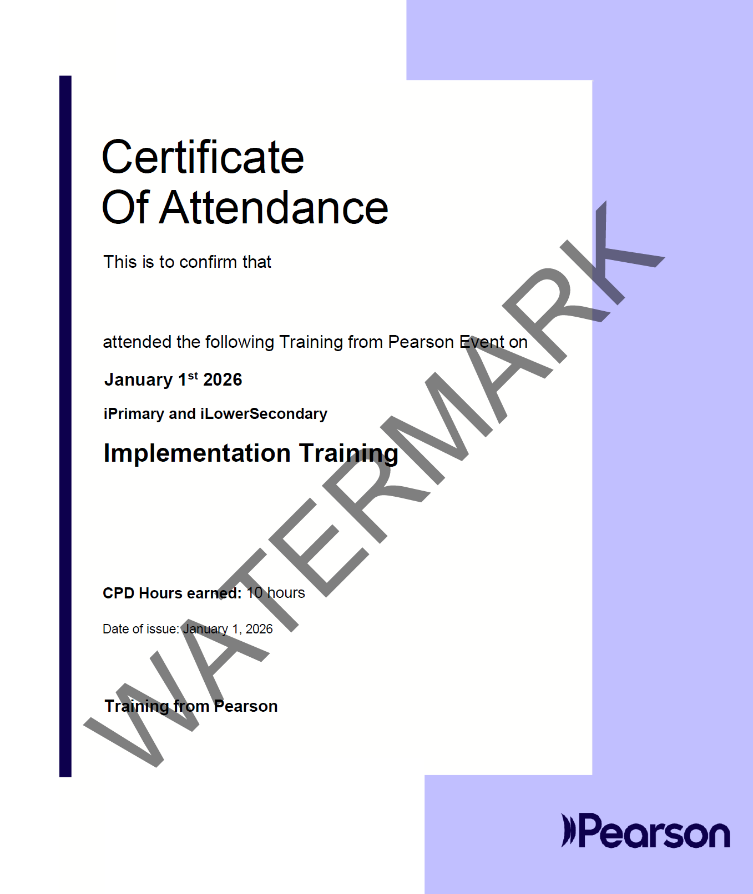

Certification and Digital Badging
iPLS Professional Development Guide – certification and digital badging
All iPLS Courses carry a certificate of completion and a digital badge.
These are presented digitally upon completion of the training courses.

Slide 55
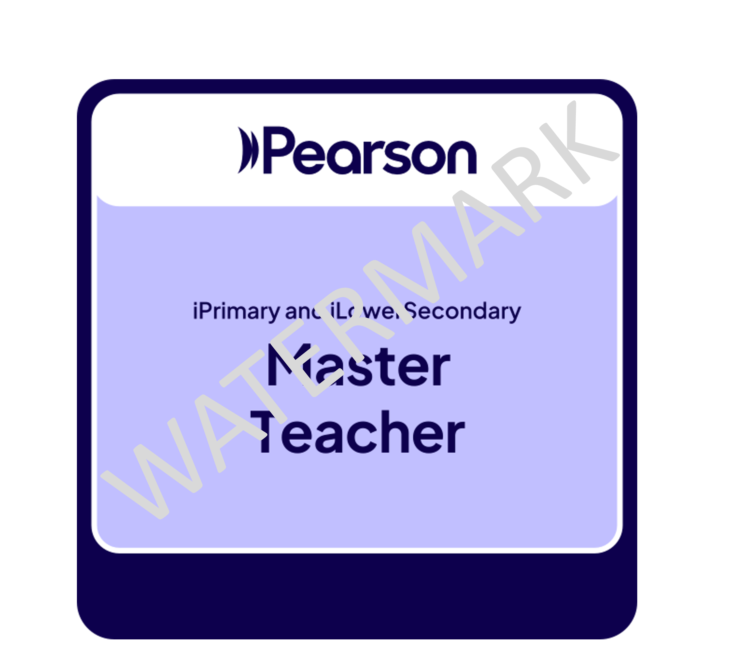
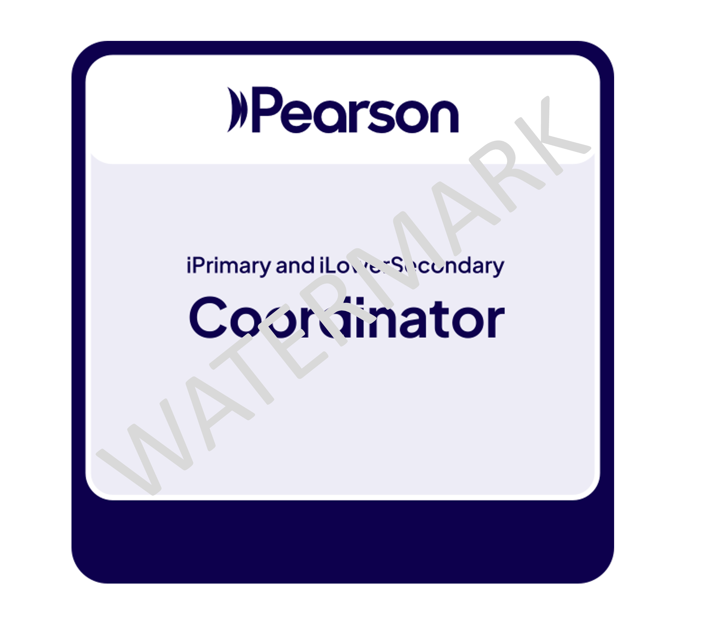
iPLS Master Teacher & iPLS Coordinator​
iPLS Professional Development Guide – iPLS Coordinator and ipls master teacher
iPLS Coordinator
iPLS Master Teacher
Earn the Edexcel, iPLS Master Coordinator Badge by becoming a Coordinator who has demonstrated their skills at applying and supporting ongoing professional learning for teachers in their schools to implement iPLS.
iPLS Master Teachers have demonstrated their skills at applying their knowledge and skills developed through the iPLS Implementation Training Programme and iPLS Continuous Professional Development into their classrooms effectively.
For more information on how to obtain the iPLS Master Teacher and/or iPLS Coordinator certificates and badges, please ask your local Pearson representative to be put in contact with the iPLS Professional Development Manager.

Slide 56
Additional Training available to iPLS Schools

Slide 57
Pearson Edexcel Ready!

Slide 58
Pearson Edexcel Ready!
Pearson Edexcel Ready! is a comprehensive and accessible professional development resource for educators working with Pearson Edexcel's suite of international qualifications—from Early Years through A Level. It's particularly suited for those seeking flexible, accredited training to integrate these curricula and prepare students effectively for assessments.
A self‑paced online course designed to support educators transitioning to or teaching within the Pearson Edexcel International Curriculum & Qualifications.
Structured into multiple practical modules, each focusing on a different educational stage or subject, and each awarding 3 hours of CPD upon completion, with a certificate.
Delivery | Fully self‑paced online
Cost | Free
CPD Hours | 3 hours per module with certificate, 27 hours in total.
Audience | International Early Years → A Level educators
Content | Curriculum structure, teaching methods, exam prep, subject-specific pedagogy

Slide 59

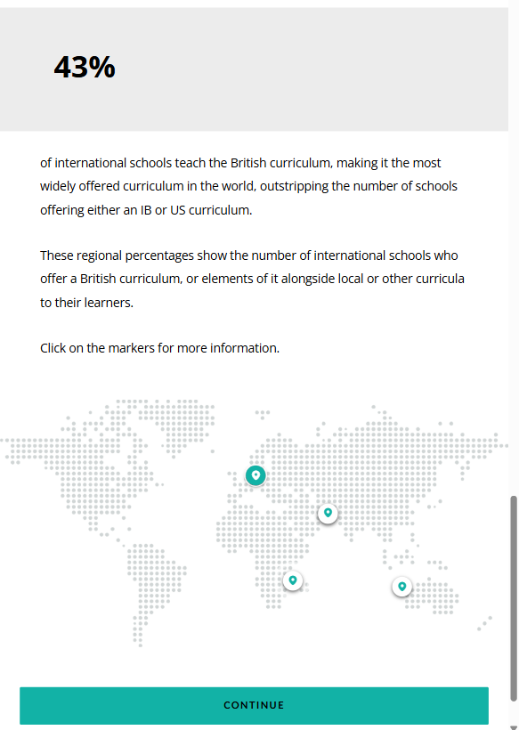
Teaching Support
Mix & Match
Pearson Edexcel Ready! Is a self-study course for teachers of bilingual and international schools making transitions from their current qualifications to Pearson Edexcel.
8 Modules to chose from allowing you to mix and match the course to support your specific needs.
Interactive
Self-Study
Interactive activities, downloadable action plans, knowledge checks and quizzes ensure you fully engage and understand the content of the course.
There are 8 modules in total, each 3 hours in length. You can plan to study these modules at a time and pace that suits you.
On the go
Easy to access
Pick up exactly where you left off. The platform will signpost your last activity, so you can return at a time and place that suits you.
Mobile, Tablet, Laptop and computer compatible.
Easy access using your EOL account. If you do not have an EOL account, you can create a free account in a few easy steps on the Pearson Professional Development Platform.

Slide 60
Pearson Edexcel Ready Modules
1
2
3
4
5
6
Pearson Edexcel Ready!
Welcome to Pearson
Pearson Edexcel Ready!
Teaching Pearson Edexcel iPrimary and iLowerSecondary
Pearson Edexcel Ready!
Teaching Pearson Edexcel in English
Pearson Edexcel Ready!
Teaching Pearson Edexcel International Early Years
Pearson Edexcel Ready!
Teaching Pearson International GCSE & International A level
Pearson Edexcel Ready!
Understanding Pearson Edexcel Exams

Slide 61
Pearson Edexcel Ready! Additional Modules
1
2
Pearson Edexcel Ready!
Teaching using Pearson International Primary Science
Pearson Edexcel Ready!
Teaching using Pearson Power Maths

Slide 62




Hours
Certificate
Digital Badge
This course adds learning hours to your Continuous Professional Development (CPD) Journey.
A certitificate is available for each module. There are 9, plus an additional overall whole course compeletion certificate.
There are also digital badges available for all completed modules. There are 9, plus an additional whole course compeletion certificate.
18
10
10

Slide 63
Pearson Edexcel Ready! Module Links
Pearson Edexcel Ready! Understanding Pearson Edexcel Exams
Pearson Edexcel Ready! Welcome to Pearson
Pearson Edexcel Ready! Teaching Pearson Edexcel iLowerSecondary
Access here
Access here
Access here
Pearson Edexcel Ready! Teaching Pearson Edexcel International Early Years
Pearson Edexcel Ready! Teaching Pearson Edexcel International GCSE & International A Level
Pearson Edexcel Ready! Teaching using Pearson International Primary Science
Access here
Access here
Access here
Pearson Edexcel Ready! Teaching Pearson Edexcel iPrimary
Pearson Edexcel Ready! Teaching Pearson Edexcel in English
Pearson Edexcel Ready! Teaching using Power Maths
Access here
Access here
Access here

Slide 64
Mindfulness

Slide 65

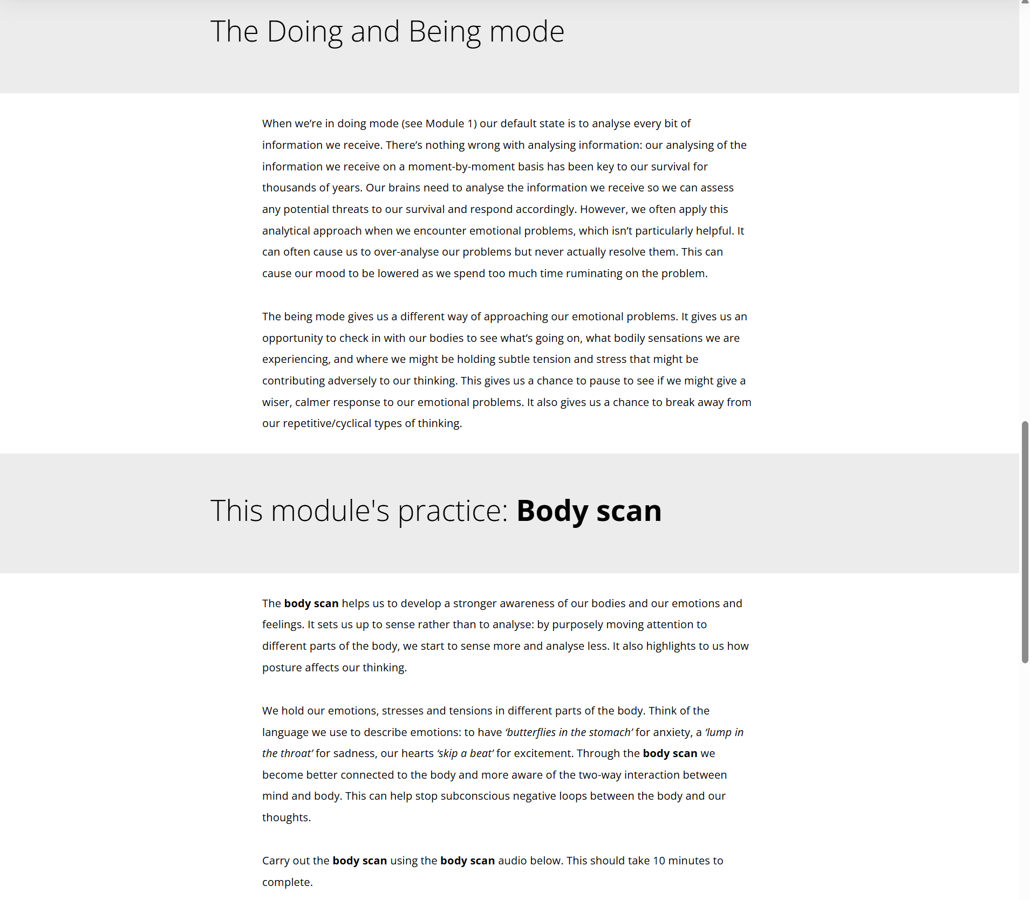
Mindfulness
This 4-week course will help enable you to build a habit of mindfulness to manage stress and anxiety and improve focus by moving away from ‘doing mode’ behaviours and towards ‘being mode’ behaviours.
Self-Paced
4-week course
Certification after course (+ digital badging)
No time limit
On the go
Pick up where you left off
Sign up via Wellbeing page
https://www.pearson.com/international-schools/why-choose-pearson/professional-development-and-training/wellbeing-courses-and-resources.html
Notes:
I’m delighted to introduce our new 4-week self-paced mindfulness course, designed specifically to support teachers like yourselves in managing stress and anxiety, and enhancing your focus throughout the school day. This course isn’t just another item on your to-do list; it’s about shifting from a constant ‘doing mode’ to a more present, mindful ‘being mode’, helping you find moments of calm amidst the busyness of teaching.
By participating, you’ll learn practical mindfulness strategies you can use both in and out of the classroom. Not only will this support your own wellbeing, but it will also help you create a positive ripple effect for your students. On completion, you’ll receive certification and a digital badge to recognise your commitment to self-care and professional growth. There’s no set time limit, so you can work through the course at your own pace, picking up right where you left off. Sign up today via the Wellbeing page and take the first step towards a more mindful, balanced teaching experience.
https://www.pearson.com/international-schools/why-choose-pearson/professional-development-and-training/wellbeing-courses-and-resources.html

Slide 66
Pearson Professional Development Academy

Slide 67
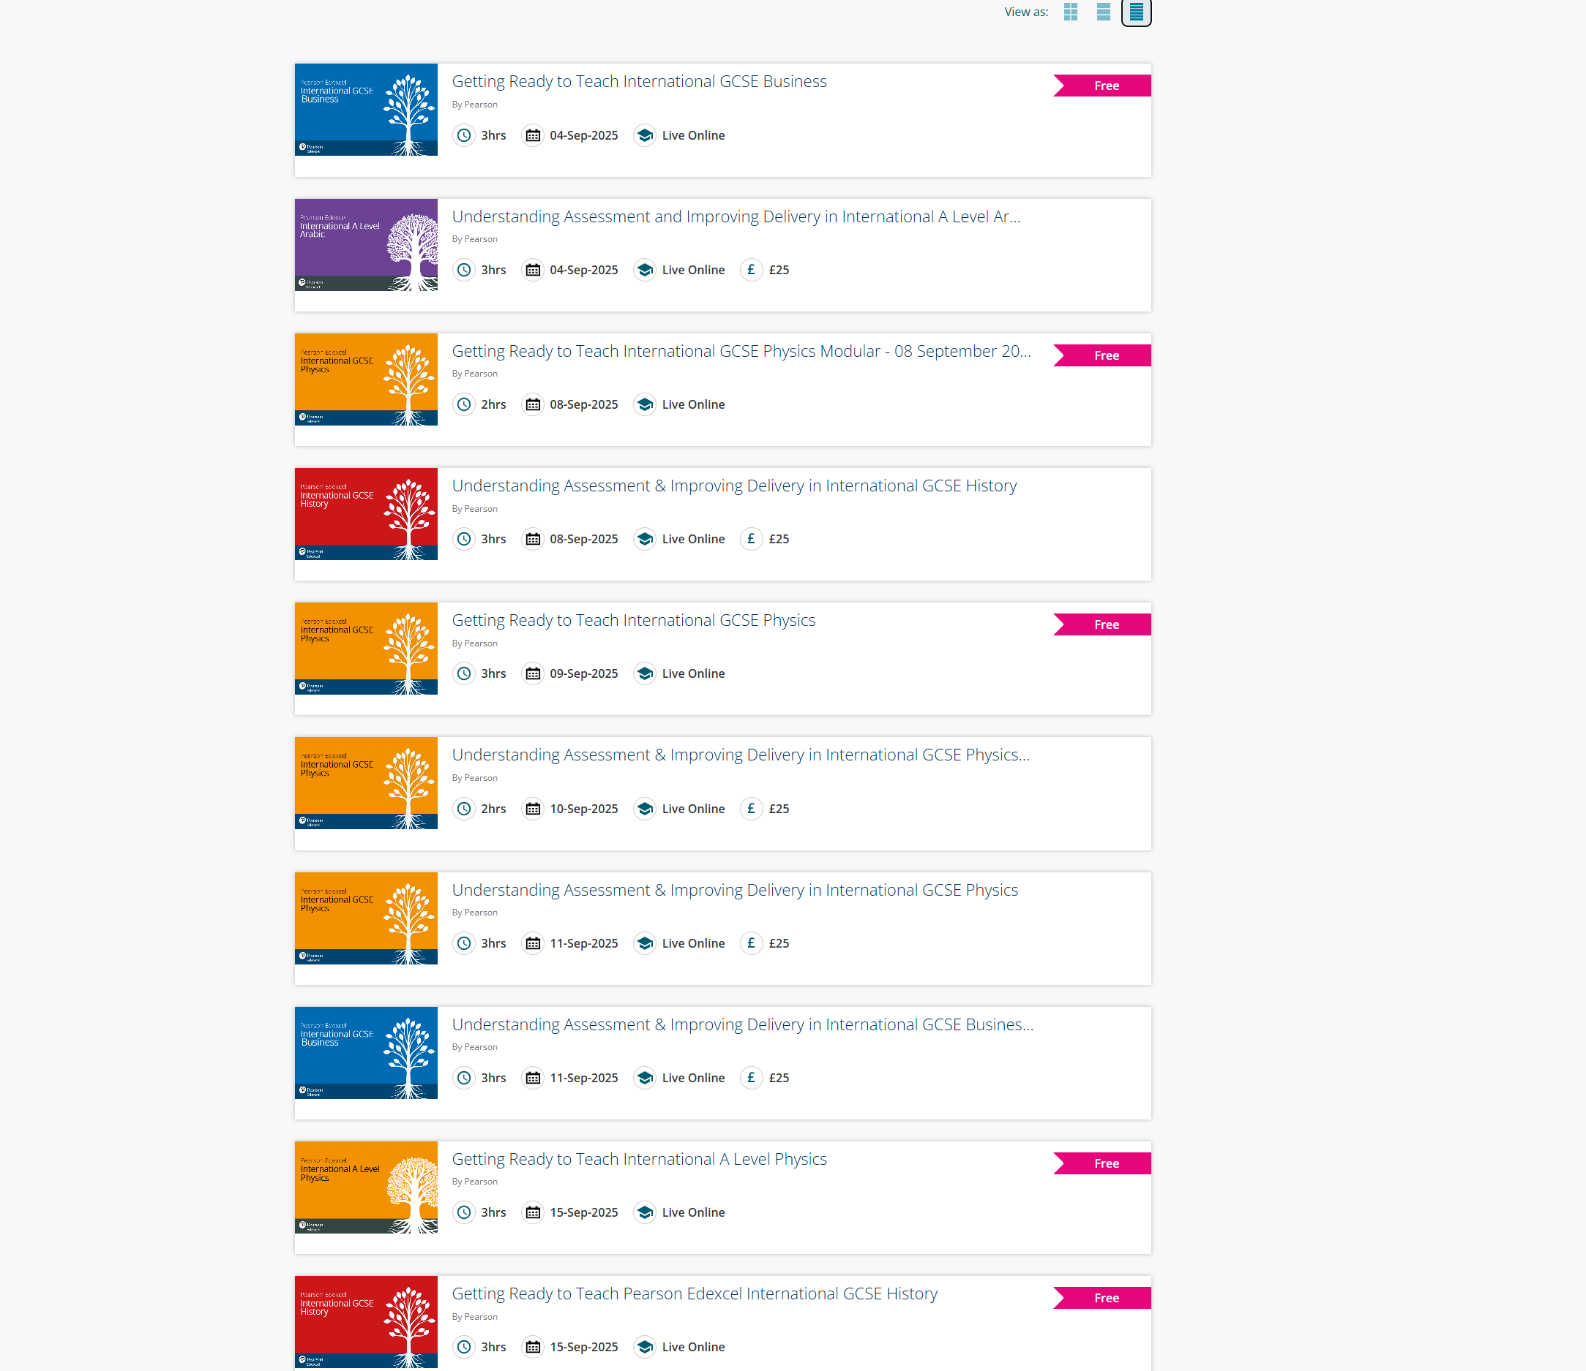
Empowering teachers through learning
We've developed the Professional Development Academy an online portal supporting teaching professionals.
You can discover courses that align with you teaching subjects (such as iPrimary, iLowerSecondary, International GCSE, and International AS/A level) to assist students, acquire new skills, and advance your career.
Access quality on-demand, live, and self-guided courses for flexible learning at your convenience.
Notes:
The Pearson Professional Development Academy is a valuable resource for teachers looking to enhance their skills, stay current with educational trends, and strategically plan their professional development.
This platform is designed with educators in mind, offering a wide range of CPD courses that span primary, secondary, and international curricula. Whether you're teaching International GCSE English, International Primary Science, International A level Languages, or a GCSE or A level, there's something here for you.
What makes the Academy stand out is its flexibility. You can choose from live online sessions, face-to-face workshops, or self-paced courses — all tailored to fit around your busy schedule. And if you miss a live session? No problem. Recordings (of some sessions) are available so you can catch up whenever it suits you.
It’s also a great tool for planning your development journey. With structured pathways and a calendar of upcoming events, you can map out your CPD goals for the term or even the whole year. Plus, if you're not sure where to start, Pearson’s consultants are on hand to help you identify the most relevant courses for your role or department.
Whether you're new to teaching or stepping into leadership, the Academy offers practical, actionable training that you can take straight into the classroom. It’s about empowering you with the tools, strategies, and confidence to keep growing professionally.
So if you haven’t explored it yet, I encourage you to take a look at pdacademy.pearson.com and see how it can support your development goals.
For all enquiries, please visit the Pearson Support Portal.
The following links directly relates to queries regarding Training,
https://support.pearson.com/uk/s/training-from-pearson

Slide 68
How to register
You find a course via the Pearson PD Academy website, using the various filters.
Click on the event you would like to attend.
Click the ‘Register’ button on the Summary Page of the event. Take note of the booking guide at the bottom of each summary event page. This provides information on if you would like to register multiple teachers or to amend/cancel your booking.
Fill in all necessary information,
    if the course is paid for, you will have two options at this point,
        Pay by credit card immediately,
        Pay by invoice 30 days after the event, this invoice is sent to your school.
You will receive an email confirming your registration, containing the following information,
  If online, the date and time and Zoom link for you to click on to join the training.
  If In-Person, the date, time and venue information & any additional information necessary.
You will receive reminders of the training and will be provided with options to amend or cancel your booking if needed.
You attend training.
Feedback and Certificates sent out based on your completion of the training.
Notes:
How to register – you can read out as is.
Simply put, via the PD academy and follow the steps

Slide 69
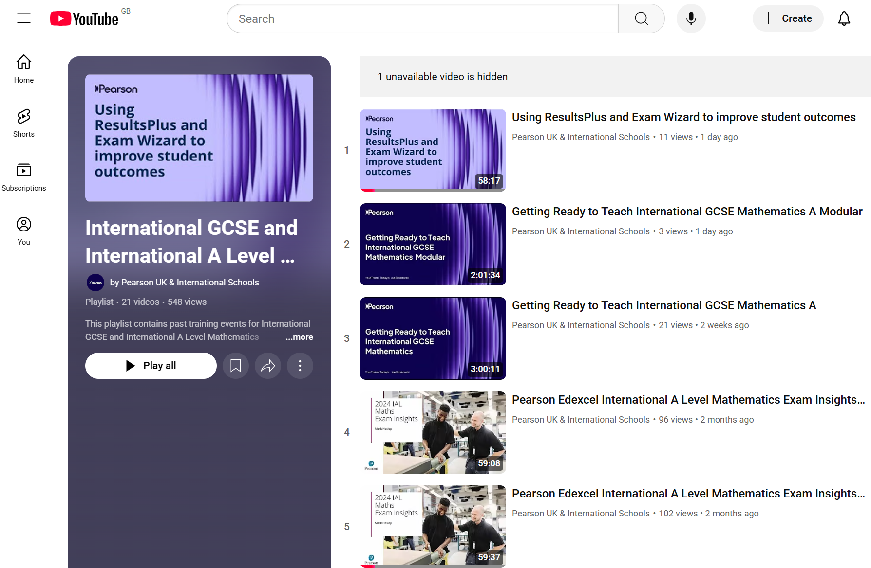
YouTube Channel
838
Videos on Pearson UK & International Educators YouTube Channel
23
Interational GCSE & International A Level Playlists
34
UK GCSE & A Level Playlists
Notes:
www.youtube.com/@PearsonUKIntSchools
International Playlists are available per subject (I.e. International GCSE and International A Level Physics)
UK Playlists are available per qualification (I.e. GCSE Physics)
These playlists are packed with expert-led CPD sessions, webinars, and training videos designed specifically for teachers. Whether you're teaching GCSEs, A Levels, or international qualifications, you'll find content that’s relevant, practical, and easy to apply in your classroom.
One of the best things about this resource is its flexibility. You can watch sessions on your own time — during a free period, after school, or even on the weekend. If you missed a free live event, no worries — the recordings are there, ready when you are.
The videos cover a wide range of topics: from marking masterclasses and curriculum updates to strategies for supporting EAL learners and developing leadership skills. So whether you're just starting out or stepping into a leadership role, there’s something here for you.
It’s also a great way to plan your CPD journey. You can use the playlist to explore areas you want to grow in, build your confidence, and even share useful sessions with colleagues to spark discussion and collaboration.
So if you haven’t already, I encourage you to check it out. Just head to the Pearson PD Academy YouTube playlist — it’s free, accessible, and designed to support your growth as an educator.

Slide 70
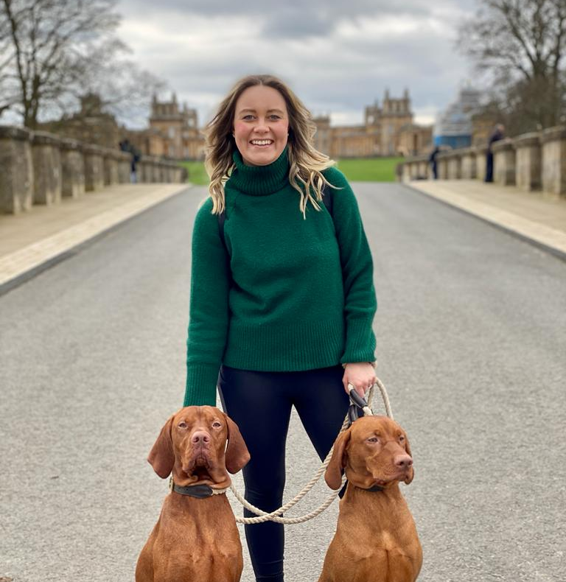
Thank you!
As a Professional Development Manager, I’m passionate about empowering educators to thrive in their roles and improve student outcomes. Teacher training is vital—it equips teachers with the tools, confidence, and support they need to deliver high-quality learning experiences.
I enjoy working with the examining teams and teachers to create training that is not only pedagogically sound but also responsive to the needs of educators—whether through live sessions, self-study modules, or collaborative workshops. I take pride in fostering environments where teachers feel supported, heard, and equipped to tackle challenges with confidence.
It’s about building relationships, nurturing growth, and ensuring that every educator—regardless of location or background—has access to the professional development they need to succeed.
Stacey Roberts-Brighton
International Professional Development Manager
Notes:
A message from the PD Manager for teachers engagement with the training courses we offer.

