Slide 1

English Language
Live Lesson
Lesson 6
Technical Accuracy
June 2020
1

Slide 2

Introduction
I am Rebecca White and I will be hosting the session today. I am a Head of English and my aim is help you improve the technical accuracy of your writing.
For today’s session all you will need is a pen and some paper.
You may also find it useful to have a dictionary to hand.

Slide 3

Community Rules
We take safe-guarding seriously and we expect everyone to treat each other with respect.
We will take appropriate actions if we feel this is needed.

Slide 4

Creating an Effective Narrative
Image by Nathalie Lees
Punctuation – Accuracy and Effect
Sentence Variation
Spelling and Vocabulary
Paragraphing
Proof-reading and Editing

Slide 5

How this will work….
Any sentence written in blue indicates an activity for you to do. For example:
Write down a list of all the different forms of punctuation you can think of.
2) Any task written in purple is designed to be more of an extension task. These are tasks that are more challenging and ones you may want to revisit after the lesson.
3) Key terms will be written in red. There will be a glossary of these terms at the end of each lesson as well as explanations as we go along.

Slide 6
Punctuation – Accuracy and Effect

Slide 7
Using punctuation
In your exam your use of punctuation will be judged on two main elements:
1. Using punctuation accurately.
2. Using punctuation for effect.
Look at the forms of punctuation below.
How would you rate your confidence to use these accurately?
Full stop . | Question mark ? | Apostrophe ’ | Dash –
Comma , | Exclamation mark ! | Colon : | Brackets ( )
Capital letter A | Speech marks “ ” | Semi-colon ; | Ellipsis …
Notes:
You may wish to print this grid and ask students to label the forms Red, Amber or Green, according to how they feel about their ability to use them accurately. They can then edit this PowerPoint accordingly.

Slide 8
Punctuation and accuracy
Capital letter
  Capital letters are always used at the start of sentences. They are also used for proper nouns, e.g. the names of people or places. The days of the week and the months of the year also start with capital letters, as do festivals such as Christmas, Diwali and Eid.
  You also need capital letters at the start of the names of languages and nationalities, e.g. French, German, Tamil, Italian, Urdu, Chinese.
  When writing about yourself, “I” is always a capital letter, e.g. “At nine, I walked home.”
Full stop
  A full stop is used to end a sentence. A full stop should always be followed by a capital letter at the start of the next sentence.
Notes:
Obviously, some students will know all of this and write with tremendous accuracy already. Some might need more support than others. Please adapt as required by your group.

Slide 9
Full stops and capital letters
This text is missing a number of capital letters and full stops. Can you spot where they should go?
  susan wondered if she could avoid her mum and just sneak out to school she really didn’t want to start her day answering loads of questions
  “mum,” she called “i’ve got to be in school early because of my spanish test i’ll see you later”
  “alright susan have you got your lunch?”
  “yeah”
Notes:
You can tell students how many things are missing at the start of the activity, or in the middle so they can double-check, or at the end.

Slide 10
  Did you spot them all?
  Susan wondered if she could avoid her mum and just sneak out to school. She really didn’t want to start her day answering loads of questions.
  “Mum,” she called. “I’ve got to be in school early because of my Spanish test. I’ll see you later.”
  “Alright Susan. Have you got your lunch?”
  “Yeah.”

Slide 11
Punctuation and accuracy – commas
  There are many ways to use commas and therefore many ways to use them incorrectly.
  Commas can be used in the following ways:
  To separate items in a list: “I need eggs, sugar and flour.”
  To separate direct speech from the rest of the sentence: “I will be there,” she said.
  To create an embedded clause when adding additional information in a sentence, e.g. “My best friend, who lived just around the corner, was always willing to listen.”
  To follow a co-ordinating conjunction that joins two clauses together: “Motorways in Britain are usually free to use, but the M6 near Birmingham does charge a toll.”
  After an adverbial phrase at the start of a sentence: “After lunch, Sue started reading her new book.”
Notes:
This is not an exhaustive list. The University of Sussex has a student-friendly guide and some students may have additional ideas from their lower years.

Slide 12
Where should the commas go?
Bob was furious. It had been three hours and he still didn’t have the things he needed to complete the job. He’d sent his son out for some nails a hammer and a saw but the boy had returned with nothing.
After this failure Bob asked his wife Susan to get the items from the DIY store. She told him she was too busy.
“I just need some nails” begged Bob. His arms were aching from holding up the broken shelf and he longed for a way to fix it so he could finally go to the loo.
Notes:
There are six commas missing.

Slide 13
Did you get them all?
Bob was furious. It had been three hours and he still didn’t have the things he needed to complete the job. He’d sent his son out for some nails, a hammer and a saw, but the boy had returned with nothing.
After this failure, Bob asked his wife, Susan, to get the items from the DIY store. She told him she was too busy.
“I just need some nails,” begged Bob. His arms were aching from holding up the broken shelf and he longed for a way to fix it so he could finally go to the loo.

Slide 14
Question marks
Question marks indicate when a question is used.
Sometimes these questions start with words such as how, what, where, when and why, e.g. “Where are we going?” “When will we get there?” “Why are we driving so slowly?”
Sometimes they start with variations of the verbs to be, to do or to have, e.g. “Is there anything I can help you with?” “Do you like chicken?” “Have you eaten anything today?”
Sometimes writers use question marks at the end of different types of phrases to reflect the intonation of the speaker, e.g. John couldn’t believe it. “Mike really did that?” he gasped.

Slide 15
Exclamation marks
Exclamation marks should be used sparingly and only when trying to achieve a specific effect.
They should only be used one at a time!
They can be used to show when someone is shouting loudly, e.g. “Help!” Brian yelled.
They can also be used to show emphasis of a specific point in the text, e.g. “It was the best day ever!”
However, if they are overused, they become less effective, so use them carefully.

Slide 16
Questions and Exclamations
Question marks and exclamation marks act like full stops and will need to be followed by a capital letter.
Look at the following text. You are only allowed to place one question mark and one exclamation mark in this paragraph, where would you put them?
He was stuck. There was no doubt in his mind that he was thoroughly, completely and utterly stuck. What a stupid thing to have happened. How could he have let himself get into this situation. What an idiot.
Notes:
Encourage students to think about how the exclamation marks help to show the emotions of the protagonist. The first exclamation mark demonstrates his panic and frustration and the second exclamation mark shows how angry the protagonist is with himself..

Slide 17
Questions and Exclamations
While the question mark is quite straightforward to place, you have a choice of place for the exclamation mark. Where did you put it?
What effect do the different positions have on the tone of the text?
He was stuck. There was no doubt in his mind that he was thoroughly, completely and utterly stuck. What a stupid thing to have happened. How could he have let himself get into this situation? What an idiot.
Notes:
Encourage students to think about how the exclamation marks help to show the emotions of the protagonist. The first exclamation mark demonstrates his panic and frustration and the second exclamation mark shows how angry the protagonist is with himself..

Slide 18
Punctuating dialogue
Using dialogue can be an effective way to increase your range of punctuation and present your character to your reader. However, it is vital that you punctuate it accurately.
Speech marks go around what has been said.
Punctuation that is linked to what has been said is placed inside the speech marks.
“Help!” shouted Sam.
“What’s wrong?” asked Max.
“I’ve fallen off the ladder,” Sam replied.
If no other punctuation is needed, a comma is used to separate direct speech from the rest of the sentence.
Notice that every time a different person speaks, a new line is used.

Slide 19
Why take the risk?
Dialogue punctuation is an area that many people find difficult and errors often occur.
However, it can be a really useful tool in developing the narrative as well as revealing something about the characters.
What information do you get about the character from this single line of dialogue?
“You really expect me to eat that? Like really? You having a laugh?”
Notes:
Encourage students to think about how it helps exaggerate the narrator’s sense of disbelief.

Slide 20
Ellipsis
Ellipsis serves a number of different functions. Its two main functions are:
To show where words have been omitted in a quotation, e.g. “It was undoubtedly the single most ridiculous, mindless and stupid thing I had ever done” becomes “It was…stupid.”
To show that there is a pause in speech, e.g. “ ‘I just…well, I wanted to…I.’ I stuttered and stumbled over my words.”

Slide 21
Combining Ellipsis and Speech
Look at the following extract. What effect does the use of ellipsis have on the reader?
“It looks like a…like a…a dragon.” That was the only word for it. The massive lizard that Cressida had spotted was the size of a mythical beast.
Notes:
Encourage students to think about how it helps exaggerate the narrator’s sense of disbelief.

Slide 22

Developing a Conversation
Two friends meet for coffee. One person has the perfect cup of coffee. The other’s tastes absolutely vile. Write the conversation between them as a way of practising using dialogue punctuation accurately.
Notes:
Encourage students to think about how it helps exaggerate the narrator’s sense of disbelief.

Slide 23

Apostrophes
Apostrophes have the following uses:
To show omission
  When a letter is omitted, e.g. do not becomes don’t, is not becomes isn’t
To show possession – singular
  To show that something belongs to someone or something, e.g. John’s bag, the dog’s paws
To show possession – plural
  If there is more than one owner, the apostrophe comes after the s, e.g. The kittens’ bed means the bed that belongs to two or more kittens.
To show possession – words ending in s
  If the word refers to one thing or person, it will usually be written like this: The boss’s phone was ringing.
  If the word refers to more than one thing or person, it will usually be written like this: The bosses’ meeting was cancelled.

Slide 24

Can you spot the apostrophe errors in this extract? How would you correct them?
The Jon’es dog had broken out of the back gate and was running all over Mr Smiths’ flower’s. He was furious. “Cant you keep that dog under control?” he yelled from his front door as he watched his flower’s roots being destroyed by the frantic digging of the energetic puppy.

Slide 25
The first line should read The Jones’ dog as it is the dog that belongs to the Jones family.
Can’t is the contracted version of cannot and therefore needs an apostrophe to show omission.
The Jon’es dog had broken out of the back gate and was running all over Mr Smiths’ flower’s. He was furious. “Cant you keep that dog under control?” he yelled from his front door as he watched his flower’s roots being destroyed by the frantic digging of the energetic puppy.
There is only one Mr Smith in this text and therefore the apostrophe needs to go before the s to show possession.
In this case, the roots belong to multiple flowers and therefore the apostrophe needs to be placed after the s.
This is a plural and therefore does not need an apostrophe.

Slide 26

Colon and semi-colon
A colon can be used to introduce a list, an example or thing.
  To make a cake you need: eggs, flour, butter and sugar.
  I could just make out what it said beneath the dust: Poison.
A semi-colon is usually used to join two clauses that could be separate sentences, often to show that the ideas are connected to each other.
  Jamal was tired; the baby had kept him awake all night.
  Carol couldn’t believe Sam had served her cottage pie; he knew she was a vegetarian.
Notes:
This is a very simplistic explanation and is designed to help students master the basics of this more advanced form of punctuation.

Slide 27
Using Colons and Semi-Colons with Confidence
As part of your revision, you should practise creating sentences using colons and semi-colons that you can then recreate in whatever piece of writing you are creating.
For example, It was the one person I____________: ___________.
It was time to _________________; I had to ___________________.
Notes:
This is a very simplistic explanation and is designed to help students master the basics of this more advanced form of punctuation.

Slide 28
Dashes and brackets
Both dashes and brackets create parenthetical clauses. These are clauses which offer additional information to the reader but can be left out of a sentence without disrupting the meaning.
The majority of the club’s supporters – a whopping 85 per cent – signed the petition to keep the stadium open.
The club’s supporters (with the exception of one or two absent members) signed the petition to keep the stadium open.

Slide 29
Why use brackets or dashes?
Look at these two sentences. How does the use of brackets or dashes affect the tone of the sentences?
Uncle Jimmy (a former detective, though he never told anyone) looked at her with a cold and calculating eye.
It was a sharp pain – like ripping tape off a hairy leg – and she winced visibly.

Slide 30
Sentence Variation

Slide 31
Punctuation and effect
  The main way to use full stops for effect is to create different types of sentences.
  There are four main types of sentence:
Minor sentence or fragment – a sentence which usually does not have a main verb in it but still conveys meaning e.g. Where is he? No idea.
Simple sentence – a sentence which is made up of a single main clause.
Compound sentence – a sentence made up of two main clauses joined by a conjunction.
Complex sentence – a sentence made up of at least one main and one subordinate clause.
Notes:
Please use whichever terminology your students are familiar with for the fragment/minor sentence. Talk through the structure with them about the sentences.

Slide 32
Punctuation and effect
  Consider the effect of having a variety of sentences in a single paragraphs.
  There are four main types of sentence:
  fragment/minor sentence
  simple sentence
  compound sentence
  complex sentence.
Jim walked out the door. He pulled his blazer tightly around him and began to walk towards Jared’s house. Just in case his mum happened to look out of the window, he walked a little quicker than normal and tried to think about how he was going to get his coat back from Michaela. His brand new coat.
Notes:
Please use whichever terminology your students are familiar with for the fragment/minor sentence. Talk through the structure with them about the sentences.

Slide 33
Ways to start a sentence
Nouns and Noun Phrases e.g. The dog barked at the postman. Seagulls flew overhead.
Pronouns e.g. It was cold. He put his coat on. I put my hat on.
-ing starts e.g. Muttering loudly, he huffed off.
Adverbs e.g. Slowly, I looked over the fence.
Subordinate clause e.g. After the fair, we spent two hours trying to get home.

Slide 34
Rewrite this extract so that it uses a variety of sentence starts. Check that the punctuation is accurate once you’ve finished.
I woke up and instantly shivered. I had never felt so cold. I was aware that this was not normal. I normally woke up feeling warm and toasty under my duvet. I knew that today was different as I could no longer feel my toes. I knew they were just numb with cold so I didn’t worry too much.

Slide 35
Spelling and Vocabulary

Slide 36

Strategies for Boosting Vocabulary
Synonym – a word that has a related meaning to another word. For example, huge and massive are synonyms of big.
Look at this image of a haunted house. Try to come up with as many synonyms as you can for ‘scary’.

Slide 37


Stealing Words
You may spot words or phrases in the texts from the reading section of your exam that you think are interesting or useful for your own piece.
Do not worry about stealing those words. Use the text to help you get the spelling right.
Just check for Americanisms!

Slide 38
Strategies for Boosting Vocabulary
A useful tip
Choose up to 10 words that you overuse in your writing. Try and find some useful synonyms for those words that are easy to spell. Practise using them in a variety of sentences.
Suggestions:
Scary
Exciting
Big
Small
Amazing

Slide 39
Paragraphing

Slide 40
Paragraphing
You MUST use a paragraph when you change:
Topic
Person (speaking, description or viewpoint)
Time
Place
For the highest marks, your paragraphing needs to be accurate and deliberate.

Slide 41

Paragraphing for Effect
On the one hand, Carlos had the best design and the most impressive idea, but he was always so difficult to work with. It was as if he needed to have a row with everyone before he could even begin and finding people to put up with his tantrums was getting increasingly challenging.
On the other hand, finding people to work with Leo would be no problem at all. He was just such a friendly person and made every member of the team feel like they were valued and respected. Every project he had ever worked on had come in on time and under budget but the design he had submitted this time was just…well…dull. There was no other word for it. It certainly wouldn’t get us the recognition we so desperately needed.
It was a tricky decision.
How does the paragraphing help present the idea
that the decision is difficult?

Slide 42
Proof-reading and Editing

Slide 43

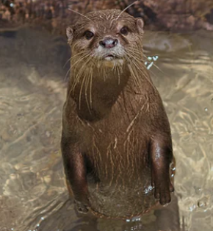

Checking your work
Checking your work takes time – approximately 2-3 minutes per page!
Check through something else first.
Give yourself a mental ‘walk away’.
Use a ruler to keep you focused.
Identify your weak spots beforehand.

Slide 44
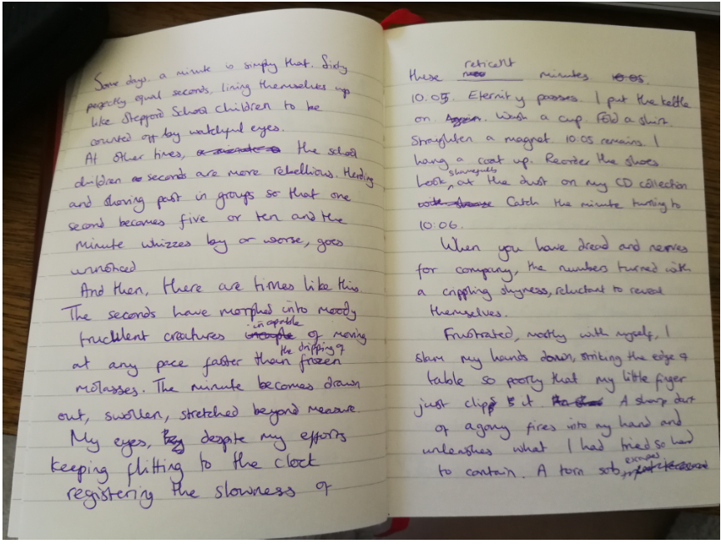
Editing is a messy business

Slide 45

This is an example of ‘editing as you go.’ I changed my mind about a sentence and scribbled out the start I made.

Slide 46
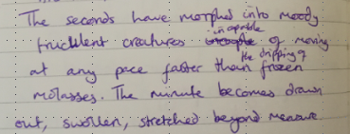
These two changes occurred as a result of proof-reading. The first, I simply missed out letters when writing incapable. This is something I do a lot when writing quickly so I always try and look out for it.
The second, I wanted to develop the image a little so I added extra words.

Slide 47

This is a strategy I use if I get stuck on a word. I simply put a faint line so that I can spot it easily when I go back and check my work. In an exam, I would use a simple word and then go back and upgrade if I had time.
Here, I realised I should have started a new paragraph as I was writing and so edited it as I was going along. If I had missed it, I could have used // when I read back through my work.

Slide 48
Review

Slide 49

What to consider…
Make sure you know how to use a range
of punctuation accurately
Practise regularly
Vary your sentence structures and starts
Work on your vocabulary
Practise paragraphing
Develop your editing strategies
Always leave time to check your work

Slide 50
Glossary of Key Terms
Minor sentence or fragment – a sentence which usually does not have a main verb in it but still conveys meaning e.g. Where is he? No idea.
Simple sentence – a sentence which is made up of a single main clause.
Compound sentence – a sentence made up of two main clauses joined by a conjunction.
Complex sentence – a sentence made up of at least one main and one subordinate clause.
Synonym – a word that has a related meaning to another word.

Slide 51

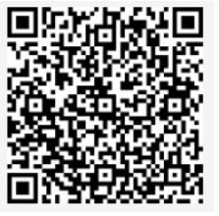
Feedback Form
Please complete the feedback form – you will find the link in the description for this video or you can use the QR code.

Slide 52

THANK YOU!

