Slide 1
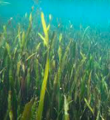
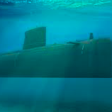
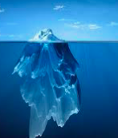
This is the closest I have come to feeling submerged

Slide 2
Lockdown by Simon Armitage
And I couldn’t escape the waking dream of infected fleas
Weekly Webinar 4
Literature focus
7th May 2020
GCSE (9-1) English

Slide 3
Agenda
Check-in
Update/feedback
Online resources
Literature ideas and resources of the week
Tea break – time to discuss, share and energise
Preview of new resources.

Slide 4
Feedback
This week:
Literature
Poetry focus
Some shared resources from you
Next week:
Language
Shout out for help from you:
More resources to be shared please!

Slide 5
Check-in
What is your biggest issue when teaching poetry in the classroom?
How have you approached teaching poetry remotely?

Slide 6
GCSE (9-1) English
Online resources

Slide 7
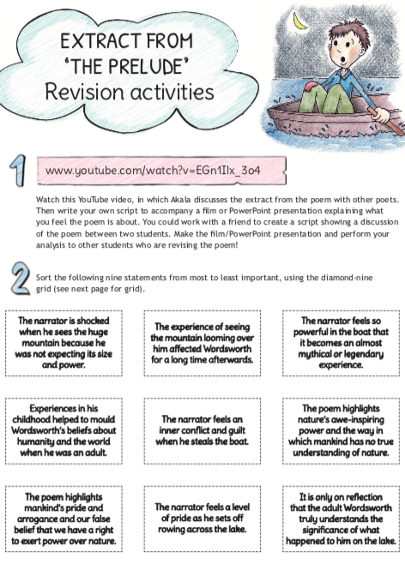
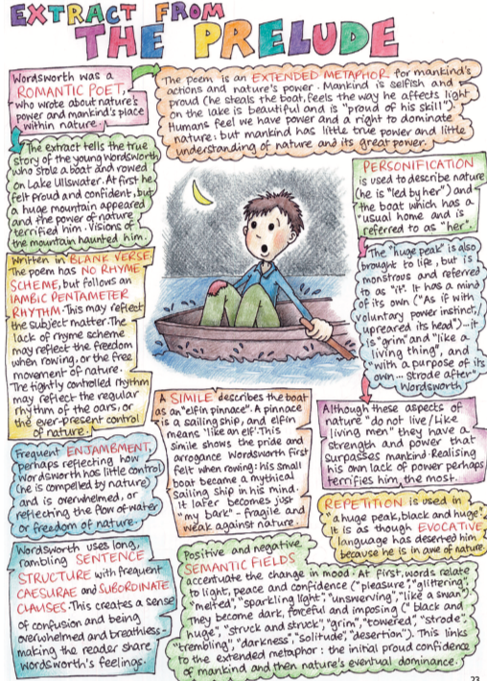
Teachit freebies

Slide 8
Teachit cruncher
after again air bamboo bedspreads boundary brimming brought came camel cattle cloth cloud cock-eyed coins couldn’t courtship cranes creeks dark dice dream dreamt earthly either elephants embroidered emmott escape exiled eyam fan-tailed fleas flower followed forests glistening hearth hedges hieroglyphs holes hypnotically infected journey like line long longer lost lotus lovers map meadows mind necessarily necklaces olde painted passing peacocks peaks plagued ponderous purging quarantine rain rare river rowland see-through sending side six slept slow snow-hatted so soggy sorry spanned star-crossed stone story streams syddall tailor’s thimbles till time times torre tracks trails un-see vinegar waking warp waterfalls weft wide-winged wife wine word wordless yaksha ye

Slide 9
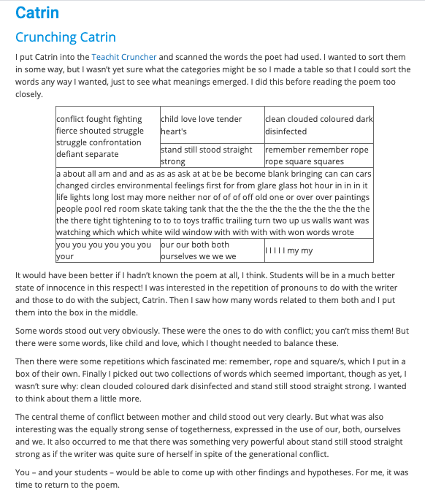
Teachit cruncher

Slide 10
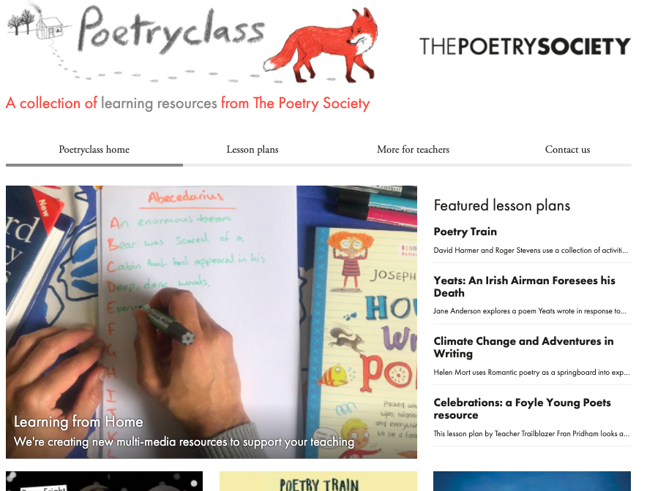
Poetry resources

Slide 11
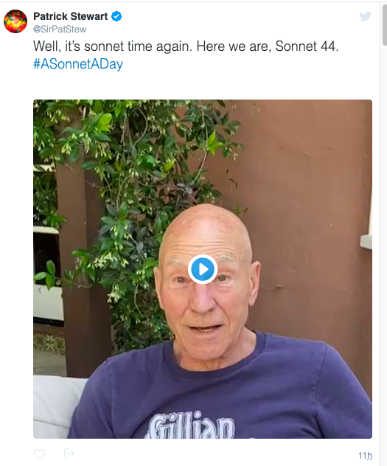
https://www.youtube.com/watch?v=cMXfrpukaIU

Slide 12
GCSE (9-1) English
Literature ideas and resources of the week

Slide 13
Poetry SPAG
A seemingly free and real sounding speach style is used by browning. This could reflect the duke, who’s character apears in many ways to be polite and amiable, for instance in the request ‘wilt ____ please ___?’ Yet this style does not completly hide his dominnering and controling personality as its evident early in the poem when...

Slide 14
This is the closest I have come to feeling submerged

Slide 15
This is the closest I have come to feeling submerged
How? has he chosen to tell us...
What? might the poet be telling us...
Why? has he chosen those methods, why has he chosen to tell us this...

Slide 16
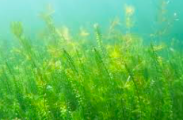
My crown sinks among the weeds

Slide 17
What’s in the Middle?
This is the closest I have come to feeling submerged
My crown sinks among the weeds

Slide 18
Unrequited love Find three things
Oh those lips that Love designed for kissing Are of such beauty and so soft to kiss. Yet Cupid’s arrow fired but keeps missing Our paths seldom cross and do often miss. I sometimes do view you dear from afar, From my seat in the town square I see thee. I pray you keep the door to your heart ajar For Cupid’s arrow to fly straight from me. But I see you with another bright flame Strolling through the town, your sweet heart’s delight. I have yet to know my heart rival’s name To challenge him to a duel, a lovers’ fight. Yet to hate him is wrong, I must succumb And wait for love to die, and hearts to numb.

Slide 19
Speed dating –
3 things to talk about
This the closest I have come
to feeling submerged. My crown
glitters wetly in the bathe of sunlight.
Koi fish suck kisses at my neck,
at the nook of my arms, behind
my knees, at the blue stems where
my blood whispers your name
in ultrasound. The deep music
of ocean, the company of algae,
cannot cover the chorus of need
that swishes and thrashes and bleeds.
I stare out, through the surface
of the water, to see if you see me
here amongst the reeds. You smile,
but only to admire your reflection.
My crown sinks among the weeds.
Oh those lips that Love designed for kissing Are of such beauty and so soft to kiss. Yet Cupid’s arrow fired but keeps missing Our paths seldom cross and do often miss. I sometimes do view you dear from afar, From my seat in the town square I see thee. I pray you keep the door to your heart ajar For Cupid’s arrow to fly straight from me. But I see you with another bright flame Strolling through the town, your sweet heart’s delight. I have yet to know my heart rival’s name To challenge him to a duel, a lovers’ fight. Yet to hate him is wrong, I must succumb And wait for love to die, and hearts to numb.
First meeting – what do they look like?

Slide 20
Poetry crunch
Oh those lips that Love designed for kissing Are of such beauty and so soft to kiss. Yet Cupid’s arrow fired but keeps missing Our paths seldom cross and do often miss. I sometimes do view you dear from afar, From my seat in the town square I see thee. I pray you keep the door to your heart ajar For Cupid’s arrow to fly straight from me. But I see you with another bright flame Strolling through the town, your sweet heart’s delight. I have yet to know my heart rival’s name To challenge him to a duel, a lovers’ fight. Yet to hate him is wrong, I must succumb And wait for love to die, and hearts to numb.
lips
beauty
arrow/missing
cross
afar
seat
pray
arrow
flame
strolling
rival’s
duel
succumb
numb

Slide 21
Model Paragraph
Short embedded quotations | I think Narcissus is about unrequited love and that this is evident from the start. The verb ‘submerged’ suggests the narrator is sinking beneath despair and the fact that he/she is ‘closest’ to this makes me think it has happened before, but he/she is now at breaking point. The feelings of despair are also evident... Similarly, ... | Close focus on question
Analysis of language |  | Subject terminology
Analysis of form/structure |  | Comparison

Slide 22
Since early middle-age (say around forty) I've been writing about ageing, poems in many registers: fearful, enraged or accepting as I moved through the decades.
Now that I'm really old there seems little left to say. Pointless to bewail the decline, bodily and mental; undignified; boring not to me only but everyone,
and ridiculous to celebrate the wisdom supposedly gained simply by staying alive. – Nevertheless, to have faith that you'll be adored as an ancient might make it all worthwhile.
Unseen poetry
How is age represented?
How much can you say about the shape of these poems?
The skin is wrinkled and speaks of age. I watch it change from year to following year
As hurrying life turns yet another page, And feel it as it drops another gear.
It’s not that bits have started to fall off,
Though annual checks will monitor decline. Occasional wheeze is now a chronic cough. Leg muscles wither though the brain seems fine.
The three score years and ten* are long-term past. And dreams of action close as I can get.
The body has mislaid that key word ‘fast’. And ‘slow’ or ‘creeping’ are a better bet.
It’s no good worrying at this lack of urge For life’s still sweet here resting on the verge.
When I am an old woman I shall wear purple With a red hat which doesn't go, and doesn't suit me. And I shall spend my pension on brandy and summer gloves And satin sandals, and say we've no money for butter. I shall sit down on the pavement when I'm tired And gobble up samples in shops and press alarm bells And run my stick along the public railings And make up for the sobriety of my youth. I shall go out in my slippers in the rain And pick flowers in other people's gardens And learn to spit. You can wear terrible shirts and grow more fat And eat three pounds of sausages at a go Or only bread and pickle for a week And hoard pens and pencils and beermats and things in boxes. But now we must have clothes that keep us dry And pay our rent and not swear in the street And set a good example for the children. We must have friends to dinner and read the papers. But maybe I ought to practice a little now? So people who know me are not too shocked and surprised When suddenly I am old, and start to wear purple.
Unseen
Poetry structure

Slide 23
Poetry structure
You want to write a poem to expose a powerful man who you feel is arrogant and domineering. You also suspect he may have killed his wife. Be careful – you want to show him to be self-serving, but he is smooth-talking and you need to reflect that. Will you use:
a sonnet
a ballad
a dramatic monologue
free verse

Slide 24
Poetry structure
You want to write a poem about a poor naive young girl who is seduced by a rich and powerful lord. When he tires of her, he callously casts her aside, leaving her pregnant and with nothing but shame.
Will you use:
a sonnet
a ballad
a dramatic monologue
free verse

Slide 25
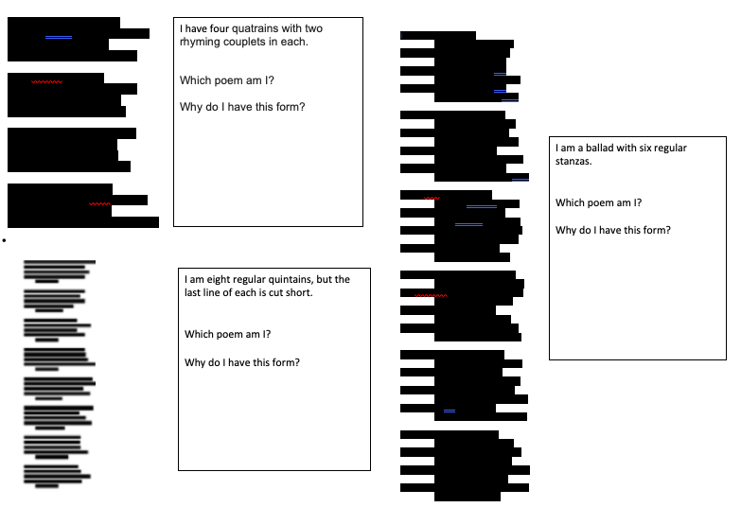
Poetry
structure

Slide 26
Model paragraph activity
Text reference | Both Owen and Tennyson use the thoughts of the soldiers to show images of war. In ‘Exposure’, Owen shows the fear and despair of the men through powerful images. The poet, who fought and died in the first world war, uses the opening stanza to describe the emotions of the soldiers to the reader. He describes how the fear makes ‘our brain ache’ as they wait in the dark ‘curious’ and ‘nervous’, but ‘nothing happens’. The repetition of the phrase throughout the poem underlines the futility of the war and the soldiers’ despair about being terrified in the trenches, waiting for something to happen. Tennyson also uses the thoughts of the soldiers to show images of war in ‘The Charge of the Light Brigade. Unlike Owen, he was not part of the charge, which was part of the Crimean war. Therefore his poem focusses on the heroic nature of the soldiers rather than his own experiences. He shows how fearless and resigned to their fate the men where with the alliterative phrase ‘theirs was but to do or die’. Unlike Owen’s soldiers who see war as futile, Tennyson’s soldiers see it as a noble cause and charge into battle even though they know the consequences of this. | Focus on the question
Analysis |  | Context
Comparison
 |  | Development

Slide 27
GCSE (9-1) English
Tea Break

Slide 28
Tea break
Your time to share ideas, inspire each other with great ideas or just say hello.

Slide 29
GCSE (9-1) English
Shared Resources

Slide 30
Thanks for sharing!
This week:
Nicola Durr
Joanne Taylor
Jinder Bains
Saira Bloomfield
Jo Tudor
We will send all these resources out to you after this webinar.

Slide 31
Sent in by Nicola Durr
Text Analysis Table
1. What can you say about the title of the text? | 2. Comment on the introductory sentence | 3. Find TWO adjectives in the first paragraph. Why has the writer chosen these? | 4. What person is the text written in? What effect does this have? | 5. Comment on the length of the sentences used in the text.
6. What genre would you say this text belongs to? | 7. Why do you think the writer has written this text? | 8. Identify the tone used. Is it friendly, neutral etc. | 9. When you read the first paragraph, how important do you think the setting is? | 10. Where is the text set? How do you know?
11. When is the text set? How do you know? | 12. Find a short sentence. What effect does this have? | 13. What is the theme of each paragraph? | 14. Find three words which give you an idea of the atmosphere | 15. What characters are in the text?
16. Find TWO adverbs. Why has the writer chosen these? | 17. Imagine you are the writer. How would you feel at the end of the extract? | 18. Imagine you are a character in the text. What are your thoughts? | 19. Find an example of a word not used today. Comment on the meaning. | 20. Choose two quotations that show the mood(s) of the narrator/character.
21. Comment on the length of the sentences used in the text. | 22. Does the writer expect us to identify with any character? How do you know? | 23. Imagine you’re explaining the text. Explain it in your own words. | 24. When you read the first paragraph, why do you think the character feels this way? | 25. You’re making a film of the text. What sort of music would you use to help to create the mood?
26. You’re teaching this session. What question would you ask about the use of language and sentences? | 27. Sum up the text in TEN words. | 28. How does the writer make us interested and engaged? Find TWO ways. | 29. Identify a quotation that gives an idea as to what may happen next. | 30. What do you think is the main purpose of this extract?
1. What can you say about the title of the text? | 2. Comment on the introductory sentence | 3. Find TWO adjectives in the first paragraph. Why has the writer chosen these? | 4. What person is the text written in? What effect does this have? | 5. Comment on the length of the sentences used in the text.
6. What genre would you say this text belongs to? | 7. Why do you think the writer has written this text? | 8. Identify the tone used. Is it friendly, neutral etc. | 9. When you read the first paragraph, how important do you think the setting is? | 10. Where is the text set? How do you know?
11. When is the text set? How do you know? | 12. Find a short sentence. What effect does this have? | 13. What is the theme of each paragraph? | 14. Find three words which give you an idea of the atmosphere | 15. What characters are in the text?
16. Find TWO adverbs. Why has the writer chosen these? | 17. Imagine you are the writer. How would you feel at the end of the extract? | 18. Imagine you are a character in the text. What are your thoughts? | 19. Find an example of a word not used today. Comment on the meaning. | 20. Choose two quotations that show the mood(s) of the narrator/character.
21. Comment on the length of the sentences used in the text. | 22. Does the writer expect us to identify with any character? How do you know? | 23. Imagine you’re explaining the text. Explain it in your own words. | 24. When you read the first paragraph, why do you think the character feels this way? | 25. You’re making a film of the text. What sort of music would you use to help to create the mood?
26. You’re teaching this session. What question would you ask about the use of language and sentences? | 27. Sum up the text in TEN words. | 28. How does the writer make us interested and engaged? Find TWO ways. | 29. Identify a quotation that gives an idea as to what may happen next. | 30. What do you think is the main purpose of this extract?

Slide 32
Make a story

Slide 33
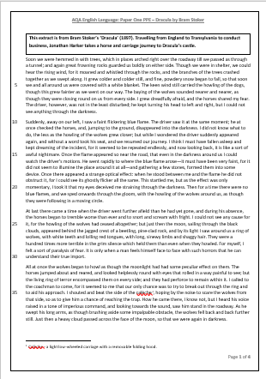
One of our previous webinar resources adapted by Jinder Bains
Summary
Summarise the extract in 3 sentences
10
Mins
Crunch the article
Find the nine juiciest words in the extract
Find
Example of FEAR being shown explicitly in the extract
Example of FEAR being shown implicitly
3 techniques used to display Harker’s struggle on the journey (language or structural)
Any points that show connotations of FEAR
Notes:
This is from Jinder Bains

Slide 34
Any other ideas to share?
If you send them to us at thefullenglish@pearson.com
we will make them available to all who have signed up today.
Send us your requests (through the questionnaire link at the end) for next week – I’ll try my best to come up with something.

Slide 35
Further dates & ideas
14th May 2020
Language
Any suggestions now?

Slide 36
GCSE (9-1) English
What more can we do to help?

Slide 37
New Resources
Knowledge organisers for ‘A Christmas Carol’ and
‘An Inspector Calls’
These consist of:
1 A3 organiser with everything on
1 A3 blank organiser for students to complete
1 A4 powerpoint with the tables from the A3 organiser on each slide.
For Knowledge Organisers click here and scroll down the page!

Slide 38
New Resources
Online learning pack for ‘Jekyll and Hyde’.
This consists of:
full text
revision/learning activities for each chapter
exam-style questions
model paragraphs
For online learning pack click here and go to the Guide section

Slide 39
New Resources
Powerpoint lessons for ‘A Christmas Carol’, ‘Jekyll and Hyde’, ‘An Inspector Calls’ and Poetry.
These consist of:
revision of texts
support and planning for exam questions
model paragraph
full commentary

Slide 40
Secondary resources
Sign-up for Secondary resources form is here: https://www.pearson.com/uk/educators/schools/update-for-schools/secondary-support.html
This gives access to:
KS3 Skills for Writing
Pearson Edexcel GCSE (9–1) English Language Text Anthology
Pearson Edexcel GCSE (9–1) English Language Core Student Book – coming soon!
Pearson Edexcel GCSE (9–1) English Language Revision Guide
AQA GCSE (9–1) English Language Revision Guide.

Slide 41
Your Subject Advisor
Clare Haviland
Telephone: 03330164120
Twitter: @PearsonTeachEng
Email or live chat
You can sign up for Clare’s
e-updates by completing this
online form
Facebook page: https://www.facebook.com/pearsonedexcelenglish/

Slide 42
Switching to Edexcel
https://www.youtube.com/watch?v=Q0DYFcgCejI.

Slide 43
Feedback

