Slide 1
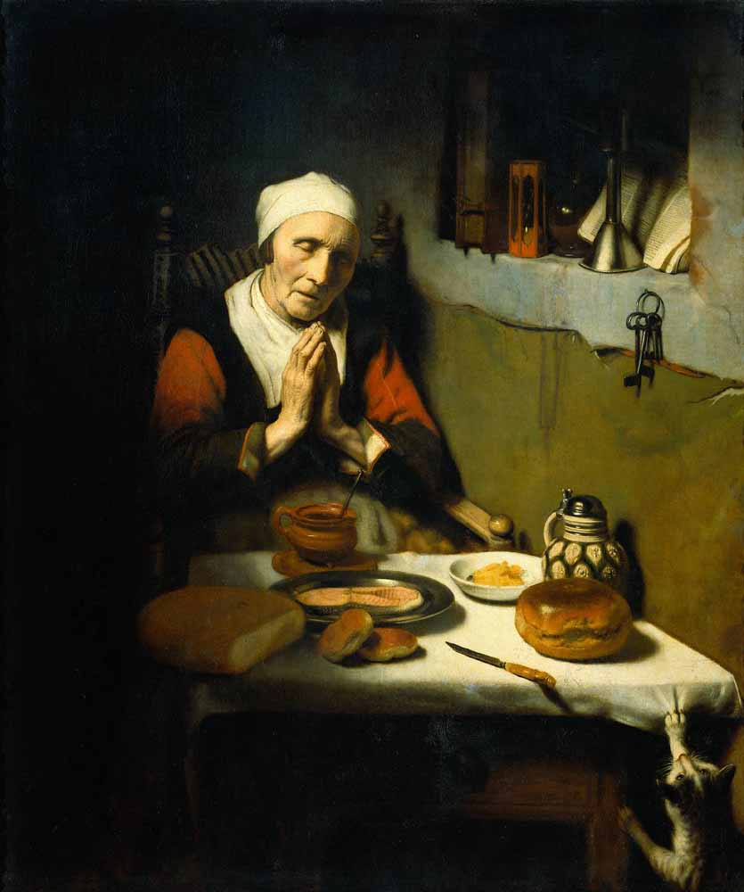
What is she praying for?
Why is she alone?
What do the keys unlock?
What could the funnel be a metaphor for?
What is the book on the shelf, and why is it left open?
Where did she get the flour from to make that large loaf?

Slide 2
Weekly Webinar 5
Language focus
14th May 2020
GCSE (9-1) English

Slide 3
Agenda
Check-in
Update/feedback
Online resources
Language ideas and resources of the week
Tea break – time to discuss, share and energise
Preview of new resources.

Slide 4
Feedback
This week:
Language
Evaluation and comparison focus
Some shared resources from you
Next week:
Literature
Shout out for help from you:
More resources to be shared please!

Slide 5
Check-in
What is your biggest issue when teaching evaluation?
What do you do in KS3 to introduce and practise evaluation?
How have you approached evaluation and comparison remotely?

Slide 6
GCSE (9-1) English
Online resources

Slide 7
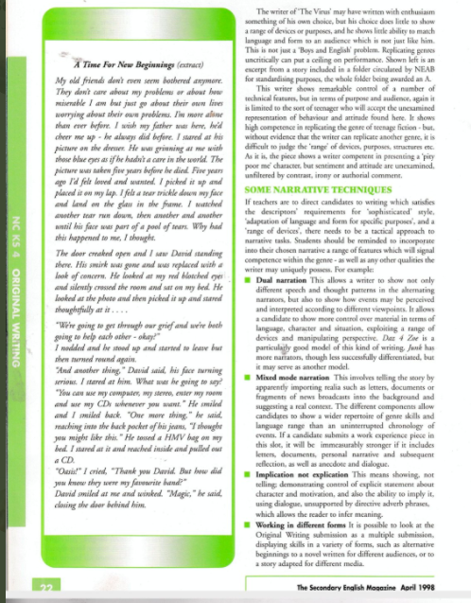
Twitter
NATE resource
@PeterThomas1607

Slide 8
Blogs to follow
Library Lady. librarian with weekly newsletter about all things library and books.
Doug Wise. Loads of useful stuff; lovely resource this week for linking art to literature.

Slide 9
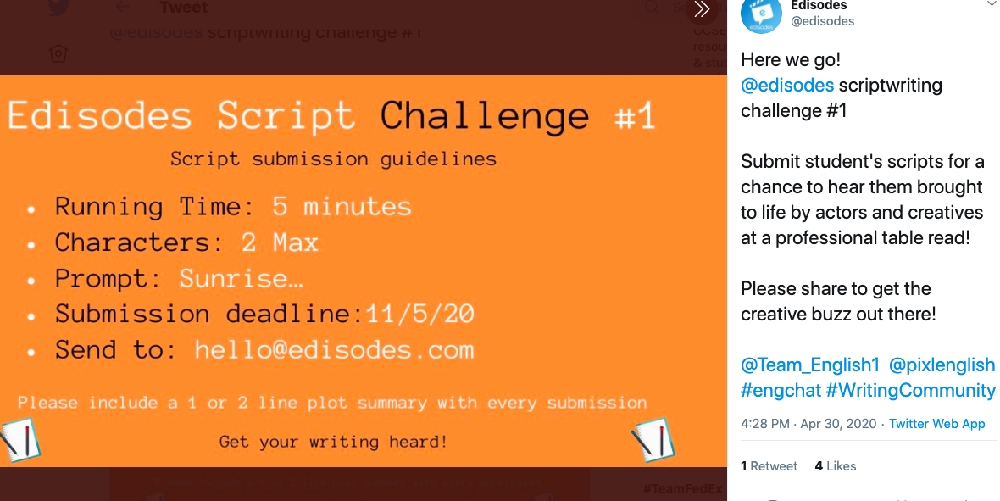
Creative writing ideas
@edisodes.

Slide 10

Blast from the past
Herts Grid for Learning

Slide 11
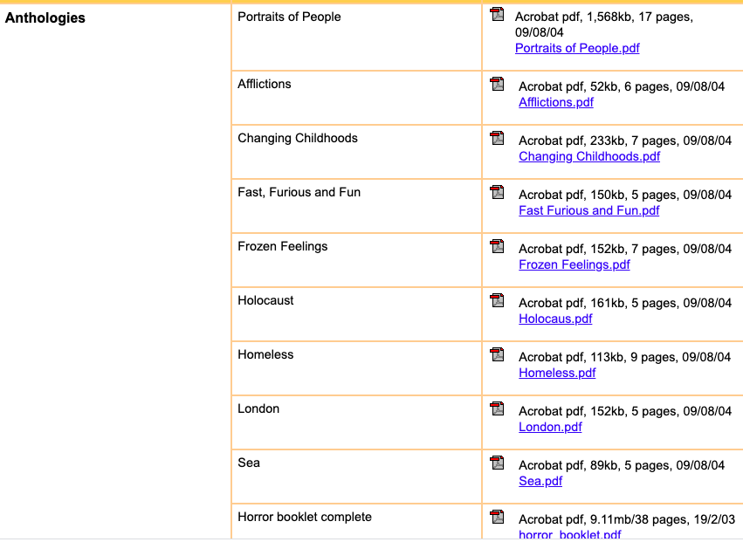
KS3

Slide 12
GCSE (9-1) English
Language ideas and resources of the week

Slide 13
Using art for creative writing
Look closely at this picture for one minute.
Write down every object you can remember from the picture.
Now select one object, write for five minutes about that object.
Why is it there?
What exactly is it?
Why is it important to the old lady?
Does it even belong to her?

Slide 14
Evaluation activities
A quick ‘ice breaker’ exercise which has worked well in the classroom is to ask students to evaluate either some pictures, what they watched on TV, the latest computer game etc. in pairs
Once they have done this for a couple of minutes, they will realise that they have made a judgement, been positive or negative and reflected on their own needs and/or those of other audiences

Slide 15
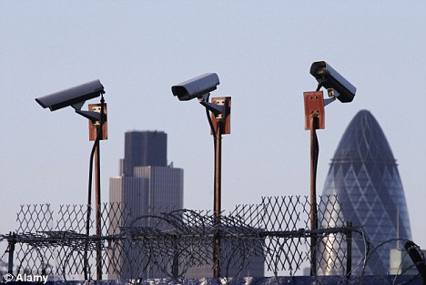
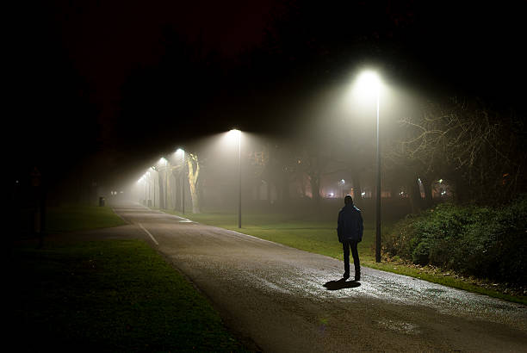
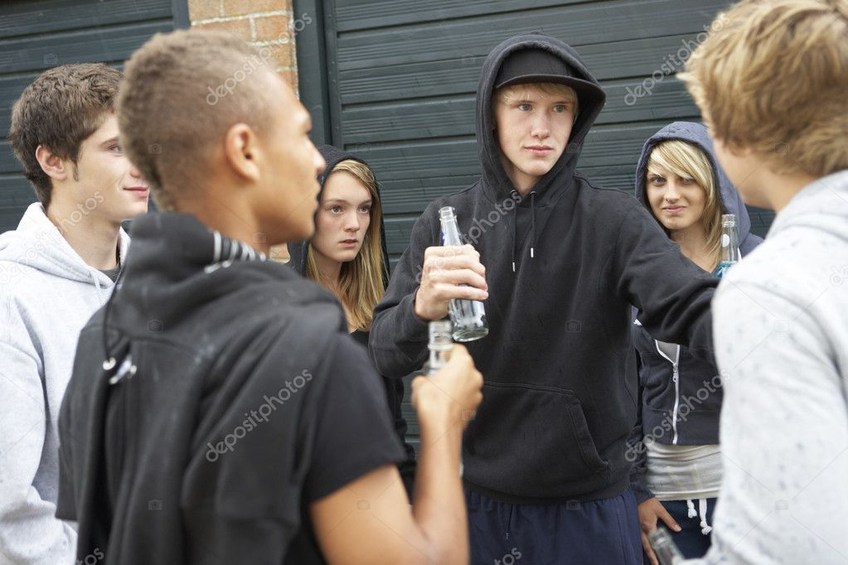
Which picture is most effective at conveying a threatening atmosphere?

Slide 16

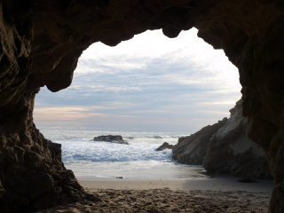
Which is most successful at creating:
a menacing atmosphere?
a peaceful atmosphere?
The photographer has attempted to engage the audience through the use of nature.
Evaluate how successfully this is achieved.

Slide 17
Using Art for Evaluation
Give the picture a title.
What are the key themes suggested by this picture?
What ideas does it give you about prayer?
What ideas about old age?
How do you relate to the picture?
Do you know anyone else who might feel differently?

Slide 18
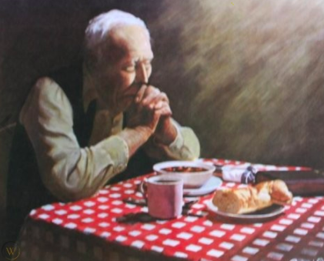
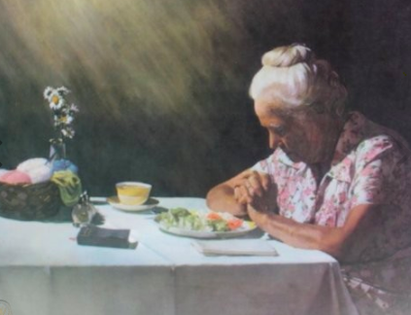
Themes or ideas
Give the pictures a title.
What ideas about food are suggested here?
Who has most to say thanks for?

Slide 19
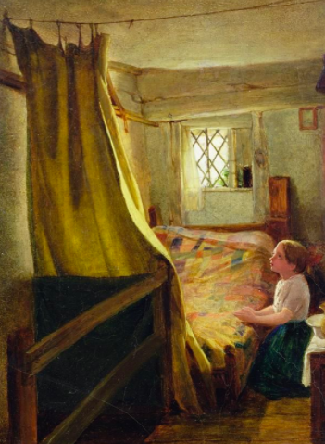
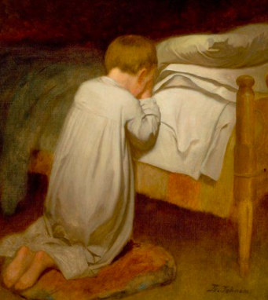
Themes or ideas
Give the pictures a title.
What ideas about prayer are suggested by each picture?
How are they suggested [evidence]?
Why [painter’s purpose/viewer’s response]?

Slide 20

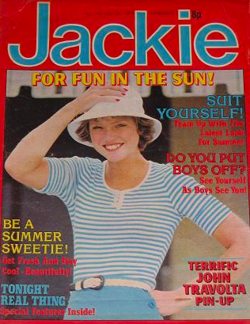
Using interesting texts for Evaluation

Slide 21
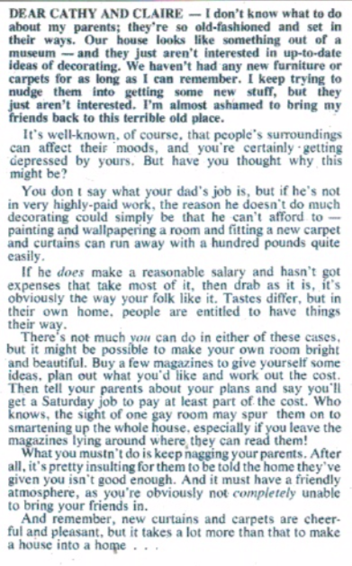


What is the main theme or idea?
How is it presented?
Why is it presented in this way [writer’s purpose/reader response]?
Extension: who might feel differently?

Slide 22
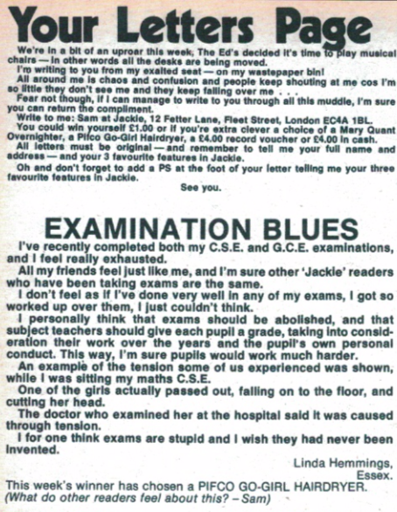
What is the main theme or idea?
How is it presented?
Why is it presented in this way [writer’s purpose/reader response]?
Extension: who might feel differently?

Slide 23
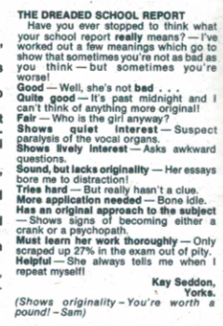
What is the main theme or idea?
How is it presented?
Why is it presented in this way [writer’s purpose/reader response]?
Extension: who might feel differently?

Slide 24
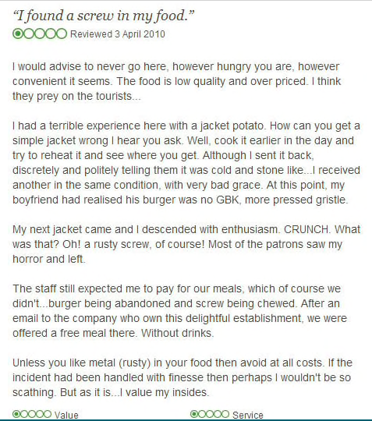
Model paragraph
Evidence from the text | The writer attempts to amuse the reader with her ideas about school reports by presenting the true thoughts of a teacher. For instance, the writer states that what teachers actually mean by the phrase ‘shows lively interest’ is that such a student asks awkward questions, which implies that teachers find this type of student difficult to deal with. This would probably amuse any teenage readers who like to ‘act the clown’ in school lessons as the letter is light hearted in tone, suggesting that there is no real harm in their behaviour. However, there may be some teenagers reading this article who feel differently... | Clear focus on the question
Evaluation of reader response |  | Development – alternative evaluations?

Slide 25
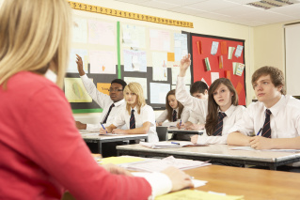
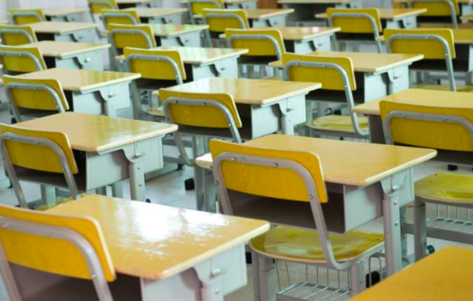

Which most closely reflects your perspective about school?

Slide 26

Evaluation into comparison
Which fruit would you use to promote healthy eating? Why? Level 3:Use the words effective/because
Level 3+: use the words ‘might also’

Slide 27
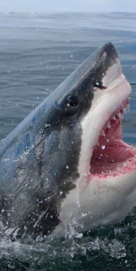
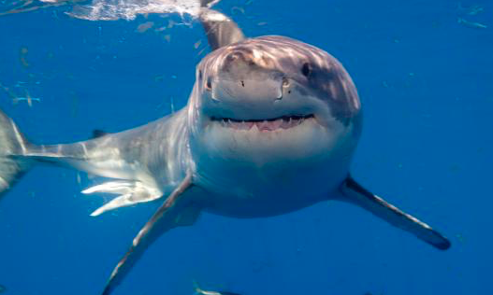
Which would you rather swim with, and why?

Slide 28
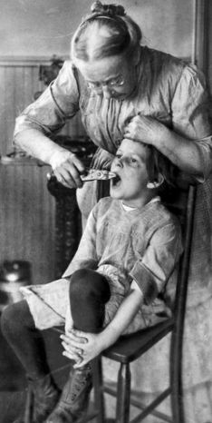
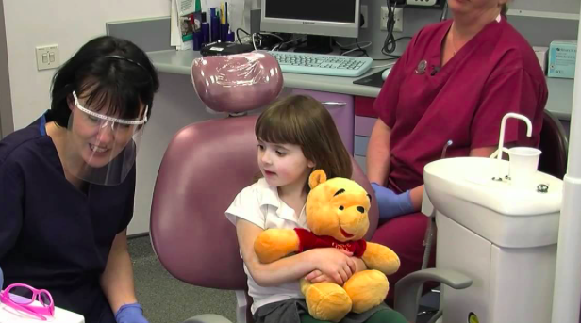
Spot the differences.

Slide 29
Which would you support, and why?
THE SHARK TRUST UK
OUR VISION
A future where sharks thrive within a globally healthy marine ecosystem.
OUR MISSION
Safeguarding the future of sharks through positive change. We achieve this through science, education, influence and action.
IT'S HERE! THE SECOND FIN FIGHTER'S SHARKFEST! GET READY FOR A FUN PACKED DAY FULL OF ALL THINGS SHARKY! Fin Fighters are an ambitious new UK shark conservation organisation; on a mission to protect sharks worldwide and end the sale and distribution of shark fin in the UK by the year 2023.

Slide 30
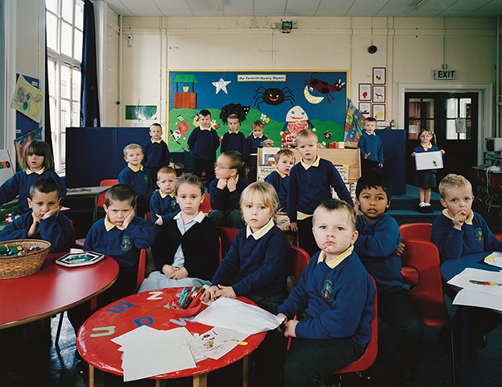

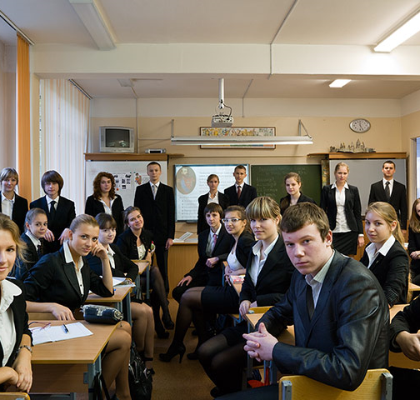
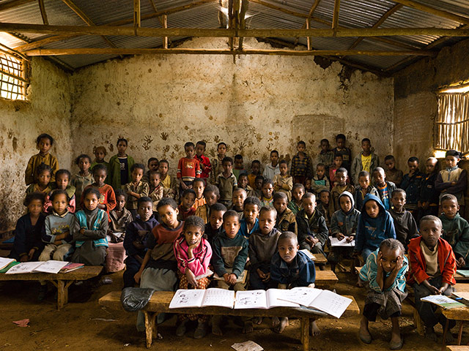

Slide 31
Model paragraph
Compare how the pictures present ideas and perspectives about education.
Evidence from text 1 | Both photographers have presented the idea that education takes place in a formal classroom situation. For instance, picture 1 shows students sat at schoolroom desks facing the front of the room in rows, presenting a very traditional, disciplined perspective about education. Similarly, in the second picture, students are forward facing and sat in rows, but whereas the students in the first picture are all sitting upright and looking serious, the photographer of picture 2 has used more casual poses. For instance, the girl in the forefront is smiling and the boy next to her is slouching against the desk behind, which suggests that this photographer’s perspective of education is that it should be more relaxed in tone. | Clear comparison of ideas/ perspectives
Evidence from text 2
Comparative connectives |  | Comparison of language/ structure
Comparative connectives

Slide 32
GCSE (9-1) English
Tea Break

Slide 33
Tea break
Your time to share ideas, inspire each other with great ideas or just say hello.

Slide 34
GCSE (9-1) English
Shared Resources

Slide 35
Thanks for sharing!
This week: Saira Bloomfield
(Natalie Bennett-Inge sent in some great Lit resources which we will show you next week).
We will send all these resources out to you after this webinar.

Slide 36

Notes:
From Saira Bloomfield

Slide 37
Any other ideas to share?
If you send them to us at thefullenglish@pearson.com
we will make them available to all who have signed up today.
Send us your requests (through the questionnaire link at the end) for next week – I’ll try my best to come up with something.

Slide 38
Further dates & ideas
21st May 2020
Literature
Any suggestions now?

Slide 39
GCSE (9-1) English
What more can we do to help?

Slide 40
New Resources
Knowledge organisers for ‘A Christmas Carol’ and
‘An Inspector Calls’
These consist of:
1 A3 organiser with everything on
1 A3 blank organiser for students to complete
1 A4 powerpoint with the tables from the A3 organiser on each slide.
For Knowledge Organisers click here and scroll down the page!

Slide 41
New Resources
Online learning pack for ‘Jekyll and Hyde’.
This consists of:
full text
revision/learning activities for each chapter
exam-style questions
model paragraphs
For online learning pack click here and go to the Guide section

Slide 42
New Resources
Powerpoint lessons for ‘A Christmas Carol’, ‘Jekyll and Hyde’, ‘An Inspector Calls’ and Poetry.
These consist of:
revision of texts
support and planning for exam questions
model paragraph
full commentary
Click Here for Link

Slide 43

To order
Click to find free Macbeth starter pack
Get a massive 55% discount by ordering at www.pearsonschools.co.uk/YN and using code 19YORK55 at checkout
Order on Amazon
Digital versions also available at www.yorknotes.com
Please note, it is not necessary to purchase endorsed or Pearson products and resources to deliver our qualifications.

Slide 44
Secondary resources
Sign-up for Secondary resources form is here: https://www.pearson.com/uk/educators/schools/update-for-schools/secondary-support.html
This gives access to:
KS3 Skills for Writing
Pearson Edexcel GCSE (9–1) English Language Text Anthology
Pearson Edexcel GCSE (9–1) English Language Core Student Book – coming soon!
Pearson Edexcel GCSE (9–1) English Language Revision Guide
AQA GCSE (9–1) English Language Revision Guide.

Slide 45

Your Subject Advisor
Clare Haviland
Telephone: 03330164120
Twitter: @PearsonTeachEng
Email or live chat
You can sign up for Clare’s
e-updates by completing this
online form
Facebook page: https://www.facebook.com/pearsonedexcelenglish/

Slide 46
Switching to Edexcel
https://www.youtube.com/watch?v=Q0DYFcgCejI.

Slide 47
Feedback

