Slide 1
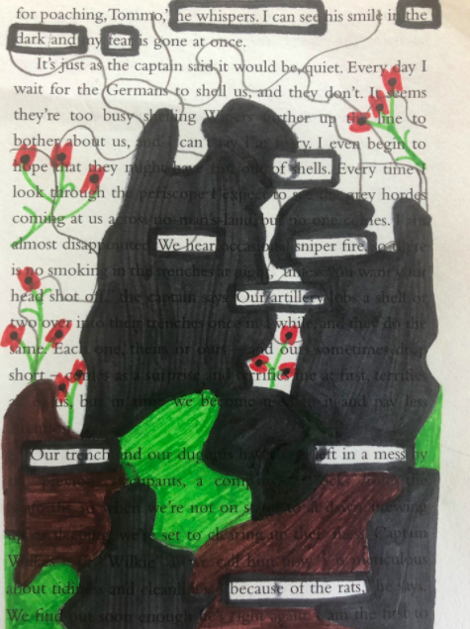
Churchdown English.

Slide 2
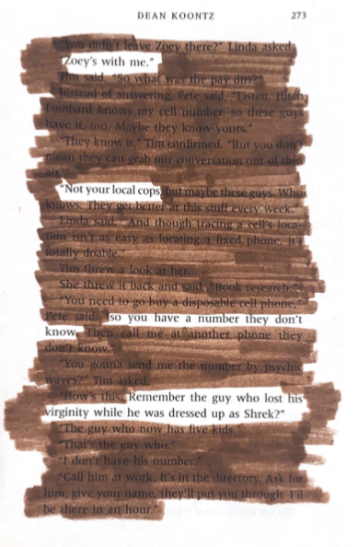

Slide 3
Weekly Webinar 8
Special guest:
KAT HOWARD
GCSE (9-1) English

Slide 4
Agenda
Check-in
Update/feedback
Online resources
KAT HOWARD
Tea break – time to discuss, share and energise
Shared resources

Slide 5
Feedback
‘As usual, a lovely hour spent’
“Great resources and ideas shared’
‘I would like a bit more time for Julie to explain things.’
‘A bit rushed, especially in the chat.’
Same as this – imaginative starters
More of the same
Some Blood Brothers resources

Slide 6
Check-in
Thoughts after nine weeks of lockdown:
What has been your biggest problem with remote learning?
What [if anything!] has been a highlight of your remote school/college experience?
How many cakes/biscuits do you think you have consumed?

Slide 7
GCSE (9-1) English
Online resources

Slide 8
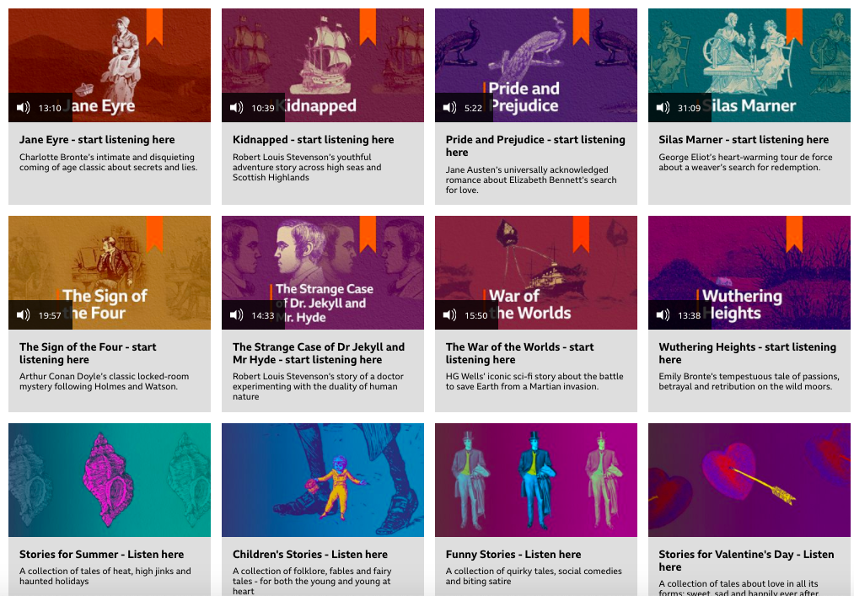
Resource of the week
BBC Classic Stories

Slide 9
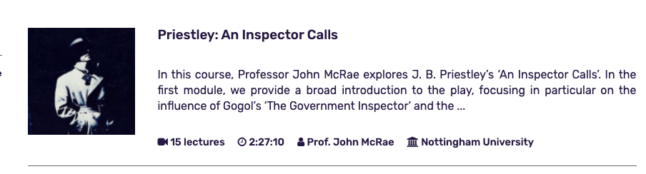

Website of the Week
massolit

Slide 10
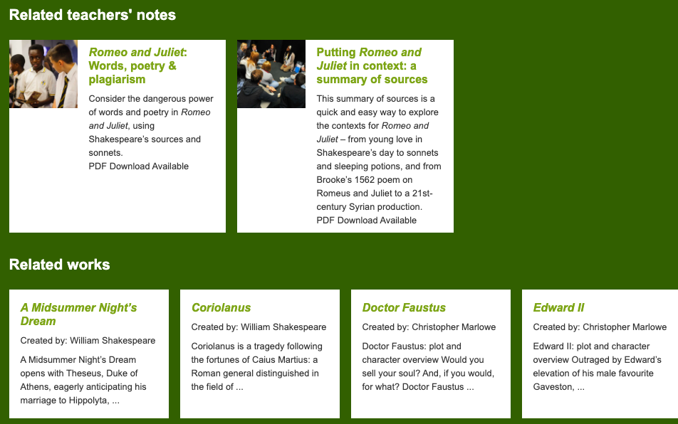
Shakespeare support
British Library

Slide 11
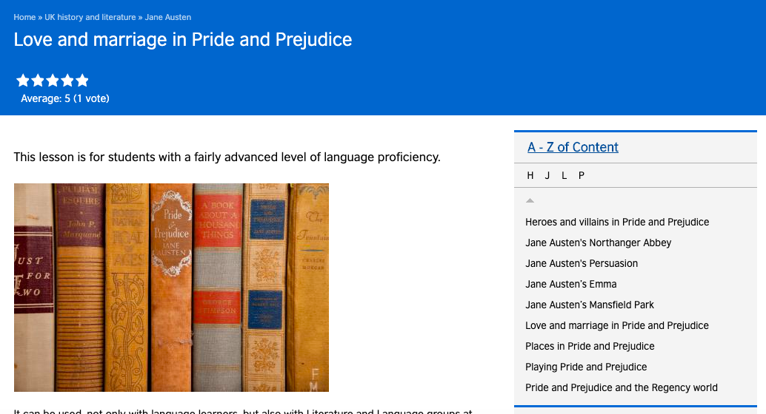
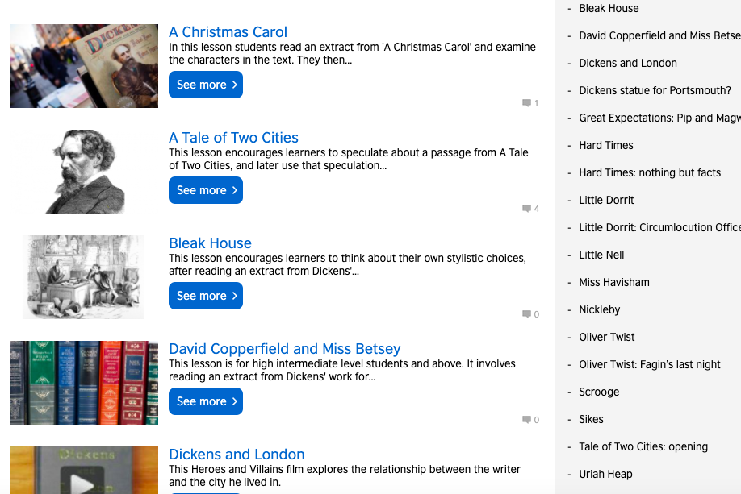
Literature lesson plans
British Council

Slide 12
GCSE (9-1) English
KAT HOWARD
FOUNDER OF LIT DRIVE

Slide 13
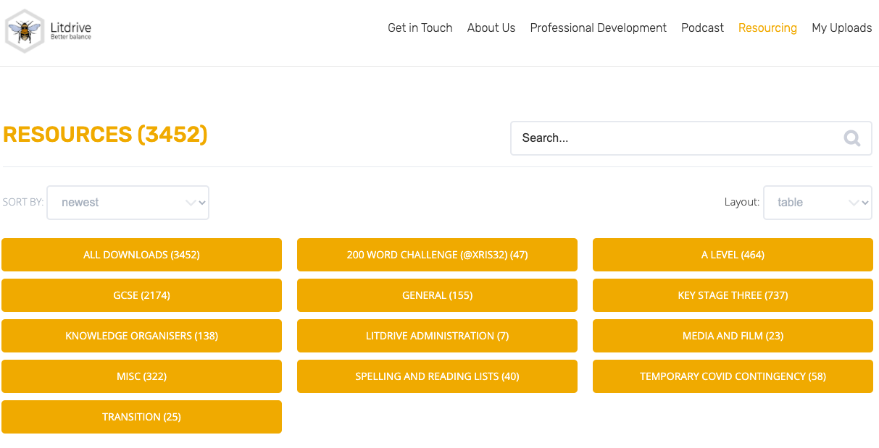

Slide 14
GCSE (9-1) English
Tea Break

Slide 15
Tea break
Your time to share ideas, inspire each other with great ideas or just say hello.

Slide 16
GCSE (9-1) English
Shared Resources

Slide 17
Thanks for sharing!
This week resources from:
Megha D – Macbeth
Nicole B - Creative writing resources ‘Drop Zoom Shift’ method.
Saira B – creative writing
These will all be available on the webpage link below
English GCSE Webinar resource page

Slide 18
Any other ideas to share? £25 voucher shared resource draw next week
If you send them to us at
thefullenglish@pearson.com
we will make them available to all who have signed up today.
Send us your requests (through the questionnaire link at the end) for next week – I’ll try my best to come up with something.

Slide 19
£10 voucher and the winner is..
Weekly Draw for
feedback survey

Slide 20
Further dates
11th June 2020 – Language
18th June 2020 – Literature
Book your place!

Slide 21
GCSE (9-1) English
What more can we do to help?

Slide 22
New Resources
Knowledge organisers for ‘A Christmas Carol’ and
‘An Inspector Calls’
Online learning pack – Jekyll and Hyde
Powerpoint lessons for ‘A Christmas Carol’, ‘Jekyll and Hyde’, ‘An Inspector Calls’ and Poetry
To come: Ppt lessons & Kos for ‘Boys Don’t Cry’, ‘Coram Boy’, ‘Refugee Boy’.

Slide 23
Free online lessons for Year 10 students
6 weekly 45 minute lessons delivered by a teacher
Started 3rd June
English Language focus
https://www.pearson.com/uk/educators/schools/subject-area/literacy-and-english/support-for-all/support-from-pearson/free-online-gcse-english-lessons.html

Slide 24
Secondary resources
Sign-up for Secondary resources form is here: https://www.pearson.com/uk/educators/schools/update-for-schools/secondary-support.html
This gives access to:
KS3 Skills for Writing
Pearson Edexcel GCSE (9–1) English Language Text Anthology
Pearson Edexcel GCSE (9–1) English Language Core Student Book – coming soon!
Pearson Edexcel GCSE (9–1) English Language Revision Guide
AQA GCSE (9–1) English Language Revision Guide.

Slide 25

Your Subject Advisor
Clare Haviland
Telephone: 03330164120
Twitter: @PearsonTeachEng
Email or live chat
You can sign up for Clare’s
e-updates by completing this
online form
Facebook page: https://www.facebook.com/pearsonedexcelenglish/

Slide 26
Switching to Edexcel
https://www.youtube.com/watch?v=Q0DYFcgCejI.

Slide 27
Feedback

