Slide 1
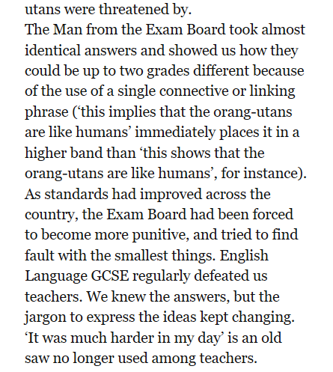
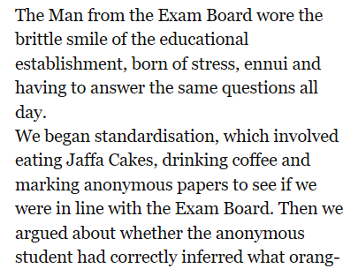
An extract from ‘The Secret Teacher: dispatches from the classroom’ by Anonymous, which covers a year in the life of a teacher. In this extract the narrator, a NQT in an English Department at a tough inner city academy, is attending his first departmental meeting, to which a visitor from the exam board has been invited.

Slide 3
Weekly Webinar 9
Language focus
GCSE (9-1) English

Slide 4
Agenda
Check-in
Update/feedback
Online resources
Language resources & ideas
Tea break – time to discuss, share and energise
Shared resources

Slide 5
Feedback – what’s wanted?
Evaluation questions - in particular getting students to make their opinion clear and not just basic PEE
Enabling students to identify 'points' within a text/ extract. They struggle to know what to write about.
Ideas for creatively approaching texts without obviously looking at exam skills
How to create really meaningful, effective multiple-choice quizzes
More guest speakers delivering CPD

Slide 6
Check-in
Reading focus:
What is the biggest barrier you face when approaching ‘challenging’ texts in the classroom?
How do you approach ‘challenging’ texts?
Do you think some of the GCSE texts are too challenging for any of your students?

Slide 7
GCSE (9-1) English
Online resources

Slide 8
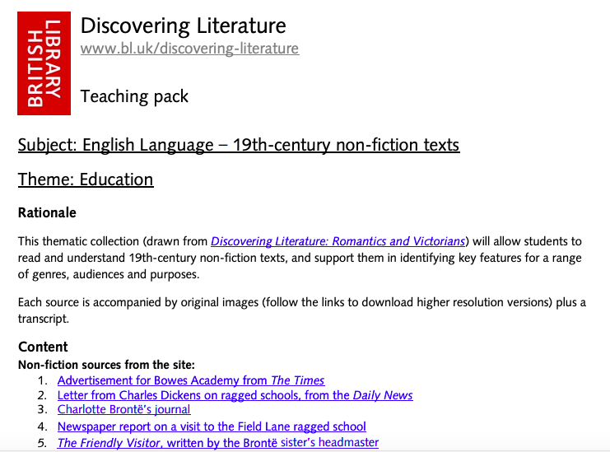
Resource of the week
19th century non-fiction British Library

Slide 9
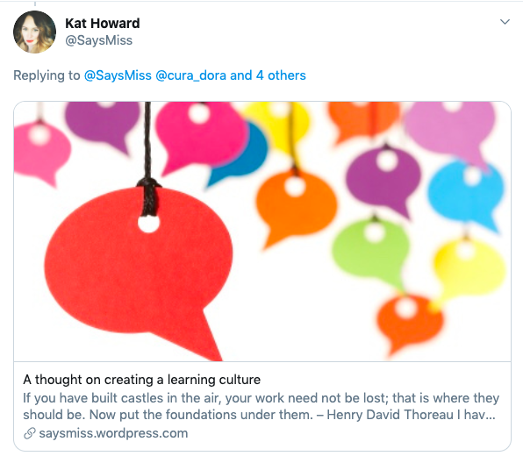
Blogs of the week

Slide 10

Blogs of the week
Kate McCabe

Slide 11
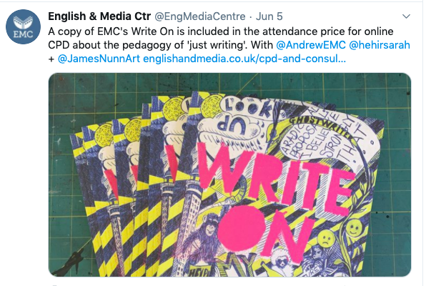
CPD of the week

Slide 12
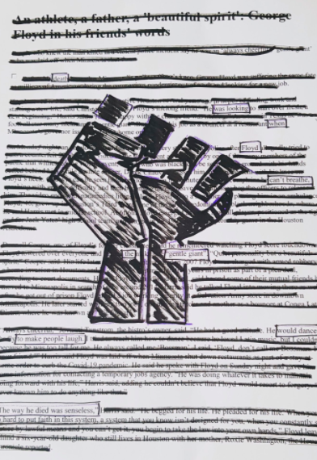
First story
@FirstStory

Slide 13
GCSE (9-1) English
Language ideas and resources

Slide 14
READING
The weak reader
The reluctant reader
The lazy reader
The inexperienced reader

Slide 15
Barbara Bleiman
‘Challenging texts can have the reverse effect to the one we fear. They can give confidence rather than taking it away.’
‘It is important to establish for students that the problems of reading a challenging text lie in the text itself, not the reader. [they] need to know they are about the meet a challenge.’

Slide 16
What makes texts difficult to read?
‘There is a serious argument that understanding texts is much more about being able to grasp the big picture, rather than understanding every word or even understanding every individual sentence. It’s about recognising the bigger structures....’

Slide 17
Reading - take the fear away
I hated him. I hated his _______ ways and his _______ manners; I hated his handsome boyish face, with its frame of golden hair, and its blue, beaming, hopeful eyes; I hated him for the sword which swung across the stiff skirts of his ________ coat, for the money which he jingled in his waistcoat pockets, for the two watches which he wore on high days and holidays, for his merry laugh, for his _________ voice, for his graceful walk, for his tall, slender figure for his ______, winning ways, which won everybody else’s friendship. I hated him for all these; but most of all, I hated him for his influence over Lucy Malden.
Notes:
Use for discussion – which verb? Why that verb? Who is speaking?
17

Slide 18
Reading - take the fear away
I hated him. I hated his _______ ways and his _______ manners; I hated his handsome boyish face, with its frame of golden hair, and its blue, beaming, hopeful eyes; I hated him for the sword which swung across the stiff skirts of his ________ coat, for the money which he _______ in his waistcoat pockets, for the two watches which he wore on high days and holidays, for his merry laugh, for his _________ voice, for his graceful walk, for his tall, slender figure for his ______, winning ways, which won everybody else’s friendship. I hated him for all these; but most of all, I hated him for his influence over Lucy Malden.
Notes:
Use for discussion – which verb? Why that verb? Who is speaking?
18

Slide 19
I hated him. I hated his foppish ways and his haughty manners; I hated his handsome boyish face, with its frame of golden hair, and its blue, beaming, hopeful eyes; I hated him for the sword which swung across the stiff skirts of his brocaded coat, for the money which he jingled in his waistcoat pockets, for the two watches which he wore on high days and holidays, for his merry laugh, for his melodious voice, for his graceful walk, for his tall, slender figure for his jovial, winning ways, which won everybody else’s friendship. I hated him for all these; but most of all, I hated him for his influence over Lucy Malden.
Read aloud:
Draw him
How many things can you remember about him?
Would you like him?
What do you think Lucy is like?
What is the narrator like?
What happens next?
Keep it active – make it fun
Notes:
Could draw him/read it aloud and see how many things you can remember about him, or take out ‘hated’ and ask whether it should be ‘hated’ or ‘loved’
19

Slide 20
They ______ this way and that, far down into the secret depths of the cave, made another mark, and ______ off in search of ______ to tell the upper world about.
In one place they found a ______ cavern, from whose ceiling descended a ______ of shining stalactites of the length and __________ of a man's leg; they walked all about it, wondering and admiring. Then, under the roof, vast ______ of bats came into view, thousands in a bunch; the candles disturbed the creatures and they came flocking down by hundreds, squeaking and darting and flapping furiously at the candles. The bats chased the children a good distance; but the ______ plunged into every new passage of the cave, and at last got rid of the ______things. Then they came upon a ____________ lake, which stretched its dim length away until its shape was lost in the shadows. The deep stillness of the place laid a ______ hand upon the spirits of the children.

Slide 21
They wound this way and that, far down into the secret depths of the cave, made another mark, and branched off in search of novelties to tell the upper world about.
In one place they found a spacious cavern, from whose ceiling descended a multitude of shining stalactites of the length and circumference of a man's leg; they walked all about it, wondering and admiring. Then, under the roof, vast knots of bats came into view, thousands in a bunch; the candles disturbed the creatures and they came flocking down by hundreds, squeaking and darting and flapping furiously at the candles. The bats chased the children a good distance; but the fugitives plunged into every new passage of the cave, and at last got rid of the perilous things. Then they came upon a subterranean lake, which stretched its dim length away until its shape was lost in the shadows. The deep stillness of the place laid a clammy hand upon the spirits of the children.

Slide 22
Fiction – active reading
Fiction – the big picture
What is happening?
Where is it happening?
Who is it happening to?
How do the characters feel?

Slide 23
Bullet point the story
Children walk around cave
Get chased by lots of bats
Becky gets scared
Talk about finding the way out
They start looking for way out
Tom gets desperate
Tom shouts to get attention
Becky cries about being lost

Slide 24
Evaluating the story
Why do we enjoy the story?
How successfully does it show the difference between the children’s reaction?
‘I felt very scared for Becky at the end’ – how far do you agree?
Children walk around cave
Get chased by lots of bats
Becky gets scared
Talk about finding the way out
They start looking for way out
Tom gets desperate
Tom shouts to get attention
Becky cries about being lost

Slide 25
Active reading – non-fiction
Non-Fiction – the Big Picture
What is the topic?
What are the writer’s main ideas?
What are the writer’s feeling about the topic?
How does the writer want you to feel?

Slide 26
Extract from ‘Why I should run our schools’, an article by Caitlin Moran from The Sunday Times. Moran did not go to school, she was educated at home.
What is the topic? Schools – how they should be run
What are the writer’s main ideas?
Job market has changed
Current education not suitable for new job market
What are the writer’s feeling about the topic?
She wants change – self-education
How does the writer want you to feel?
Wants readers to think of their own children
As my post-home-schooled life has been fairly successful, I am now convinced that semi-feral library-based self-education is the route for everyone else in Britain – in the same way that grammar-educated Theresa May believes grammar schools will make everyone else as successful as her, and Michael Gove’s joy in rote-learning grammar led him to believe that every seven-year-old should be air-punching while identifying subordinating conjunctions.
First, as anyone with a teenage/young adult child will know, the notion of them going into a full-time, long-term job with a pension at the end of it looks like something we left behind in the 20th century. The old pathway – learn a skill, use it for 40 years, then retire – is over. The jobs of the future require flexibility and self-motivation. Indeed, the majority of jobs our children will have – in just a few years’ time – have almost certainly not been invented yet.
Currently, however, British education is almost perfectly formulated to prevent the creation of Zuckerbergs, Gateses or Ubers. Coding is still not a core subject; the crushing schedule of test-revision and homework means children have no free time to pursue creative/entrepreneurial extra-curricular activities; and any sense of personal dynamism is pointless. What happens if you finish your maths early? They just give you more maths.

Slide 27
Use the contextual information
Extract from ‘Grey is the Colour of Hope’, a memoir written in 1988 by Russian writer and poet Irina Ratushinskaya. The memoir covers Ratushinskaya’s arrest, details of her time in a Russian ‘strict regime’ camp and her release in 1986. She was arrested and imprisoned for writing what was considered to be ‘anti-Soviet’ poetry. In this edited extract the camp officer, Podust, is checking the prisoners’ possessions in ‘the Zone’.
An extract from ‘The Secret Teacher: dispatches from the classroom’ by Anonymous, published by The Guardian Press, which covers a year in the life of a teacher. In this extract the narrator, a NQT in an English Department at a tough inner city academy, is attending his first departmental meeting, to which a visitor from the exam board has been invited.

Slide 28
This is a publicity notice for a lecture by John Brocksopp, a former convict from York who had returned to Britain after 14 years in a penal colony in Australia. ‘Transportation’ was the practice of sending criminals out of the country. It was almost a century old at the time of this lecture and had always been controversial.
This is an extract from Pablo Escobar Part 1: The Rise, a biography of the Columbian drug lord and terrorist who is reputed to be the wealthiest criminal in history, having amassed an estimated net worth of 30 billion US dollars at the time of his death in 1993. This extract is about the teenage years of Pablo and his brother Roberto.
In autumn 1888, five women in east London’s slums died at the hands of an unknown man. The murderer became known as ‘Jack the Ripper’, a now legendary name that still haunts London’s streets. On 5 October 1888 this letter was sent anonymously to the City of London Police accusing the actor Richard Mansfield of perpetrating the murders. Mansfield was at this time playing the dual role of the fictional Jekyll and Hyde on the London stage.

Slide 29
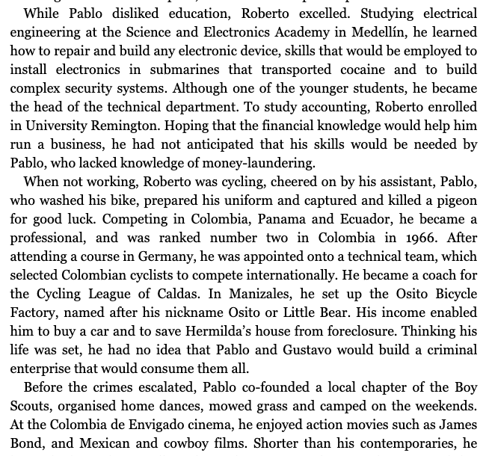

Slide 30
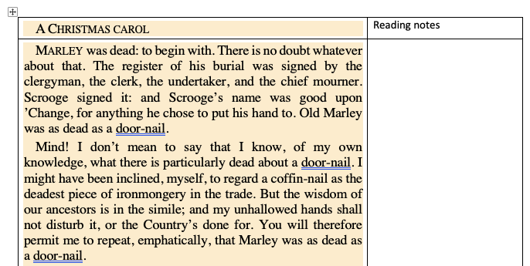
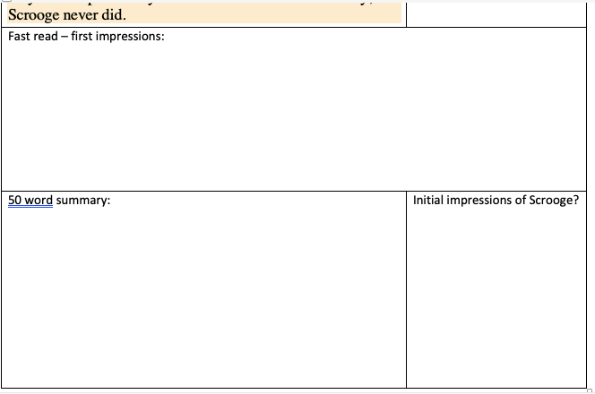
Reading notes

Slide 31
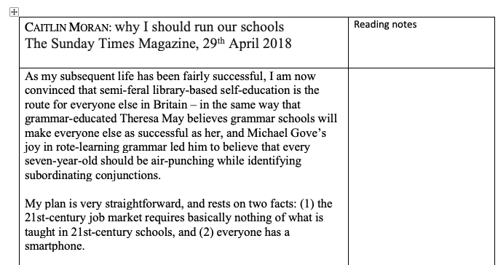
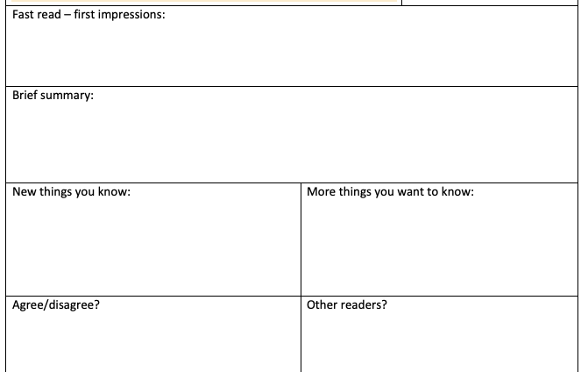
Reading notes

Slide 32
Reading – make it active
Teaching a short story; one can work through the story, drawing out meaning paragraph by paragraph and then considering how storyline, setting and characterisation work to make the story successful.
Or one can read the story without the first two paragraphs; ask the students to speculate on the significance of one or two selected incidents in the story; then reveal the missing paragraphs and ask the students to decide whether they should come at the beginning or end of the story –which would be better and how would each position affect our understanding of the story?
https://www.letsthinkinenglish.org/wp-content/uploads/2014/04/Preparing-for-the-changes-in-GCSE-English2.pdf

Slide 33

For the first time, the woman felt fear, though she did not know why. Adrenaline shot through her trunk and her limbs, generating a tingling heat and urging her to swim faster. She guessed that she was fifty yards from shore. She could see the line of white foam where the waves broke on the beach. She saw the lights in the house, and for a comforting moment she thought she saw someone pass by one of the windows.
The fish closed on the woman and hurtled past, a dozen feet to the side and six feet below the surface. The woman felt only a wave of pressure that seemed to lift her up in the water and ease her down again. She stopped swimming and held her breath. Feeling nothing further, she resumed her lurching stroke.
The fish smelled her now, and the vibrations—erratic and sharp—signaled distress. The fish began to circle close to the surface. Its dorsal fin broke water, and its tail, thrashing back and forth, cut the glassy surface with a hiss. A series of tremors shook its body.
The fish was about forty feet from the woman, off to the side, when it turned suddenly to the left, dropped entirely below the surface, and, with two quick thrusts of its tail, was upon her.

Slide 34

Miss Havisham – Great Expectations
The mad, vengeful Miss Havisham, a wealthy dowager who lives in a rotting mansion and wears an old wedding dress every day of her life, is not exactly a believable character, but she is certainly one of the most memorable creations in the book. Miss Havisham’s life is defined by a single tragic event: her jilting by Compeyson on what was to have been their wedding day. From that moment forth, Miss Havisham is determined never to move beyond her heartbreak. She stops all the clocks in Satis House at twenty minutes to nine, the moment when she first learned that Compeyson was gone, and she wears only one shoe, because when she learned of his betrayal, she had not yet put on the other shoe. With a kind of manic, obsessive cruelty, Miss Havisham adopts Estella and raises her as a weapon to achieve her own revenge on men. Miss Havisham is an example of single-minded vengeance pursued destructively: both Miss Havisham and the people in her life suffer greatly because of her quest for revenge.
Give different criteria for fact recall:
Why she seems sad
Why she seems mad
Why she seems dangerous
Notes:
Listen, and then write down 3 to 5 bullet points about Miss H. Can be differentiated by giving headings or asking for 3 key facts. Or by asking only for key vocabulary used.

Slide 35
Listen & Recall
1. Note taker writes down key features of the story (tip: you will need to paraphrase) | 2. Picture taker draws images to represent the key messages/ features of the story
3. Listener cannot note down anything but must commit information heard to memory | 4. Assessor must listen prepare to test others.
Sit with your home group.
Allocate one of the roles above to each group member
Relocate to another table with three others of the same number (all number 1s on one table etc)
Watch and listen carefully to story and carry out your assigned role.
Return to home group tables to feedback
Assessors listen to each group member to test on recall (starting with listeners)
Assessors feed back on successes of various methods.
Notes:
35

Slide 36
GCSE (9-1) English
Tea Break

Slide 37
Tea break
Your time to share ideas, inspire each other with great ideas or just say hello.

Slide 38
GCSE (9-1) English
Shared Resources

Slide 39
Thanks for sharing!
Paulette T - Summer homework booklet for Yr 7 and Yr8
These will all be available on the webpage link below
English GCSE Webinar resource page

Slide 40
Any other ideas to share? £25 voucher shared resource
If you send them to us at
thefullenglish@pearson.com
we will make them available to all who have signed up today.
Send us your requests (through the questionnaire link at the end) for next week – I’ll try my best to come up with something.

Slide 41
£10 voucher and the winner is..
Weekly Draw for
feedback survey

Slide 42

Fortnightly Draw for
Shared resources

Slide 43
Further dates
18th June 2020 – Literature
25th June 2020 – Special Guest
2nd July 2020 - Watch this space!
9th July 2020 – Language
16th July 2020 - Literature
Book your place!

Slide 44
GCSE (9-1) English
What more can we do to help?

Slide 45
Free online lessons for Year 10 students
6 weekly 45 minute lessons delivered by a teacher
Started 3rd June
English Language focus
https://www.pearson.com/uk/educators/schools/subject-area/literacy-and-english/support-for-all/support-from-pearson/free-online-gcse-english-lessons.html

Slide 46
Secondary resources
Sign-up for Secondary resources form is here: https://www.pearson.com/uk/educators/schools/update-for-schools/secondary-support.html
This gives access to:
KS3 Skills for Writing
Pearson Edexcel GCSE (9–1) English Language Text Anthology
Pearson Edexcel GCSE (9–1) English Language Core Student Book – coming soon!
Pearson Edexcel GCSE (9–1) English Language Revision Guide
AQA GCSE (9–1) English Language Revision Guide.

Slide 47
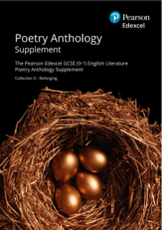
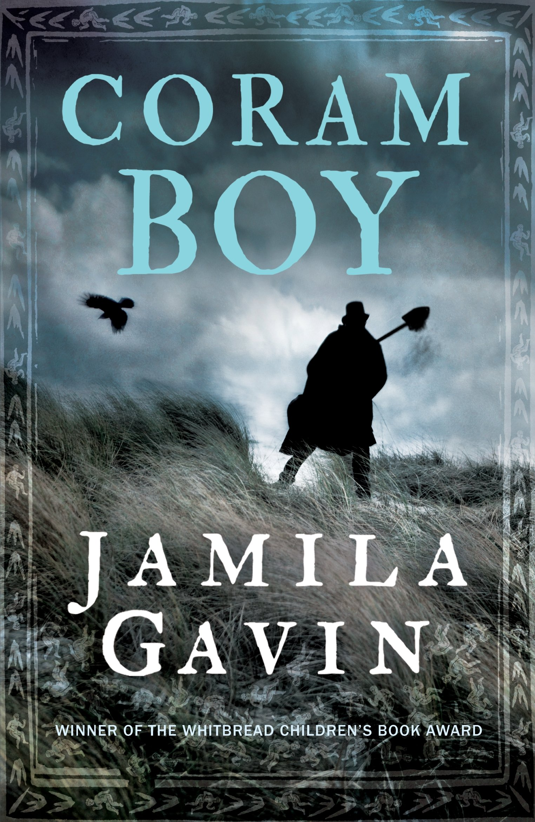




GCSE English Literature 1ET0
Introducing four new texts and a new poetry collection First teaching: September 2019
First assessment: May 2021
>Find out more on our website

Slide 48
Can you help with research?
Teacher assessed grades this summer – what has been your experience?
If you are a Head of Department*, we’d like to hear from you about your unique experiences at this unprecedented time. Please sign up here to speak to the Research team at Pearson.
All participants will be entered in a prize draw for £100 Amazon vouchers.
*Please get in touch if you are a HoD for any of the following subjects: GCSE/GCE Maths, English, History, Science, Art and Design, Tech Award Music, Tech Award Health and Social Care, BTEC National Applied Psychology, BTEC National Business, BTEC National Creative Media.

Slide 49

Your Subject Advisor
Clare Haviland
Telephone: 03330164120
Twitter: @PearsonTeachEng
Email or live chat
You can sign up for Clare’s
e-updates by completing this
online form
Facebook page: https://www.facebook.com/pearsonedexcelenglish/

Slide 50
Switching to Edexcel
https://www.youtube.com/watch?v=Q0DYFcgCejI.

Slide 51
Feedback

