Slide 1

You’re producing R & J and setting it in the present day. Which balcony would you use, and why?

Slide 2
Weekly Webinar 12
Best of Literature
GCSE (9-1) English

Slide 3
Agenda
Check-in
Update/feedback
Online resources
Literature resources
Tea break – time to discuss, share and inspire
Shared resources

Slide 4
Feedback – what’s wanted?
Non linear approaches for a SOW - resitting learners | Next week
Advice on exams for 2021 / any news around provisional changes | As soon as we know!
Modelling via on line learning | Ppt lessons
Retrieval practice tips & tricks! | This session
comparing poems in an effective way/ how to effectively plan a poetry comparison | This session
Planning assessments to reduce teacher workload | MCQ – webinar 11
Generally more ideas at approaching texts in innovative ways- these have been amazing sessions. | This session?!
Anything KS3 would be great, especially for reluctant writers. Quick wins for reading and writing re-engagement (particularly with students who haven't completed any work throughout lockdown and aren't attending the in school sessions before the summer break). Possibly how others are tackling "catch-up" work over the summer (and how they're targeting the students who actually need to "catch-up"). | Webinar 3 covered KS3 Poll

Slide 5
Check-in
What [if any] catch-up are you offering in the summer?
What are you offering KS3 at the moment?

Slide 6
GCSE (9-1) English
Online resources

Slide 7

CPD of the week
@TeamEnglishNC

Slide 8
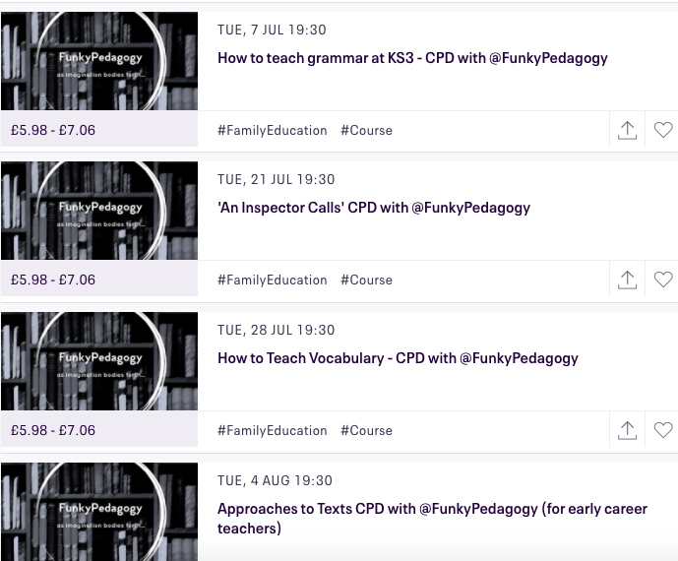
Great CPD
Booking link
all profits to
TouchstoneLovesFood

Slide 9
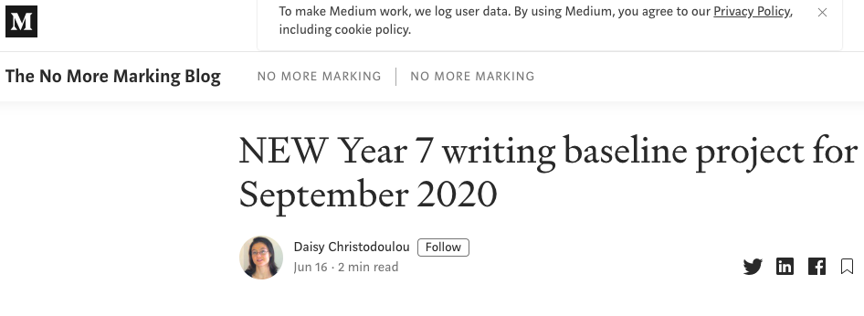
Blog of the week
Nomoremarking.

Slide 10

Idea of the week
Link to blog.

Slide 11
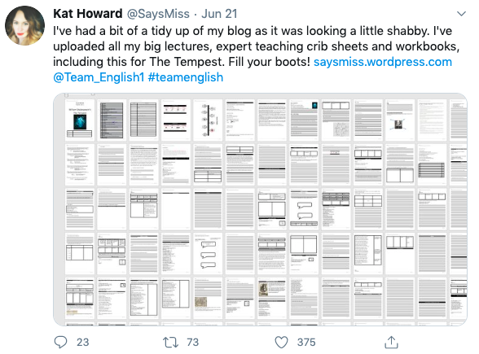
Kat Howard’s stuff
Link to Tweet.

Slide 12
GCSE (9-1) English
Literature resources

Slide 13
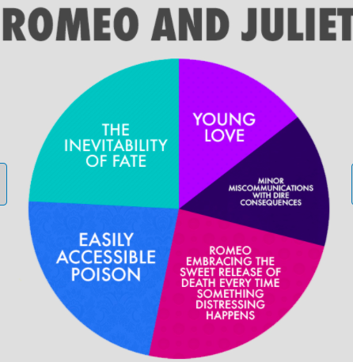

Slide 14
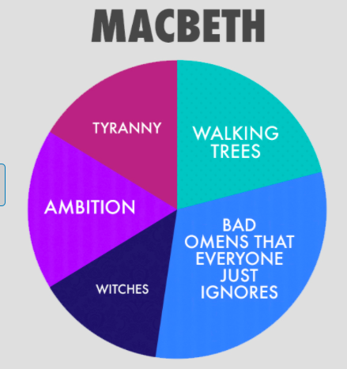

Slide 15
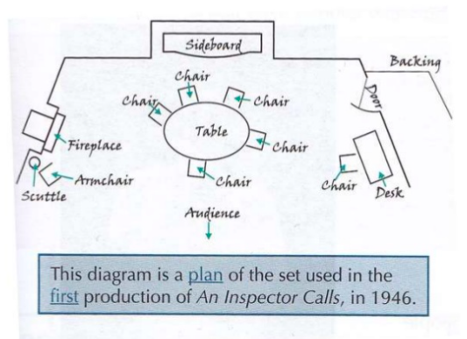

Slide 16

Boys Don’t Cry Summary
The novel opens with Dante at home awaiting his __________. When the doorbell rings his excitement is short-lived as it is Melanie, with a baby. Melanie tells him that the baby, Emma, is his and after leaving the baby with him in order to go to the shops, she tells him on the phone that she cannot ____ and is leaving Emma with him. Dante’s results arrive and he is disappointed in his father’s _______ reaction. Tyler’s response to the arrival of Emma is immediately _______ rather than __________; he goes out to buy everything Dante will need and is insistent that Dante rise to the challenge of caring for his daughter. Dante struggles to ____ with Emma and spends his first night alone with her; shocked by how difficult it is to look after a small child. Dante’s story is __________ with Adam’s, who is taken to the hospital by his father to find out about his _________. Unlike Dante, he is instantly smitten with Emma and finds showing his love for her very easy. Dante and Adam have a conversation about Adam’s _________, where it becomes clear that whilst Adam is very __________ about being gay, Dante is more _________ and feels that Adam might grow out of it.
With nobody around to look after Emma, Dante takes her with him to ___ _____ as he does not want to miss out on his ‘once-in-a-lifetime’ celebration of his A Level results. At the bar he meets up with ________, his new girlfriend, and his friends ____, Logan and others. He tells his friends Emma is a ________ but when Adam turns up Dante is worried that his brother will ‘give the game away’. When Adam is asked to leave by Josh, _____ fails to defend him. Emma starts to cry and when _____ calls her ‘ugly’ it is a turning point for Dante, who tells them she is his daughter. Collette finds it hard to handle. Dante leaves the bar and decides to get a ___ ____. Aunt ______ turns up and is an unexpected source of support to Dante, telling him that all parents worry ’about mucking it up’. Dante begins to come to terms with parenthood, taking Emma to the playground and experiencing a moment of _____ when she starts crawling.
Dante tells his father he has given up on __________ as he needs to look after his daughter; when he opens the DNA test it confirms her parentage. Dante starts to enjoy __________ but Collette struggles and involves her sister, a ______ ______, who visits and panics Dante into thinking his daughter will be taken away. Meanwhile, Adam’s chapters tell of his happiness over a new ____________, but he does not reveal who the person is. He ends the relationship as the person involved will not publicly acknowledge Adam. At a celebration for Dante’s birthday, Josh openly insults Adam, calling him a ‘_____ son-of-a-bitch’. On the way home, Josh beats Adam badly and he is hospitalised. Whilst at the hospital with his father and Aunt Jackie, Dante finds out that his father’s reticence is due to his disappointment that Dante has followed in his footsteps by becoming a ______ ___ _____. Father and son finally share their feelings. Dante tries to take ______ by finding Josh, and Dante is shocked when Josh reveals his is gay. When Adam returns home he finds it hard to come to terms with his altered __________ and attempts suicide. The novel ends with Emma bringing the brothers together, Adam coming to terms with appearance, and Dante realising that the Bridgemans have become a ______at last.

Slide 17
Boys Don’t Cry Summary
The novel opens with Dante at home awaiting his A Level results. When the doorbell rings his excitement is short-lived as it is Melanie, with a baby. Melanie tells him that the baby, Emma, is his and after leaving the baby with him in order to go to the shops, she tells him on the phone that she cannot cope and is leaving Emma with him. Dante’s results arrive and he is disappointed in his father’s low key reaction. Tyler’s response to the arrival of Emma is immediately practical rather than emotional; he goes out to buy everything Dante will need and is insistent that Dante rise to the challenge of caring for his daughter. Dante struggles to bond with Emma and spends his first night alone with her, and is shocked by how difficult it is to look after a small child. Dante’s story is interspersed with Adam’s, who is taken to the hospital by his father to find out about his headaches. Unlike Dante, he is instantly smitten with Emma and finds showing his love for her very easy. Dante and Adam have a conversation about Adam’s sexuality, where it becomes clear that whilst Adam is very comfortable about being gay, Dante is more conflicted and feels that Adam might grow out of it.
With nobody around to look after Emma, Dante takes her with him to Bar Belle as he does not want to miss out on his ‘once-in-a-lifetime’ celebration of his A Level results. At the bar he meets up with Collette, his new girlfriend, and his friends Josh, Logan and others. He tells his friends Emma is a relative but when Adam turns up Dante is worried that his brother will ‘give the game away’. When Adam is asked to leave by Josh, Dante fails to defend him. Emma starts to cry and when Logan calls her ‘ugly’ it is a turning point for Dante, who tells them she is his daughter. Collette finds it hard to handle. Dante leaves the bar and decides to get a DNA test. Aunt Jackie turns up and is an unexpected source of support to Dante, telling him that all parents worry ’about mucking it up’. Dante begins to come to terms with parenthood, taking Emma to the playground and experiencing a moment of panic when she starts crawling.
Dante tells his father he has given up on university as he needs to look after his daughter; when he opens the DNA test it confirms her parentage. Dante starts to enjoy parenthood but Collette struggles and involves her sister, a social worker, who visits and panics Dante into thinking his daughter will be taken away. Meanwhile, Adam’s chapters tell of his happiness over a new relationship, but he does not reveal who the person is. He ends the relationship as the person involved will not publicly acknowledge Adam. At a celebration for Dante’s birthday, Josh openly insults Adam, calling him a ‘queer son-of-a-bitch’. On the way home, Josh beats Adam badly and he is hospitalised. Whilst at the hospital with his father and Aunt Jackie, Dante finds out that his father’s reticence is due to his disappointment that Dante has followed in his footsteps by becoming a father too young. Father and son finally share their feelings. Dante tries to take revenge by finding Josh, and Dante is shocked when Josh reveals his is gay. When Adam returns home he finds it hard to come to terms with his altered appearance and attempts suicide. The novel ends with Emma bringing the brothers together, Adam coming to terms with appearance, and Dante realising that the Bridgemans have become a family at last.

Slide 18
Correct the mistakes
Macbeth kills Macduff | Macbeth sees the ghost of Lady Macbeth
Witches were thought to be holy in 16th and 17th centuries | At the start, Macbeth and Banquo are given five prophecies
Duncan is killed in his own castle | Malcolm becomes king as he was adopted

Slide 19
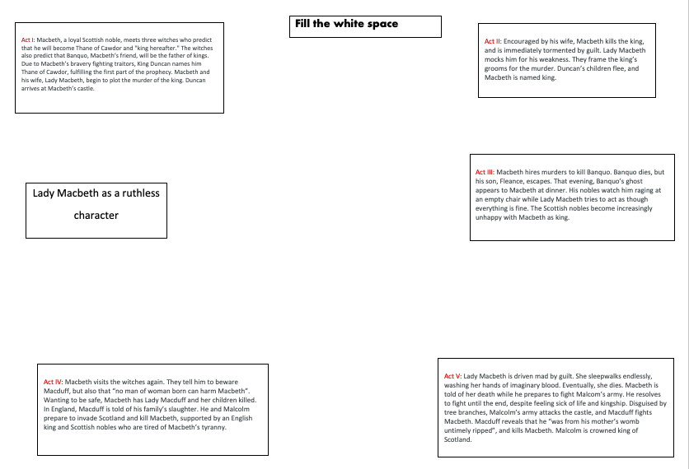

Slide 20
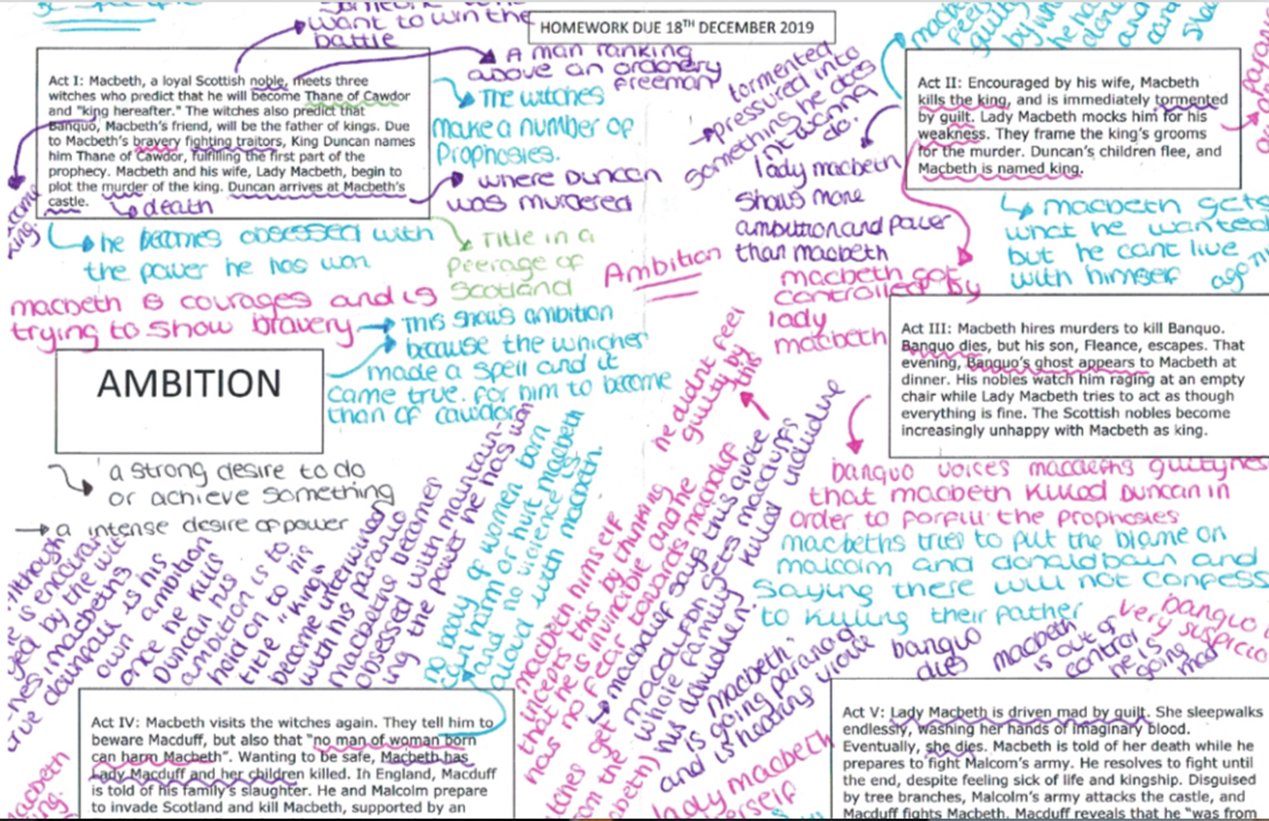

Slide 21
How does Sheila develop over the course of the play?
Gerald admits his relationship with Eva, who had changed her name to Daisy
Sheila is angry with Gerald and gives the ring back
Mrs Birling tries to bully the Inspector
Sheila realises her mother might have something to do with Eva’s death.
Mrs Birling admits turning the girl away from her charity
It is revealed that Eva was pregnant
Sheila accuses Eric of being drunk
Sheila shows excitement about her engagement ring
Mr Birling makes a pompous speech outlining his views
The Inspector arrives
Birling denies responsibility for Eva’s death, and shows no remorse.
Sheila realises her jealousy caused Eva to be sacked
Left alone with Gerald, Sheila warns him not to lie
Eric confesses to his relationship with the girl and realises she was pregnant
Eric accuses his mother of killing Eva and his child
The Inspector makes a dramatic speech about social responsibility
The Inspector leaves
Gerald and Mr Birling work out that the man was not a police inspector
Eric and Sheila feel guilty; the others shrug off any guilt and relax
The telephone rings; an inspector is on the way.

Slide 22
Birling presents himself as a man of experience and wisdom, lecturing the young men on man’s responsibilities, which he believes are to look after himself and his family. Talks about war and Titanic which suggest his experience is not that valid.
Gerald admits his relationship with Eva, who had changed her name to Daisy
Sheila is angry with Gerald and gives the ring back
Gerald leaves as he is upset and saddened by Eva’s death
Mrs Birling tries to bully the Inspector
Sheila realises her mother might have something to do with Eva’s death. She criticises her mother and tries to stop her talking
Mrs Birling admits turning the girl away from her charity
It is revealed that Eva was pregnant
Sheila accuses Eric of being drunk
Sheila shows excitement about her engagement ring
Mr Birling makes a pompous speech outlining his views
The Inspector arrives
Birling denies responsibility for Eva’s death, and shows no remorse.
Sheila realises her jealousy caused Eva to be sacked
Left alone with Gerald, Sheila warns him not to lie
First sign that Sheila will learn from experience as she shows some remorse; but still concerned about the impact on herself, rather than the wider idea of responsibility.
Sheila learns from experience and accepts responsibility and is frightened of her parents’ jovial response to the hoax. Eric also appears to have learned – he agrees with his sister.
Eric confesses to his relationship with the girl and realises she was pregnant
Eric accuses his mother of killing Eva and his child
The Inspector makes a dramatic speech about social responsibility
The Inspector leaves
Gerald and Mr Birling work out that the man was not a police inspector
Eric and Sheila feel guilty; the others shrug off any guilt and relax
Gerald offers Sheila the ring back, suggesting everything is alright now.
The telephone rings; an inspector is on the way.

Slide 23
Stave 1 - Scrooge, an ageing miser, dislikes Christmas and refuses a dinner invitation from his nephew Fred. He turns away two men who seek a donation for the poor and only grudgingly allows his overworked, underpaid clerk, Bob Cratchit, Christmas Day off with pay. That night Scrooge is visited at home by Marley (his old partner’s) ghost, who is weighed down by heavy chains and money boxes from a lifetime of greed. Marley tells Scrooge that he has a single chance to avoid the same fate: he will be visited by three spirits and must listen or be cursed
Stave 2 - The first spirit, the Ghost of Christmas Past, takes Scrooge to Christmas scenes of Scrooge's boyhood. The scenes reveal Scrooge's childhood at school, his relationship with his sister, Fan, and a Christmas party hosted by Mr Fezziwig. Scrooge's fiancée Belle is shown ending their relationship, as she realises that he will never love her as much as he loves money. Finally, they visit a now-married Belle with her large, happy family on the Christmas Eve that Marley died. Scrooge, upset by hearing Belle's description of the man that he has become, demands that the ghost remove him from the house..
Themes – fill this white space with ideas about where themes are reflected in the plot.
Stave 5 -Scrooge awakens on Christmas morning a changed man. He makes a large donation to the charity, sends a large turkey to the Cratchit home for Christmas dinner and spends the afternoon with Fred's family. The following day he gives Cratchit an increase in pay, and begins to become a father figure to Tiny Tim. From then on Scrooge treats everyone with kindness, generosity and compassion, embodying the spirit of Christmas.
Stave 4 - The third spirit, the Ghost of Christmas Yet to Come, shows Scrooge a Christmas Day in the future. The ghost reveals scenes involving the death of a disliked man. Others are relieved he is dead as they have more time to pay their debts. The ghost shows him Bob Cratchit and his family mourning the death of Tiny Tim. The ghost then allows Scrooge to see a neglected grave, with a tombstone bearing Scrooge's name. Sobbing, Scrooge pledges to change his ways.
Stave 3 - The second spirit, the Ghost of Christmas Present, visit Fred's Christmas party. They also see Bob Cratchit's family feast and his youngest son, Tiny Tim, who is seriously ill. The spirit informs Scrooge that Tiny Tim will die unless the course of events changes. Before disappearing, the spirit shows Scrooge two children named Ignorance and Want. He tells Scrooge to beware the former above all

Slide 24
Stave 1 - Scrooge, an ageing miser, dislikes Christmas and refuses a dinner invitation from his nephew Fred. He turns away two men who seek a donation for the poor and only grudgingly allows his overworked, underpaid clerk, Bob Cratchit, Christmas Day off with pay. That night Scrooge is visited at home by Marley (his old partner’s) ghost, who is weighed down by heavy chains and money boxes from a lifetime of greed. Marley tells Scrooge that he has a single chance to avoid the same fate: he will be visited by three spirits and must listen or be cursed
Stave 2 - The first spirit, the Ghost of Christmas Past, takes Scrooge to Christmas scenes of Scrooge's boyhood. The scenes reveal Scrooge's childhood at school, his relationship with his sister, Fan, and a Christmas party hosted by Mr Fezziwig. Scrooge's fiancée Belle is shown ending their relationship, as she realises that he will never love her as much as he loves money. Finally, they visit a now-married Belle with her large, happy family on the Christmas Eve that Marley died. Scrooge, upset by hearing Belle's description of the man that he has become, demands that the ghost remove him from the house..
Scrooge is a miser who puts his own greed and love of money above everything else. He is obsessed with money and becomes alone and unloved.
Poverty | Greed | Love & Friendship | Supernatural | transformation | Time | Isolation
Scrooge sees how his actions in the past impact on the future and this makes him change his ways and transform his personality.
The third spirit travels through time to the future but also shows Scrooge that he still has time to improve his own life and the lives of others.
Stave 5 -Scrooge awakens on Christmas morning a changed man. He makes a large donation to the charity, sends a large turkey to the Cratchit home for Christmas dinner and spends the afternoon with Fred's family. The following day he gives Cratchit an increase in pay, and begins to become a father figure to Tiny Tim. From then on Scrooge treats everyone with kindness, generosity and compassion, embodying the spirit of Christmas.
Stave 4 - The third spirit, the Ghost of Christmas Yet to Come, shows Scrooge a Christmas Day in the future. The ghost reveals scenes involving the death of a disliked man. Others are relieved he is dead as they have more time to pay their debts. The ghost shows him Bob Cratchit and his family mourning the death of Tiny Tim. The ghost then allows Scrooge to see a neglected grave, with a tombstone bearing Scrooge's name. Sobbing, Scrooge pledges to change his ways.
Stave 3 - The second spirit, the Ghost of Christmas Present, visit Fred's Christmas party. They also see Bob Cratchit's family feast and his youngest son, Tiny Tim, who is seriously ill. The spirit informs Scrooge that Tiny Tim will die unless the course of events changes. Before disappearing, the spirit shows Scrooge two children named Ignorance and Want. He tells Scrooge to beware the former above all

Slide 25
Tolerance
Growing up
Anger
Masculinity
Family
Fatherhood
Dante
Adam
Tyler
Melanie
Josh
Collette
Aunt Jackie
Emma
Melanie leaves the baby with Dante
Tyler’s response to Dante’s results disappoints his son, but Tyler does give practical support with Emma
Dante struggles to bond with Emma, but Adam finds her instantly loveable
Dante and Adam talk about Adam’s sexuality, Adam is comfortable with it but Dante is conflicted.
Dante fails to defend his brother from insults in the Bar Belle, but defends his daughter from taunts that she is ‘ugly’
Aunt Jackie turns up and supports Dante, Dante starts to come to terms with parenthood, worrying when Emma start crawling.
Adam starts a secret relationship with Josh.
Dante gives up on university and starts to enjoy parenthood, but Collette interferes and involves social services
Josh insults Adam on a night out and then beats him badly on the way home. Dante and his father finally talk properly.
Dante goes to take revenge and finds out Josh is gay.
Adam attempts suicide. He comes to terms with his altered appearance and the family finally bond.

Slide 26
Tolerance
Growing up
Anger
Masculinity
Family
Fatherhood
Dante
Adam
Tyler
Melanie
Josh
Collette
Aunt Jackie
Emma
Dante initially tolerates his friends’ casual homophobia
Dante is initially immature and naïve about parenthood, resenting the fact that Emma is putting a stop to his dreams of university.
Tyler is unable to express his emotions, taking an authoritarian approach, making Dante feel resentful.
Aunt Jackie shows importance of extended family
Melanie leaves the baby with Dante
Tyler’s response to Dante’s results disappoints his son, but Tyler does give practical support with Emma
Dante struggles to bond with Emma, but Adam finds her instantly loveable
Dante and Adam talk about Adam’s sexuality, Adam is comfortable with it but Dante is conflicted.
Dante fails to defend his brother from insults in the Bar Belle, but defends his daughter from taunts that she is ‘ugly’
Aunt Jackie turns up and supports Dante, Dante starts to come to terms with parenthood, worrying when Emma start crawling.
Adam starts a secret relationship with Josh.
Dante gives up on university and starts to enjoy parenthood, but Collette interferes and involves social services
Josh insults Adam on a night out and then beats him badly on the way home. Dante and his father finally talk properly.
Dante goes to take revenge and finds out Josh is gay.
Adam attempts suicide. He comes to terms with his altered appearance and the family finally bond.

Slide 27
What do you feel about any issues raised here?
What experience do you have of any of the issues?
The novel opens with Dante at home awaiting his A Level results. When the doorbell rings his excitement is short-lived as it is Melanie, with a baby. Melanie tells him that the baby, Emma, is his and after leaving the baby with him in order to go to the shops, she tells him on the phone that she cannot cope and is leaving Emma with him. Dante’s results arrive and he is disappointed in his father’s low key reaction. Tyler’s response to the arrival of Emma is immediately practical rather than emotional; he goes out to buy everything Dante will need and is insistent that Dante rise to the challenge of caring for his daughter. Dante struggles to bond with Emma and spends his first night alone with her, and is shocked by how difficult it is to look after a small child. Dante’s story is interspersed with Adam’s, who is taken to the hospital by his father to find out about his headaches. Unlike Dante, he is instantly smitten with Emma and finds showing his love for her very easy. Dante and Adam have a conversation about Adam’s sexuality, where it becomes clear that whilst Adam is very comfortable about being gay, Dante is more conflicted and feels that Adam might grow out of it.
With nobody around to look after Emma, Dante takes her with him to Bar Belle as he does not want to miss out on his ‘once-in-a-lifetime’ celebration of his A Level results. At the bar he meets up with Collette, his new girlfriend, and his friends Josh, Logan and others. He tells his friends Emma is a relative but when Adam turns up Dante is worried that his brother will ‘give the game away’. When Adam is asked to leave by Josh, Dante fails to defend him. Emma starts to cry and when Logan calls her ‘ugly’ it is a turning point for Dante, who tells them she is his daughter. Collette finds it hard to handle. Dante leaves the bar and decides to get a DNA test. Aunt Jackie turns up and is an unexpected source of support to Dante, telling him that all parents worry ’about mucking it up’. Dante begins to come to terms with parenthood, taking Emma to the playground and experiencing a moment of panic when she starts crawling.
Dante tells his father he has given up on university as he needs to look after his daughter; when he opens the DNA test it confirms her parentage. Dante starts to enjoy parenthood but Collette struggles and involves her sister, a social worker, who visits and panics Dante into thinking his daughter will be taken away. Meanwhile, Adam’s chapters tell of his happiness over a new relationship, but he does not reveal who the person is. He ends the relationship as the person involved will not publicly acknowledge Adam. At a celebration for Dante’s birthday, Josh openly insults Adam, calling him a ‘queer son-of-a-bitch’. On the way home, Josh beats Adam badly and he is hospitalised. Whilst at the hospital with his father and Aunt Jackie, Dante finds out that his father’s reticence is due to his disappointment that Dante has followed in his footsteps by becoming a father too young. Father and son finally share their feelings. Dante tries to take revenge by finding Josh, and Dante is shocked when Josh reveals his is gay. When Adam returns home he finds it hard to come to terms with his altered appearance and attempts suicide. The novel ends with Emma bringing the brothers together, Adam coming to terms with appearance, and Dante realising that the Bridgemans have become a family at last.

Slide 28
What do you know about any of this?
How is your experience of life different to that of Eva or the Birlings?
An Inspector Calls by J B Priestley, is a three-act play that revolves around the apparent suicide of a young woman, Eva Smith. It was first performed in the Soviet Union in 1945, and in England the following year. The focus is the prosperous Birling family, who live in a comfortable home in the fictional town of Brumley. They are visited by the mysterious Inspector Goole during their celebration of the engagement of Sheila Birling to Gerald Croft. The Inspector reveals that a girl called Eva Smith has taken her own life by drinking disinfectant. The family are horrified but initially confused as to why the Inspector has called to see them. What follows is a tense and uncomfortable investigation by an all-knowing Inspector through which the family discover that they are all in fact caught up in this poor girl's death.
Mr Birling sacked her as she wanted a pay rise, Sheila used her status as a valued customer to have her dismissed from a dress shop. Both Gerald and Eric had sexual relationships with her and then discarded her. When she was pregnant and desperate, she turned to Mrs Birling’s charity, but was turned away. At the time the play was set, 1912, there was no welfare state.

Slide 29
16.1% of single-parent households today are headed by fathers | Educational performance appears to be one of the main barriers which stop people moving out of poverty. [2012] | Black Lives Matter
‘An adroit investigation of [modern] family relations, very clearly portrayed’ [Guardian review | Stonewall | Men or mice: is masculinity in crisis? [Guardian, 2017]
1995, Famous dark stout drink made in Dublin had been due to run a commercial directed by Tony Kaye featuring two men kissing to the sound of Tammy Wynette’s Stand By Your Man. It was cancelled. | Social norms have also changed. In early 2000s, a lot of young female role models were getting pregnant. Among some young women it was a mark of status to get pregnant. Now it’s considered totally uncool. | One in four children now grow up in one-parent homes and 42% of marriages end in divorce

Slide 30
Context – here are some ideas
Dante reflects a positive message – he suggests a meritocratic ideal because despite his ethnicity and single-parent background, he gets four A* at A Level and a university place. It is also not presented in the novel as something unusual.
16.1% of single-parent households today are headed by fathers | Educational performance appears to be one of the main barriers which stop people moving out of poverty. [2012] | Black Lives Matter
‘An adroit investigation of [modern] family relations, very clearly portrayed’ [Guardian review | Stonewall | Men or mice: is masculinity in crisis? [Guardian, 2017]
1995, Guinness had been due to run a commercial directed by Tony Kaye featuring two men kissing to the sound of Tammy Wynette’s Stand By Your Man. It was cancelled. | Social norms have also changed. In early 2000s, a lot of young female role models were getting pregnant. Among some young women it was a mark of status to get pregnant. Now it’s considered totally uncool. | One in four children now grow up in one-parent homes and 42% of marriages end in divorce
Adam reflects the more enlightened 21st century acceptance of homosexuality, but Blackman shows that intolerance still exists as she presents Josh as conflicted about his sexuality. Dante also does not automatically stand up for his brother, reflecting the casual homophobia still present in society.
Melanie is presented as alone and struggling at the start of the novel, suggesting that society does not adequately support young single mothers. The judgmental nature of society is also represented by the woman in the shop, who assumes Dante is living on benefits.

Slide 31


KING MALCOLM
We shall not spend a large expense of time
Before we reckon with your several loves,
And make us even with you. My thanes and kinsmen,
Henceforth be earls, the first that ever Scotland
In such an honor nam’d. What’s more to do,
Which would be planted newly with the time,
As calling home our exil’d friends abroad
That fled the snares of watchful tyranny,
Producing forth the cruel ministers
Of this dead butcher and his fiend-like queen,
Who (as ’tis thought) by self and violent hands
Took off her life; this, and what needful else
That calls upon us, by the grace of Grace,
We will perform in measure, time, and place.
So thanks to all at once and to each one,
Whom we invite to see us crown’d at Scone.
Flourish. Exeunt omnes.
Describe Malcom in :
Six adjectives:
Three:
Summarise the speech in 3 sentences
FIND :
Something that would remind the audience of his father.
Something that shows he does not want to accord Macbeth any dignity.
A sign that he believes in democracy.
Crunch the speech – find the nine juiciest words

Slide 32
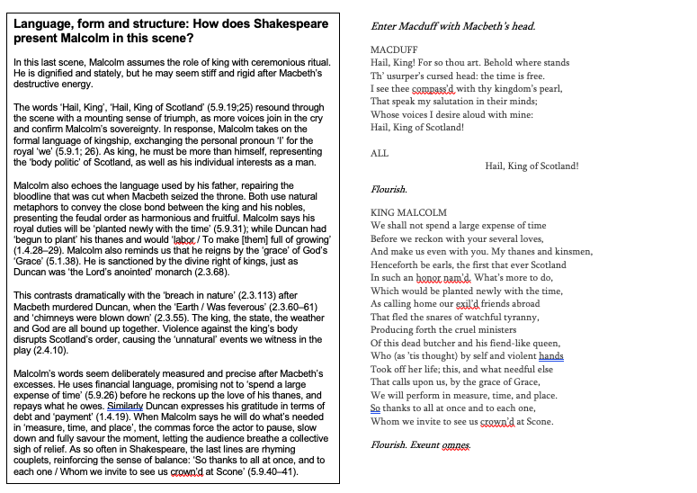
British Library

Slide 33
Building up your comparison
Exposure | Images of war
Our brains ache, in the merciless iced east winds that knive us . . . Wearied we keep awake because the night is silent . . . Low drooping flares confuse our memory of the salient . . . Worried by silence, sentries whisper, curious, nervous, But nothing happens. Watching, we hear the mad gusts tugging on the wire, Like twitching agonies of men among its brambles. Northward, incessantly, the flickering gunnery rumbles, Far off, like a dull rumour of some other war. What are we doing here? The poignant misery of dawn begins to grow . . . We only know war lasts, rain soaks, and clouds sag stormy. Dawn massing in the east her melancholy army Attacks once more in ranks on shivering ranks of grey, But nothing happens. Sudden successive flights of bullets streak the silence. Less deadly than the air that shudders black with snow, With sidelong flowing flakes that flock, pause, and renew, We watch them wandering up and down the wind’s nonchalance, But nothing happens Pale flakes with fingering stealth come feeling for our faces— We cringe in holes, back on forgotten dreams, and stare, snow-dazed, Deep into grassier ditches. So we drowse, sun-dozed, Littered with blossoms trickling where the blackbird fusses. —Is it that we are dying? Slowly our ghosts drag home: glimpsing the sunk fires, glozed With crusted dark-red jewels; crickets jingle there; For hours the innocent mice rejoice: the house is theirs; Shutters and doors, all closed: on us the doors are closed,— We turn back to our dying. Since we believe not otherwise can kind fires burn; Now ever suns smile true on child, or field, or fruit. For God’s invincible spring our love is made afraid; Therefore, not loath, we lie out here; therefore were born, For love of God seems dying. Tonight, this frost will fasten on this mud and us, Shrivelling many hands, and puckering foreheads crisp. The burying-party, picks and shovels in shaking grasp, Pause over half-known faces. All their eyes are ice, But nothing happens. | Point 1
 | Point 2
 | Point 3
 | Relevant context? Which point to connect it with.

Slide 34
Building up your comparison
Exposure | Images of war
Our brains ache, in the merciless iced east winds that knive us . . . Wearied we keep awake because the night is silent . . . Low drooping flares confuse our memory of the salient . . . Worried by silence, sentries whisper, curious, nervous, But nothing happens. Watching, we hear the mad gusts tugging on the wire, Like twitching agonies of men among its brambles. Northward, incessantly, the flickering gunnery rumbles, Far off, like a dull rumour of some other war. What are we doing here? The poignant misery of dawn begins to grow . . . We only know war lasts, rain soaks, and clouds sag stormy. Dawn massing in the east her melancholy army Attacks once more in ranks on shivering ranks of grey, But nothing happens. Sudden successive flights of bullets streak the silence. Less deadly than the air that shudders black with snow, With sidelong flowing flakes that flock, pause, and renew, We watch them wandering up and down the wind’s nonchalance, But nothing happens Pale flakes with fingering stealth come feeling for our faces— We cringe in holes, back on forgotten dreams, and stare, snow-dazed, Deep into grassier ditches. So we drowse, sun-dozed, Littered with blossoms trickling where the blackbird fusses. —Is it that we are dying? Slowly our ghosts drag home: glimpsing the sunk fires, glozed With crusted dark-red jewels; crickets jingle there; For hours the innocent mice rejoice: the house is theirs; Shutters and doors, all closed: on us the doors are closed,— We turn back to our dying. Since we believe not otherwise can kind fires burn; Now ever suns smile true on child, or field, or fruit. For God’s invincible spring our love is made afraid; Therefore, not loath, we lie out here; therefore were born, For love of God seems dying. Tonight, this frost will fasten on this mud and us, Shrivelling many hands, and puckering foreheads crisp. The burying-party, picks and shovels in shaking grasp, Pause over half-known faces. All their eyes are ice, But nothing happens. | Point 1 – emotions of soldiers. The opening stanza is powerful as it shows the fear of the men during the cold, silent night. The stanza shows the psychological effects of war as their ‘brains ache’. The use of the words ‘silence’, ’whisper’, ‘curious’, ‘nervous’ show how the men are on edge and terrified by everything. Owen then ends the tension by saying ‘but nothing happens’. The repetition of this phrase at the end of a number of the stanzas underlines not only how the soldiers are living in constant fear, but that the war is futile or pointless
 | Point 2 – Inevitability of death. The second part of the poem uses a lot of images and motifs of death and how it is inevitable. The soldiers’ despair is reflected by the use of rhetorical questions – ‘is it that we are dying?’. The use of the word ‘ghost’ also implies that they feel dead and forgotten by people at home – ‘on us the doors are closed’. They have lost all faith – ‘For love of God seems dying’ which shows the reader how the soldiers have accepted death as inevitable
 | Point 3 – Dangers of battle Owen uses alliteration to describe the bullets which are being fired from the enemy when he refers to how the ‘sudden successive flights of bullets streak the silence.’ This powerful image allows the reader to understand how close to the war the soldiers were as they can hear the bullets. This adds to the description of how the ‘flickering gunnery rumbles’ to show the reader what war is really like
 | Relevant context? Which point to connect it with. Poem is set in World War One in the trenches. Owen is a soldier who died in the war. This links to point 1 as we are getting a first hand account from a person who was directly involved in the war.

Slide 35
Building up your comparison
Charge of the Light Brigade |  | Images of war
Half a league, half a league, Half a league onward, All in the valley of Death Rode the six hundred. ‘Forward, the Light Brigade! Charge for the guns!’ he said: Into the valley of Death Rode the six hundred. ‘Forward, the Light Brigade!’ Was there a man dismay’d? Not tho’ the soldier knew Someone had blunder’d: Their’s not to make reply, Their’s not to reason why, Their’s but to do and die: Into the valley of Death Rode the six hundred. Cannon to right of them, Cannon to left of them, Cannon in front of them Volley’d and thunder’d; Storm’d at with shot and shell, Boldly they rode and well, Into the jaws of Death, Into the mouth of Hell Rode the six hundred. | Flash’d all their sabres bare, Flash’d as they turn’d in air Sabring the gunners there, Charging an army, while All the world wonder’d: Plunged in the battery-smoke Right thro’ the line they broke; Cossack and Russian Reel’d from the sabre-stroke Shatter’d and sunder’d. Then they rode back, but not Not the six hundred. Cannon to right of them, Cannon to left of them, Cannon behind them Volley’d and thunder’d; Storm’d at with shot and shell, While horse and hero fell, They that had fought so well Came thro’ the jaws of Death, Back from the mouth of Hell, All that was left of them, Left of six hundred. When can their glory fade? O the wild charge they made! All the world wonder’d. Honour the charge they made! Honour the Light Brigade, Noble six hundred! | Point 1 – Emotions of soldiers
 |  | Point 2 – Inevitability of death . The use of religious imagery underlines the fact that many of the soldiers will die. Tennyson uses the biblical allusion – ‘Valley of Death’ as well as personification when he refers to the ‘jaws of Death’. This leaves the reader in no doubt that the soldiers will not all return. This is confirmed at the end of the 4th stanza with the line ‘not the six hundred’.
 |  | Point 3 – Dangers of battle
 |  | Relevant context? Which point to connect it with.

Slide 36
GCSE (9-1) English
Tea Break

Slide 37
Tea break
Your time to share ideas, inspire each other with great ideas or just say hello.

Slide 38
GCSE (9-1) English
Shared Resources

Slide 39
Thanks for sharing!
These will all be available on the webpage link below
English GCSE Webinar resource page

Slide 40
Any other ideas to share? £25 voucher shared resource (fortnightly draw)
If you send them to us at
thefullenglish@pearson.com
we will make them available to all who have signed up today.
Send us your requests (through the questionnaire link at the end) for next week – I’ll try my best to come up with something.

Slide 41
£10 voucher and the winner is..
Weekly Draw for
feedback survey

Slide 42
Further dates
9th July 2020 – Special guest Benjamin Zephaniah! Focus on Diversity in Literature
16th July 2020 – Language: Looking ahead to 2021
Book your place!

Slide 43
Additional free online support
Tuesday 14th July:
NQT – Preparing for your first year. All subjects and exam boards welcome.
Wednesday 15th July:
Heads of Department – Preparing for the return in September.

Slide 44
GCSE (9-1) English
What more can we do to help?

Slide 45
The latest current and 2021 updates can be found through the following link and will be updated as soon as new information is available
https://qualifications.pearson.com/en/campaigns/pearson-covid-19/united-kingdom-covid-19-coronavirus-update.html

Slide 46
Free online lessons for Year 10 students
6 weekly 45 minute lessons delivered by a teacher
Started 3rd June
English Language focus
Follow this link

Slide 47
New Knowledge Organisers
Boys Don’t Cry
The Empress
Refugee Boy
Coram Boy
Follow this link

Slide 48
Secondary resources
Sign-up for Secondary resources form is here: https://www.pearson.com/uk/educators/schools/update-for-schools/secondary-support.html
This gives access to:
KS3 Skills for Writing
Pearson Edexcel GCSE (9–1) English Language Text Anthology
Pearson Edexcel GCSE (9–1) English Language Core Student Book – coming soon!
Pearson Edexcel GCSE (9–1) English Language Revision Guide
AQA GCSE (9–1) English Language Revision Guide.

Slide 49
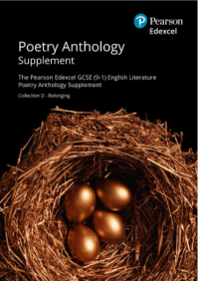
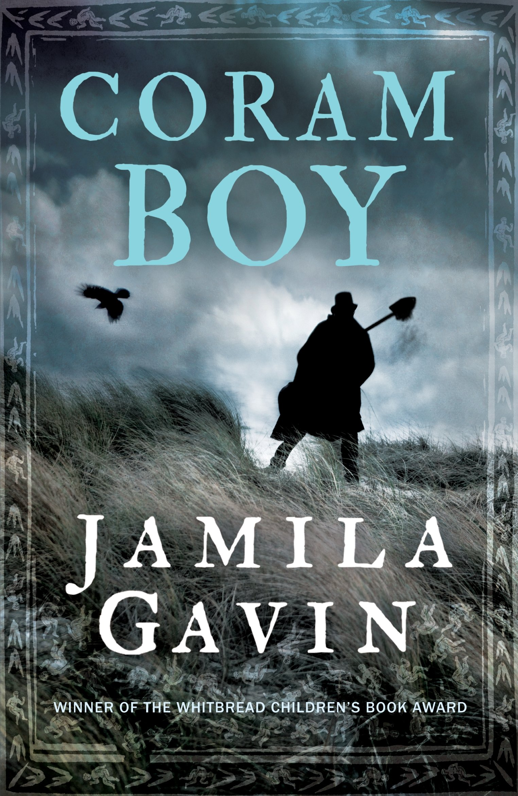


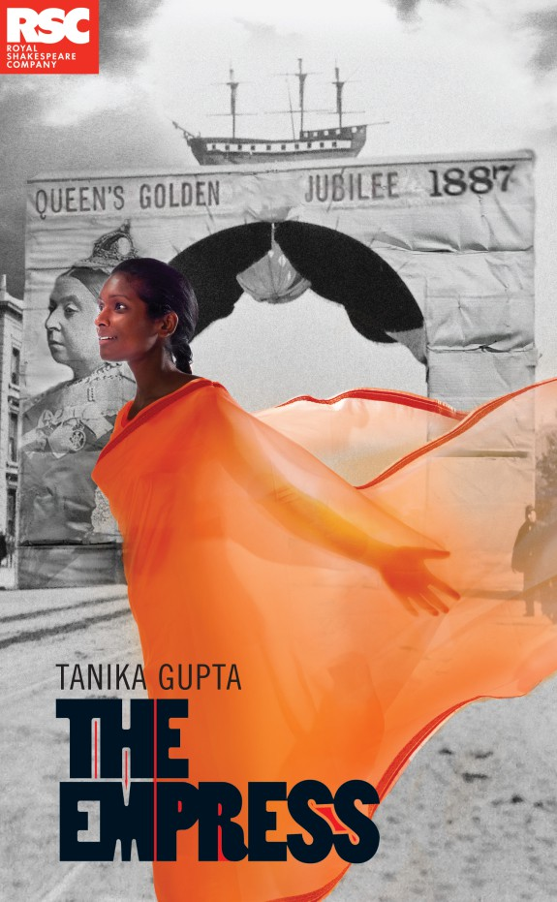

GCSE English Literature 1ET0
Introducing four new texts and a new poetry collection First teaching: September 2019
First assessment: May 2021
>Find out more on our website

Slide 50
Can you help with research?
Teacher assessed grades this summer – what has been your experience?
If you are a Head of Department*, we’d like to hear from you about your unique experiences at this unprecedented time. Please sign up here to speak to the Research team at Pearson.
All participants will be entered in a prize draw for £100 Amazon vouchers.
*Please get in touch if you are a HoD for any of the following subjects: GCSE/GCE Maths, English, History, Science, Art and Design, Tech Award Music, Tech Award Health and Social Care, BTEC National Applied Psychology, BTEC National Business, BTEC National Creative Media.

Slide 51

Your Subject Advisor
Clare Haviland
Telephone: 03330164120
Twitter: @PearsonTeachEng
Email or live chat
You can sign up for Clare’s
e-updates by completing this
online form
Facebook page: https://www.facebook.com/pearsonedexcelenglish/

Slide 52
Switching to Edexcel
https://www.youtube.com/watch?v=Q0DYFcgCejI.

Slide 53
Feedback

