Slide 1

TIMSS-based teacher workshops adding value to policy and practice in England
Jennie Golding (UCL);
Grace Grima (Pearson)

Slide 2




Background
England’s TIMSS background is summarised in the abstract
We report on the design, impact and evaluation of workshops for teachers in mathematics and science education, intended to add value to TIMSS participation by promoting interest in and understanding of TIMSS19 findings - but also probing specific outcomes, and their implications, in professionally-informed and collaborative ways, so as to support diagnostic and formative use of items
For specificity, we focus on the mathematics workshop

Slide 3

School-level impact of TIMSS in England
Historically, little professional engagement (though school reports), especially in subject-specific ways, though webinar national launch well-attended
Aims: begin to bridge the policy-practice gap in professionally-informed and collaborative ways while also enhancing teachers’ assessment literacy, including their appreciation of the potential of TIMSS to inform school-level approaches.
Design-based approach (Anderson & Shattuck, 2012) starting with a 1.5 hour web-based workshop for 80 (primary and secondary) mathematics education professionals in April 2021 (followed, by similar for science teachers and related workshop for school leadership+)
Content Slide Text Only with Color Accents

Slide 4
Research Questions and Initial design decisions
What potential professional development and policy issues are evidenced in participant responses to the workshop? How should workshop design be developed so as to enhance addressing of each of those?
Facilitated by assessment and subject-specific education experts, experienced in working with practising teachers, education practice, research and policy.
Focused on either mathematics or science; and, engaged with TIMSS structures and items at grades 4 and 8
Focus on potential learning from performance in relation to specific items.
Semi-structured, related to teachers’ classroom experience, and actively valuing what they bring
TIMSS IP: permission must be sought before using items

Slide 5
Content design
To interpret findings, teachers need:
Overview of TIMSS development and structure, including the approach to benchmarking and distribution of test items by content and cognitive domains, for comparison with their enacted, curriculum
Exposure to high level findings situating item-specific data, especially in the light of recent initiatives in England around adoption of ‘mastery’ approaches used in HPJs
Teachers then bring considerable contextualised knowledge, including around student dispositions.
Personal engagement with items: it is only by answering the question themselves that teachers begin to grasp the demands made
Opportunity for supported reflection on implications for them and barriers to addressing those

Slide 6
Practice- and policy-related design
We also wanted to know teachers’ views on
Why is the level of mathematics performance in grade 4 not (yet) continued into grade 8?
Are students building the depth of conceptual grasp and experience of cognitive challenge, as well as the productive dispositions (Kilpatrick et al., 2001), they need for long term progression, across content and cognitive domains?
How can the spread of performance be addressed?
Or difference in performance by socio-economic status?
…or differences in attitude by gender?

Slide 7
Structure for subject-specific workshops
What is TIMSS? High level national outcomes and international comparisons
Overview of Grade 4 subject content, outcomes by content and cognitive domain, and relationship with other variables
Sample gr4 items* released by benchmark and discussion: focus on items selected for their relative performance, relationship to policy intentions, and potential professional, implications
Similarly for grade 8
Overarching questions
  Which of these findings surprise you?
  What use could you make of the items in your classroom?
  How does the demand of the items compare with what is needed for deep conceptual understanding?
  What are the outcomes telling us about our priorities?
  What other questions are relevant to your practice (or would you like answered)?

Slide 8
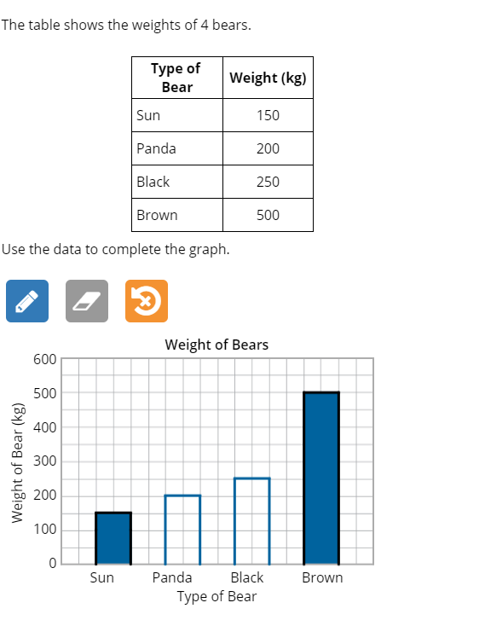
Addressing the spread
Gr 4 Low Benchmark item
HK: 98%
84%^, m=81%
Notes:
For example, Figure 1 shows a Grade 4 ‘Low Benchmark’ item, answered correctly by 84% of year 5 students in England, significantly above the international facility mean of 81%. Although data handling was the strongest content area for these year 5 participants, it is important to identify what might have precluded correct answering by the other 16% (Hong Kong’s facility, for example, was 98%).

Slide 9
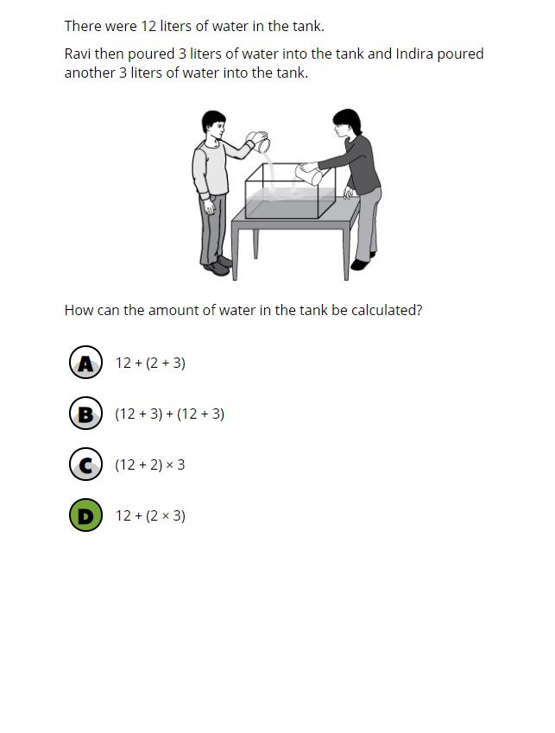
Grade 8 prerequisites
Gr 4 Intermediate Benchmark item
55%, m=53%
Notes:
Figure 2 shows another Grade 4 item, this time benchmarked as Intermediate. Facility in England was 55%, above the international mean, but not significantly so. The diagram supports understanding of the context, so the focus is on notation for arithmetic processes. This is key for building pre-algebraic understanding of number, and so for later development, but not easy to teach in meaningful ways, since experience needs to be built in a variety of embeddings. Primary school practitioners would benefit from understanding the later significance of such learning and sharing pedagogic approaches; secondary school practitioners should appreciate the related insecurities that students might bring, so that related ideas can be further strengthened; and professionals can then inform the ways in which policy is framed so as to support such notions.

Slide 10
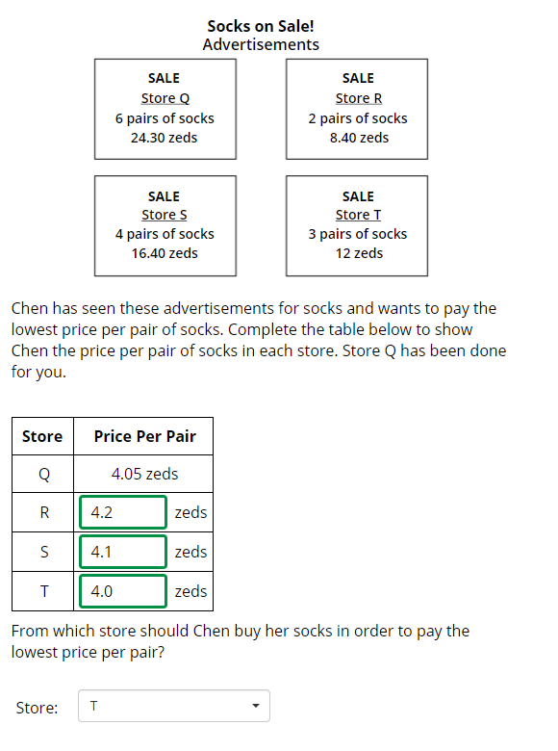
Gr 8 cross-curriculum
Gr 8 Intermediate benchmark item, covering both proportional reasoning and decimal comparison, through the context of money
59%, m=56%

Slide 11
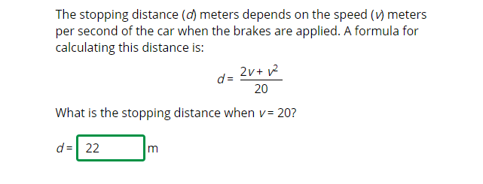
Gr 8 algebraic fluency
High benchmark item, important for later progression:
40%, m=35%

Slide 12
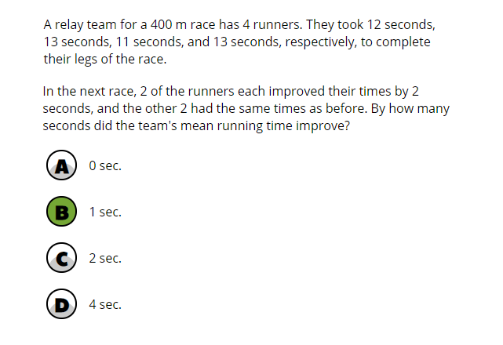
Grade 8 unstructured
Advanced benchmark item
35%*, m=35%

Slide 13
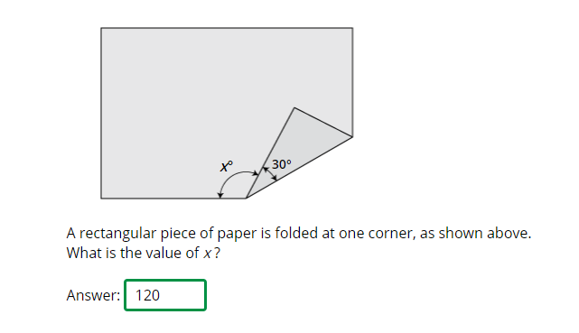
Grade 8 unstructured spatial reasoning
Advanced benchmark item
Note relationships of spatial reasoning with advanced mathematics fluency ( Wi et al., 2012)
26%, m=26%

Slide 14
Data and analysis
Analysis: constructivist grounded approach (Charmaz, 2014); interpretation informed by the literature on teacher professional development and that on teachers as policy players.
Focused on apparent relationships between design decisions and participant response, in relation to both need and evidence of professional development, and possible implications for policy and for teacher interaction with policy.
Data: Recordings of workshops, including related chat. The workshops were constrained to run remotely, with a facility for ‘chat’, because of the pandemic; recording was advertised in advance; and no breakout rooms.

Slide 15
Findings
Teachers pointed to validity issues such as familiarity with the digital interface; flexibility to cope with ‘Zeds’, English as a second language ….
Professional practice:
Teachers recognise engagement with items and related performance as helpful for classroom teaching, addressing desirable mathematical and scientific behaviours intended by national curricula, but often poorly represented in commonly used curriculum resources – or national assessments
Teachers recognise gains for both formative and summative literacy
They vary in their capacity to analyse the aspects of an item that might cause difficulty, but, some were able to identify, inter alia, that
- TIMSS tasks are more unstructured than many tasks commonly used in textbooks, or assessments, in England

Slide 16
Findings (continued)
- Tasks often cross mathematical area boundaries, again relatively uncommon in English classroom experiences
Tasks often use basic digital facility such as core spreadsheet functionality, exploration of scenarios using digital means: these are again not well-represented in most English classrooms
All these aspects represent highly valued areas of mathematical functioning
Confidence levels vary between teachers – for teaching and/or assessing and addressing item content
If mathematical behaviours represented in TIMSS are genuinely valued, teachers say it would be useful to access them in easily-useable formats (e.g. classroom item banks, enriched with focused pedagogical support for use - cf R&D department, Malta, 2014)

Slide 17
Conclusions
For TIMSS delivery: possible unfamiliarity for students (e.g. ‘liters’, zeds, but note adaptation)
For webinars: Organisation with (mixed phase) breakout rooms for discussion should support > opportunities for practitioner deep reflection
For research: if ‘TIMSS-thinking’ is valued, it’s possible also to develop data analysis around association of teacher (reported) behaviours with Ma/Sci attainment (that could be shared with teachers and with teacher educators: Erikkson 2019, Burroughs 2019) though it might be of limited reliability
Workshops can offer gains in summative and formative assessment literacy, and for subject-specific teaching – if workshops feature sufficient assessment, subject and subject pedagogical expertise
Careful design of such opportunities can enhance both professional knowledge and related policy, while also addressing barriers between teachers and policymakers
Such work can focus on fundamental purposes of mathematics education in an age of high stakes summative assessments

Slide 18

Thank you for listening
j.golding@ucl.ac.uk
grace.grima@pearson.com
Closing Slide

