Slide 1
A MULTIMODAL APPROACH TO WRITING
Reading and Writing with Technology
Kim Flachmann

Slide 2
The Basic Premises
Our students are reading and writing now more than they ever have before—in the form of email, text messages, blogs, Web sites, and Nings.
Students are surrounded by all forms of media daily: ads, music, videos, Podcasts, eBooks, photos.
Granted, these forms of communication are abbreviated and often superficial, but this is where we need to start.

Slide 3
Reading and Writing
Readers and writers need to work together to make meaning.
Teaching students how to read and write as part of a continuous process is essential to their success in these two skills.
Students will benefit from practicing the full integration of reading and writing.

Slide 4
Critical Thinking
Students need to progress from literal to interpretive to analytical thinking.
No matter what form of communication we use as a vehicle, we can teach analytical or critical thinking.
Critical thinking is an essential component of succeeding in college.
Critical thinking leads to close reading, which leads to “deeper” learning.

Slide 5
Active Reading
Students learn best from participating as fully as possible in their reading and writing.
We remember 10 percent of what we hear, 20 percent of what we read, and 80 percent of what we say and do.
So our students will learn most effectively if we actively involve them in the material.
Active reading also promotes “deeper” learning.

Slide 6
WPA Outcomes
Rhetorical Knowledge
Critical Thinking, Reading, and Composing
Processes
Knowledge and Conventions

Slide 7
Teaching an Essay
Traditional Apparatus
+
Technological Resources
+
Multimodal Assignments

Slide 8
Prereading
Approximately how many “friends” do you have? Do they fall into different categories? How many are you close to? What purpose do the others serve in your social network?
Why do so many people socialize on the Internet? What are the advantages and disadvantages of this type of networking?
Do you enjoy hearing stories about other people’s lives?

Slide 9
Author Biography
Michael Rogers is a “futurist-in-residence” at the New York Times Company, where he writes articles on media and technology. He also runs a speaking, writing, and consulting business called “Practical Futurist,” which he founded in 2004. He was previously the technology guru at Newsweek and vice president of the new media division at the Washington Post. His article “What Evolutionary Psychology Says about Social Networking” was originally published in an MSNBC column on September 10, 2007.

Slide 10
ESSAY
WHAT EVOLUTIONARY PSYCHOLOGY SAYS
ABOUT SOCIAL NETWORKING
by Michael Rogers
http://www.msnbc.msn.com/id/20642550/ns/technology _and_science-innovation/t/how-social-can-we-get/

Slide 11
Vocabulary
digerati: the elite of the computer industry and online communities
widgets: mini computer applications
blogosphere: all blogs and their interconnections
Paleolithic: a prehistoric era distinguished by the development of the first stone tools
hominids: a primate of a family (Hominidae) that includes humans and their fossil ancestors

Slide 12
Literal/Interpretive Questions
This essay focuses on both causes and effects. Write out the essay’s thesis, and list the causes and effects connected with that thesis. Then, circle the real causes. Does the author put more stress on causes or effects? Why do you think this is so?
What do you believe the author means when he says, “Facebook . . . might become the new Internet” (para. 1)? According to the information in this article, how realistic do you think this prediction is?
What does the timeline of social networking sites tell us about our instinctive need to gossip? According to Michael Rogers, in what ways is gossiping about relationships a basic necessity of human existence?
Robin Dunbar claims, “language evolved as a way to maintain and identify social relationships” (para. 6). What do you think he means by this statement?

Slide 13
Analytical Questions
Based on the information in this essay, what is the relationship between evolutionary psychology and gossip? Which is the cause, and which is the effect?
How are grooming and social networking related? What other social processes are involved in this relationship?
According to Dunbar, understanding their place in the “group hierarchy” (para. 4) was extremely important to the primates. Is this process still important today? What is the role of this process in human communication in our world today?
What is Rogers implying in this essay about the future of social networking?

Slide 14
Rhetorical Questions
Rogers uses several analogies or comparisons in his first two paragraphs. List these comparisons, and then discuss which ones you find most effective.
The author introduces Robin Dunbar early in the essay and then quotes him throughout the essay. What does Dunbar’s expertise add to Rogers's argument?
What does Rogers’ s reference to celebrity journalism contribute to the essay?
The author ends his essay with a series of questions that ask us to consider whether or not we are redefining human communication and our role as social creatures. Is this an effective ending to this essay or not? Add one more question to his list of inquiries.

Slide 15
Projects
Podcast/DVD/Video: In a medium of your choice, make your own statement about the importance of social networking in today’s world.
Web Site: Design a fictitious Web site that explains the most important aspects of human communication and why they are important.
Blog/Wiki/Ning: Start a Blog, Wiki, or Ning conversation about how social networking helps us learn “why we are the creatures we are today” (para. 3). Then write your own commentary on the reasoning behind the thread of responses that occurred.
Research: Read and summarize the three resources below . Generate one specific question from each resource that focuses on cause/effect reasoning. Then answer one of your questions in a documented essay, consulting these and other sources as necessary.

Slide 16
Resources
Web Site
International Network for Social Network Analysis: www.insna.com
Under the About SNA tab, click on the What is Social Network Analysis link
Academic Article
“Alone in the Crowd: The Structure and Spread of Loneliness in a Large Social Network” by John T. Cacioppo, James H. Fowler, and Nicholas A. Christakis
Journal of Personality and Social Psychology 97.6 (2009): 977–991
Audio/Video
YouTube: www.youtube.com
Search: “The Business of Social Networks” by Rocketboom
Click on the Video link

Slide 17
Teaching a Cartoon
Traditional Apparatus
+
Technological Resources
+
Multimodal Assignments

Slide 18
Prereading
When did you read your first entire book? What was it?
What books and magazines have you read recently?
Do you like to read? Why or why not?

Slide 19
Author Biography
Roz Chast is a staff cartoonist for the New Yorker, to which she has contributed over a thousand cartoons since 1979. Her most recent book is Theories of Everything: Selected, Collected, and Health-Inspected Cartoons, 1978-2006. She also illustrated The Alphabet from A to Y with Bonus Letter Z written by Steve Martin.

Slide 20
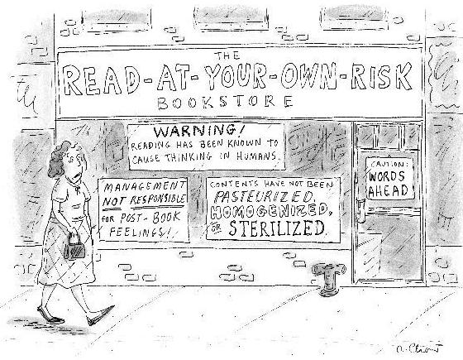
CARTOON
http://www.cornwalllibrary.org/Chaz_Read_at_your_own_risk.gif

Slide 21
Vocabulary
pasteurized: cleansed of harmful microorganisms
sterilized: sanitized
homogenized: made of the same consistency throughout

Slide 22
Literal/Interpretive Questions
What role does cause and effect reasoning play in this cartoon?
What is the general tone of this cartoon?
Which of the messages in this cartoon is most humorous to you? What makes it funny?
Why would someone want books that are “pasteurized, homogenized, and sterilized”?

Slide 23
Analytical Questions
How do the signs on the windows explain the name of the bookstore?
Where do you imagine this storefront might be? What in the drawing brings you to this conclusion?
In what ways are the signs in this cartoon similar to signs in other stores? What is the reason for these types of signs?
What is the significance of the sign on the door? Is that the most effective place for

Slide 24
Rhetorical Questions
What do you like or dislike about the cartoonist’s artistic style?
What does the woman in front of the bookstore add to the cartoon?
Which of the cartoonist’s artistic elements attract the most attention? Why do you think this is so?
How do the different types of handwriting on the signs help make the cartoon funny?

Slide 25
Projects
Script: Develop this cartoon into a conversation between two or more people talking about reading.
Billboard: Design a billboard with your own message about the benefits of reading.
Survey/Essay: Develop a questionnaire about people’s reading habits. Phrase your questions so you can discover the reasons behind these habits. Then write up the results of your survey for your class.
Research: Read and summarize the three resources below . Generate one specific question from each resource that focuses on cause and effect reasoning. Then answer one of your questions in a documented essay, consulting these and other sources as necessary.

Slide 26
Resources
Web Site
Internet Archive: www.archive.org
Explore the many public domain works you can download for free or view on the Internet
Academic Article
“Cartoon Violence and Freedom of Expression” by David Keane
Human Rights Quarterly 30.4 (2008): 845–875
Audio/Video
National Public Radio: www.npr.org
Search: “‘Reading Rainbow’ Reaches Its Final Chapter”
Click on the Listen Now link

Slide 27
Teaching a Graph
Traditional Apparatus
+
Technological Resources
+
Multimodal Assignments

Slide 28
Prereading
What do you know about the oil industry?
What different types of power does oil generate in the U.S.?
How do you personally rely on oil in your daily life?

Slide 29
Author Biography
This article was written by a team of contributors at the McKinsey Global Institute, a subdivision of McKinsey & Company, a worldwide management consulting firm whose global managing director is Dominic Barton . The Institute, which is the company’s economics research arm, studies global markets, consumption, productivity, and the impact of technology on the world economic marketplace. Graphics for the article were created by Katherine Yester, a designer at Foreign Policy Magazine . The article first appeared in the September-October 2009 issue of Foreign Policy Magazine.

Slide 30
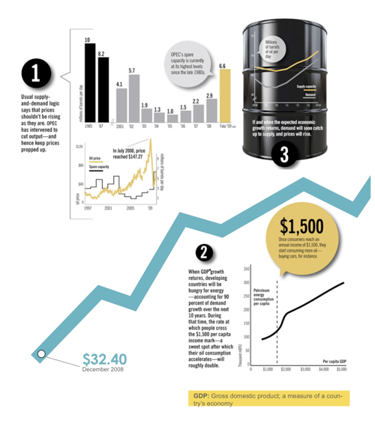
GRAPH

Slide 31
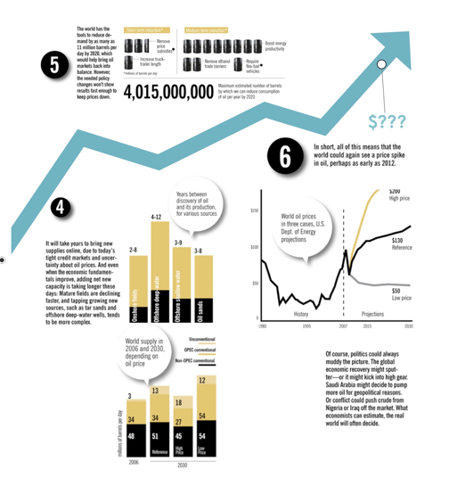
GRAPH
Kinsey Global Institute

Slide 32
Vocabulary
OPEC: Organization of the Petroleum Exporting Countries; a group that protects the interests of countries that export petroleum
tar sands: naturally occurring mixtures of sand or clay, water, and an extremely dense and viscous form of petroleum called bitumen

Slide 33
Literal/Interpretive Questions
This series of graphs tells a very complex story about the oil industry. Explain Graphs 1 through 5 in your own words.
According to the information here, what are the main reasons oil prices increase? What causes them to decline?
What does the author mean by the phrase “When GDP growth returns” (Graph 2)? What is the significance of this statement in reference to the price of oil?
According to these graphs, how do OPEC quotas affect oil prices?

Slide 34
Analytical Questions
How can the world reduce its demand for oil? Explain the primary actions required based on the graphs provided here.
Once economic growth returns, when will demand for oil catch up to supply (Graph 3)? What will make this happen?
What does the number 4,015,000,000 refer to in Graph 5? What are the consequences of this number in the oil industry for the year 2020?
Why could the world see a rapid spike in oil prices in the near future? Explain the reasons for this increase.

Slide 35
Rhetorical Questions
How does the visual layout of these graphs help you understand them?
In your opinion, which types of people and organizations would be most interested in the information in these graphs?
Which of the graphs do you think is easiest to understand? Why?
What does a graph accomplish that another format could not? In your opinion, is this the most effective way of displaying such information? Explain your answer.

Slide 36
Projects
Blog/Wiki/Ning: Find more information about world oil production, and enter an existing Internet conversation about oil. Exchange at least five posts with others on the site. Print your conversation for class discussion.
YouTube Video: Research one of the causes or effects associated with oil prices and create a brief YouTube production about your findings. Make sure your video shows a clear relationship between one specific market variable and the current price of oil.
Graph/Essay: Choose one of the predictions for 2012 in Graph 6, draw a hypothetical Graph 7, and write an essay explaining your graph.
Research: Read and summarize the three resources below . Generate one specific question from each resource that focuses on cause/effect reasoning. Then answer one of your questions in a documented essay, consulting these and other sources as necessary.

Slide 37
Resources
Web Site
American Petroleum Institute: www.api.org
Academic Article
“Causes and Consequences of the Oil Shock of 2007-08” by James D. Hamilton
Brookings Papers on Economic Activity Spring (2009): 215–261
Audio/Video
History.com: www.history.com
Search: “Oil Drilling Ships”; click on the Modern Marvels Video link

Slide 38
Summary
A multimodal approach to writing starts with the students’ interests.
It teaches students close reading of both visuals and texts.
Close reading is a habit of mind that will transfer with your students to other courses.
Close reading leads to “deeper” learning.

Slide 39
Contact Information
Kim Flachmann
Writing Program Coordinator
California State University, Bakersfield
kflachmann@csub.edu

