Slide 1
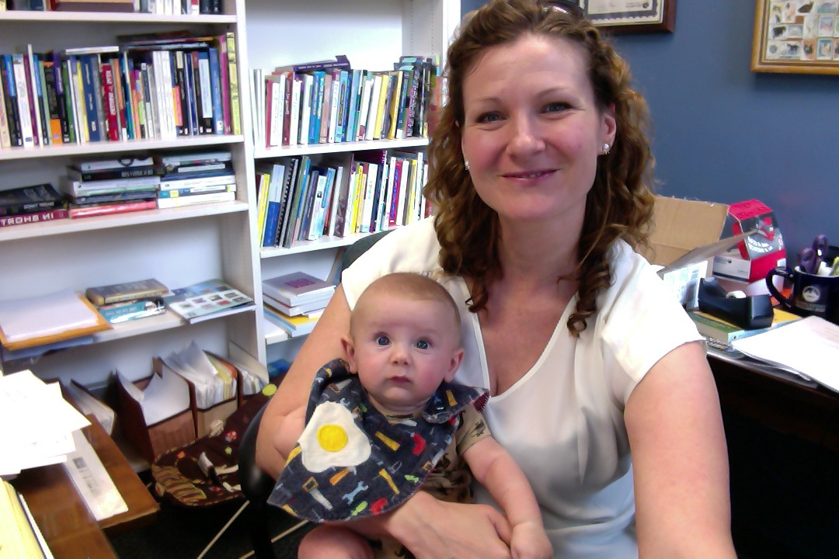
Putting Down the Pen
An Argument for Audio Commenting
Sarah DeBacher
FWP Chair, University of New Orleans
Director, Greater New Orleans Writing Project

Slide 2
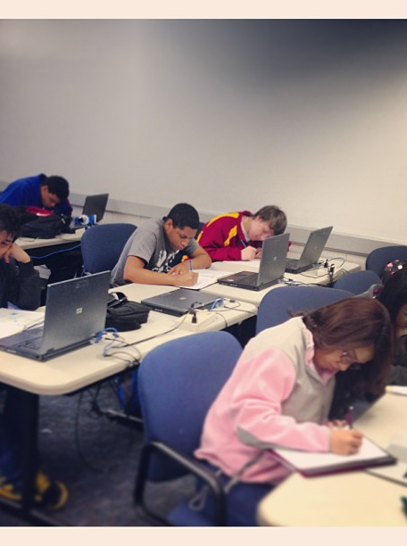
Student Perceptions of Teacher Feedback
We Say
Awk.
Word choice
Nice!
Cliché
They Hear
No.
No, no. no.
Nice!
No, no, no.

Slide 3
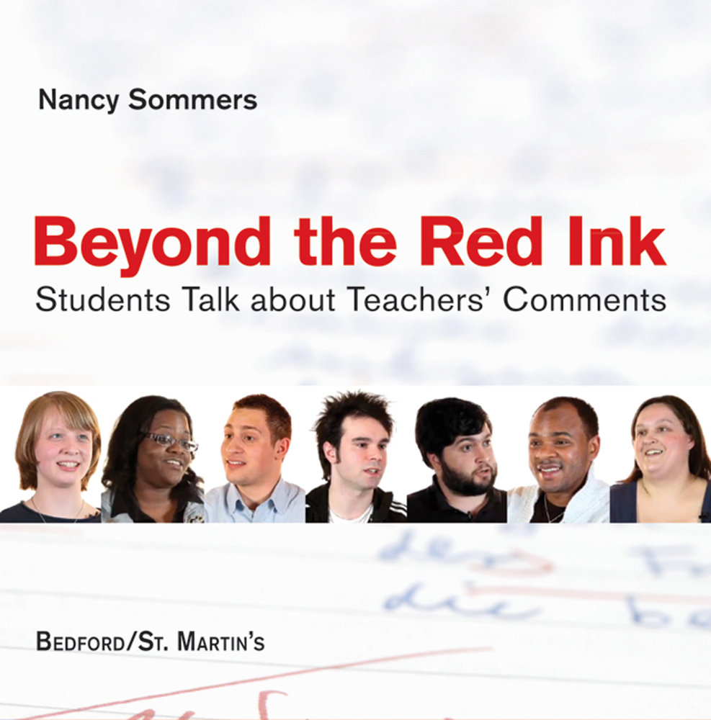
https://youtu.be/XluNo599LMY
To see
“To see a discouraging comment on a paper makes a student not want to write again.”
“A lot of red sometimes can make a person give up.”
“When I get back a paper that’s just words crossed out, it feels absolutely terrible. I mean, are you just checking for grammar? Did you see the thought I put into this?”
“Trying to decipher the words usually causes more problems.”

Slide 4
What Students Want
To know that their work has actually been read
Complete thoughts
Detailed explanations
More than just corrections
Specific suggestions for improvement
Clarity—in delivery, in purpose
Encouragement and empathy

Slide 5
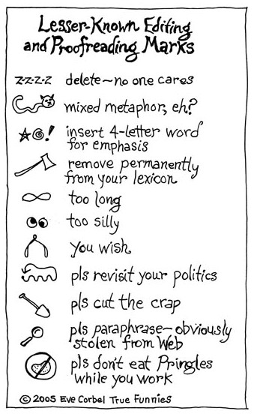

Slide 6
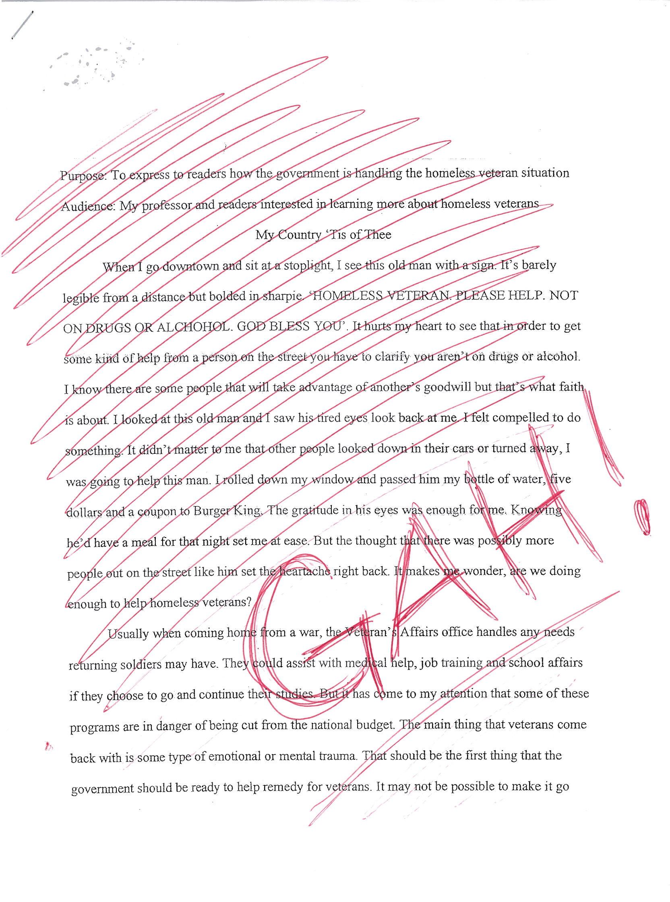

Slide 7
Findings in “Responding to Student Writing” by Nancy Sommers
WE APPROPRIATE: “[T]eachers’ comments can take students’ attention away from their own purposes […] and focus that attention on the teachers’ purpose in commenting.” (e.g. student gets told to edit and develop a single paragraph at the same time)
WE COMMAND: “[M]ost teachers’ comments are not text-specific and could be interchanged, rubber-stamped, from text to text.” (e.g. “be specific; “think about your reader”)

Slide 8


Slide 9
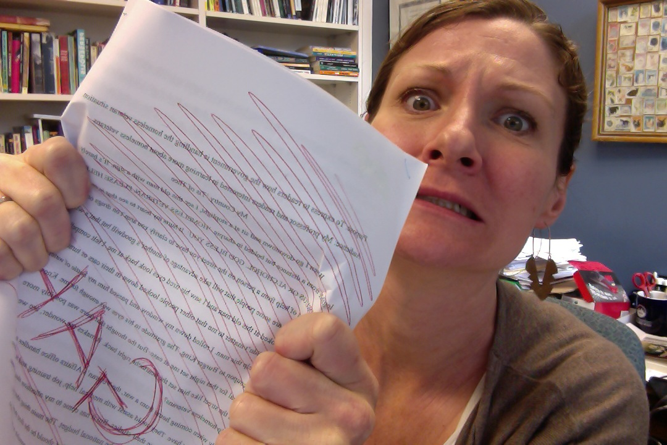


Slide 10
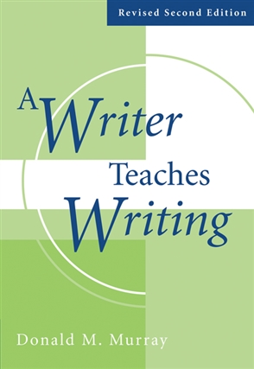
Conference Teaching
“Conference teaching is the most effective—and the most practical—method of teaching composition.”—Donald Murray

Slide 11
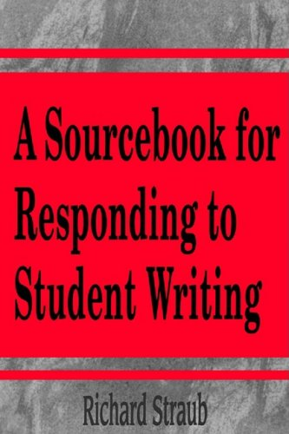
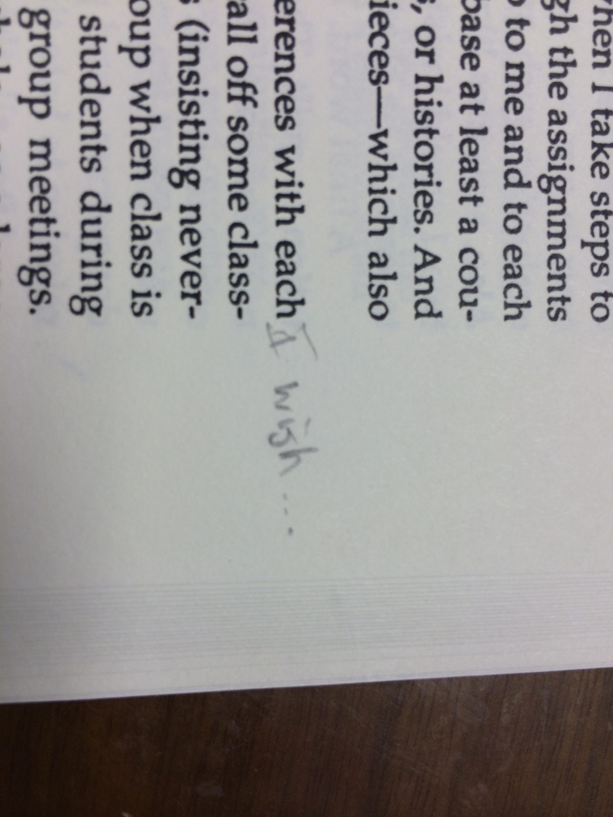
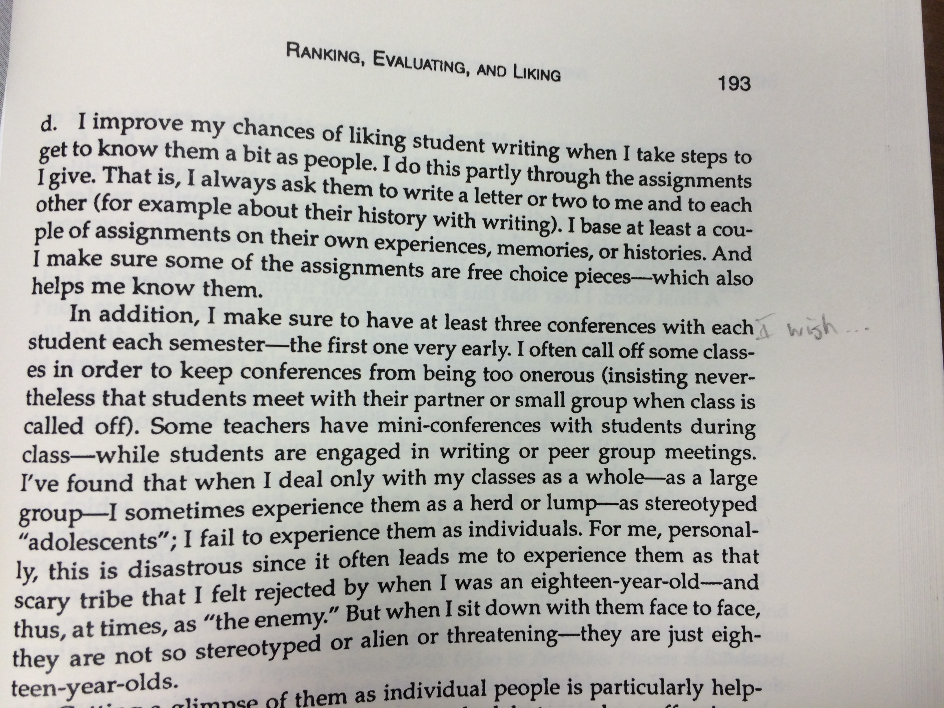
Conference Teaching

Slide 12
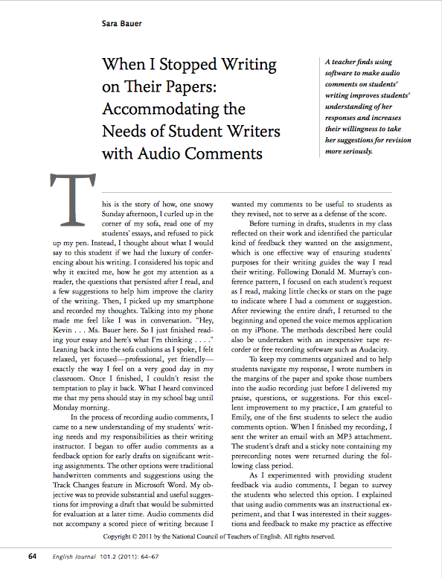
“When I stopped writing on my students’ papers and made use of audio comments instead, I discovered that assessment, which I had always regarded as a chore, could be a powerful teaching tool […]”—Sara Bauer

Slide 13
Why Audio Commenting?
It allows teachers to say more—and to be more specific—in less time
It encourages teachers to focus on higher order concerns
It reminds the teacher that we are teaching writers
It’s less anxiety producing, more pleasant
Students get more useful, encouraging feedback
It calls for students to engage with feedback
It allows students to maintain authority
It reduces red-ink anxiety

Slide 14
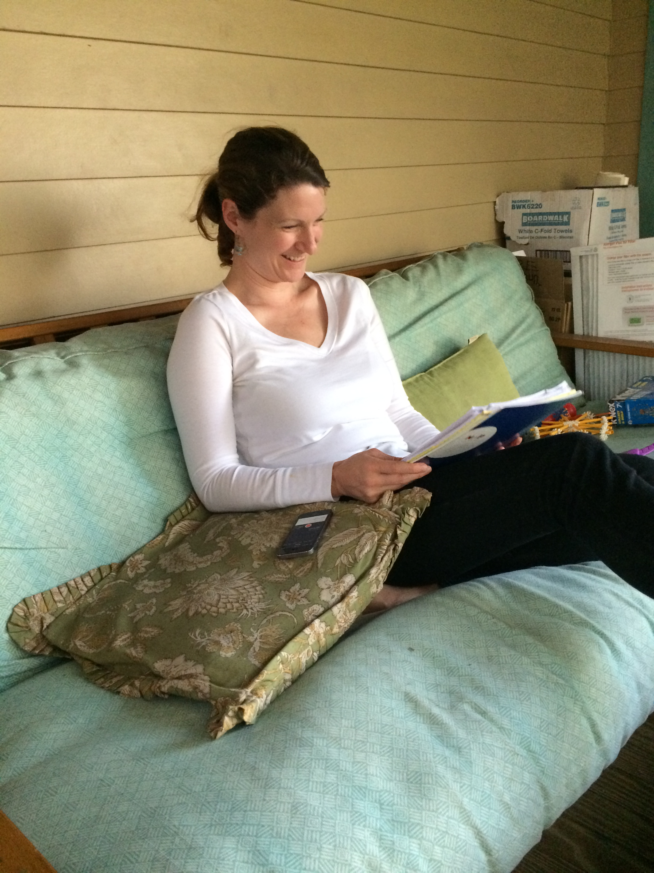



Slide 15
Practical Considerations
Decide whether to comment on drafts or final revisions (or both)
Decide what recording device you’ll use
Decide how much time you’ll spend on each response
Decide how you’ll organize your comments—either “reading live” or responding after reading
Decide whether/what you’ll write on the students’ essays

Slide 16
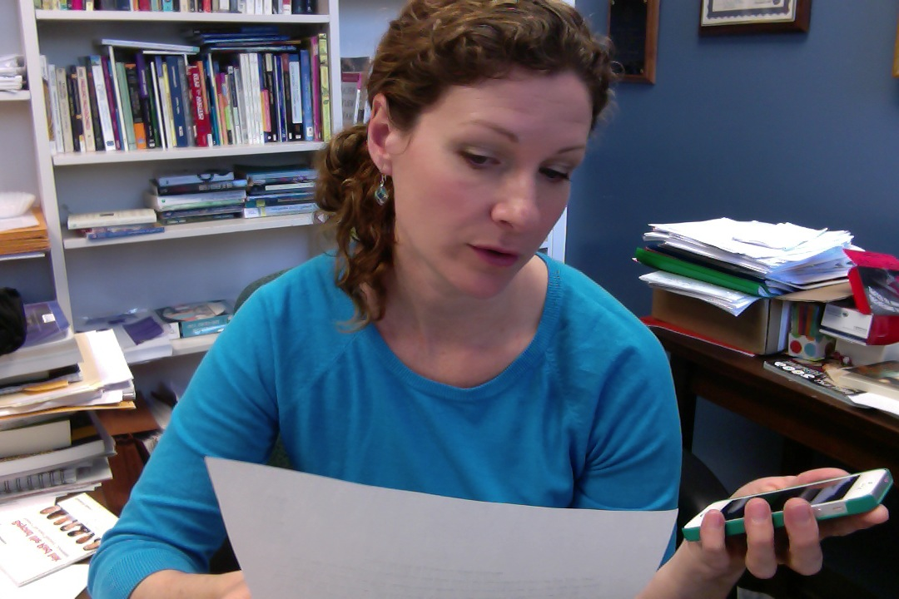
Audio Commenting Demonstration
This file’s format is .m4a—a file type that can easily be played using iTunes or QuickTime

Slide 17
What Students Want
To know that their work has actually been read
Complete thoughts
Detailed explanations
More than just corrections
Specific suggestions for improvement
Clarity—in delivery, in purpose
Encouragement and empathy

Slide 18
What Students Have Said
“The audio feedback method was awesome because I felt like I was in the office with the instructor.”
“I liked the audio feedback. It seemed more personal than just writing auto corrections on a text.”
“The feedback is a great help for the final portfolio.”

Slide 19
Qualitative Study:
Do College Composition Students Prefer Handwritten or Audio Feedback on Papers?
.”
“I liked the audio feedback. It seemed more personal than just writing auto corrections on a text.”
“The feedback is a great help for the final portfolio.”
Phase One: 197 students completed a survey on commentary preferences
176 respondents preferred audio feedback on their papers
8 respondents preferred handwritten feedback on their papers
13 respondents would prefer both handwritten and audio feedback on all papers
“I liked the audio feedback. It seemed more personal than just writing auto corrections on a text.”
“The feedback is a great help for the final portfolio.”
Phase Two: 20 students interviewed on commentary preferences
Findings show that students prefer audio feedback to handwritten because:
Audio helped to increase their confidence and motivation
Audio helped them to internalize instructor feedback for greater transfer from paper to paper
Audio gave them more feedback for revision
Audio reduced their misinterpretation of feedback
Audio strengthened the student-professor bond
“I liked the audio feedback. It seemed more personal than just writing auto corrections on a text.”
“The feedback is a great help for the final portfolio.”

Slide 20
Additional Applications
Audio “author’s notes” from student to teacher
Audio feedback for students during peer review
Audio conferencing in campus writing centers
Video conferencing (jing, other screen-cap apps)
Notes:
Having fully implemented audio feedback in my writing classes, I’ve now become interested in other applications for audio feedback. In Talking About Text, Jeff Sommers describes a kind of audio author’s note or letter of reflection to launch the instructor’s feedback—at the time, recorded on a cassette tape. I have my students compose an author’s note that accompanies their essays, setting the stage for my feedback. I can see them submitting those with Mp3 or M4a files, supporting that feeling of a conversation that’s happening between writer and teacher, or writer and audience. The 2008 essay, “Can You Hear Us Now, A Comparison of peer review quality when students give audio versus written feedback” found that the quality of the comments was “significantly higher than the quality of the written comments.” So this could really benefit peer review—particularly when students are in an online course—a venue that can feel impersonal. Other research findings support the use of audio feedback in campus writing centers, and, of course, many teachers are combining audio feedback with screen-capturing software, which allows more control over students’ “reading” of the feedback. So there are certainly other applications to explore.

Slide 21
Resources
Boswood, Tim; Robert H. Dwyer, From marking to feedback: Audiotaped responses to student writing (1995) TESOL Journal 05.2, pp. 20-23
Huang, S. (2000). A quantitative analysis of audiotaped and written feedback produced for students' writing and students' perceptions of the two feedback methods. Tunghai Journal, 41, 199-232.
Ice, P., Swan, K., Diaz, S., Kupczynski, L., & Swan-Dagen, A. (2010). An analysis of students' perceptions of the value and efficacy of instructors' auditory and text-based feedback modalities across multiple conceptual levels. Journal of Educational Computing Research, 43(1), 113-134. Retrieved from http://www.baywood.com/journals/previewjournals.asp?id=0735-6331
Johanson, Robert, Rethinking the red ink: Audio-feedback in the ESL writing classroom (1999) ERIC Document Reproduction Service, ED 467 865
Kim, L (2004). Online technologies for teaching writing: Students react to teacher response in voice and written modalities. Research in the Teaching of English, 38(3), 304-337. Retrieved from http://www.ncte.org/journals/rte
Silva, M. (2012). Camtasia in the classroom: Student attitudes and preferences for video commentary or Microsoft Word comments during the revision process. Computers & Composition, 29(1), 1-22. doi:10.1016/j.compcom.2011.12.001
Sipple, S. (2007). Ideas in practice: Developmental writers' attitudes toward audio and written feedback. Journal of Developmental Education, 30(3), 22-31.
Smith, Linda E., Writing and audio cassette evaluations: Enhancing language acquisition and writing skills for ESL students (1995),ERIC Document Reproduction Service, ED 386 027
Still, B. (2006). Talking to students: Embedded voice commenting as a tool for critiquing student writing. Journal of Business and Technical Communication 20(4), 460-475. Retrieved from http://jbt.sagepub.com/
Syncox, D. (2003). The effects of audio-taped feedback on ESL graduate student writing. (Master's thesis). Retreived from http://digitool.library.mcgill.ca
Warnock, Scott. “Responding to Student Writing with Audio-Visual Feedback.” Writing and the iGeneration: Composition in the Computer-Mediated Classroom. Eds. Terry Carter and Maria A. Clayton. Southlake, TX: Fountainhead Press, 2008. 201-27.
Wood., K.A., Moskovitz, C., & Valiga, T. (2011). Audio feedback for student writing in online nursing courses: Exploring student and instructor reactions. The Journal of Nursing Education, 50(9), 540-543. doi: 10.3928/01484834-20110616-04.

Slide 22
“[T]here is no single best way of responding to student writing.”

Slide 23


Putting Down the Pen
An Argument for Audio Commenting
Sarah DeBacher
sdebache@uno.edu

